Slide 1
The Vietnam War
An Introduction

Slide 2
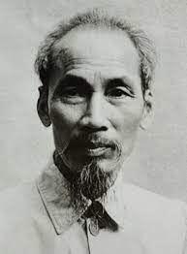
Colonialism
Vietnam was a French colony since the 1850s.
It was invaded by the Japanese during WW2. After WW2, Ho Chi Minh set up a communist government in the north, while a western-backed government was established in the south. Both sides wanted a unified nation, but one wanted it modeled on communism and the other wanted closer ties with the West.
In 1954 communist forces forced the French out of Vietnam.

Slide 5
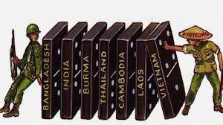
The Viet Cong
Viet Cong is short for Vietnamese communists.
Domino Theory – belief that if one Southeast Asian country fell to communism, many other countries would follow.
Containment – The West were prepared to use their resources to contain the spread of communism
Intervention – Intervention to stop communism included: financial aid, political backing and at times military support.

Slide 6
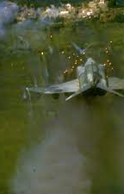
War Begins
US began moving some troops into Vietnam in the 1950s, but moved in thousands more after the North attacked two US destroyers in the Gulf of Tonkin.
President Lyndon Johnson was given broad war making powers and the US began heavy bombing of the North in Operation Rolling Thunder.
The US also started bombing neighboring Laos and the Ho Chi Minh trail.

Slide 8
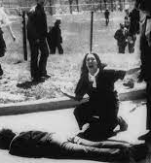
Protests
By 1967 there were close to 500,000 American troops in Vietnam.
Between 1966 and 1973 more than 500,000 US military personnel deserted. Many Americans fled the US for Canada to avoid being drafted into the army.
Protests arose across the US:
Kent State Shooting
At Kent State University, the Ohia National Guard killed 4 protestors and injured 9.

Slide 9
Protests
What do people protest today? Do these protests find a great deal of success? Explain.

Slide 12
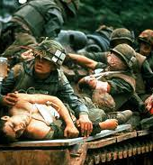
Tet Offensive
On January 31, 1968, the North sent 70,000 troops into the South. The Americans were able to hold their ground but there were heavy losses and American General Westmoreland called for 200,000 more troops.
The American public was stunned by the losses and the call for more troops.

Slide 15
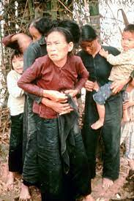
My Lai Massacre
The next few years brought more carnage including the revelation that American soldiers had killed more than 400 unarmed civilians in the village of My Lai.
Anti-war protests escalated culminating in 1969 when 250,000 protestors met in Washington D.C.

Slide 16
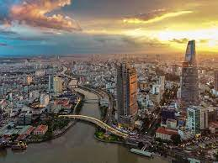
Ending the Conflict
In 1973, the United States and North Vietnam concluded a peace treaty.
The war lasted until 1975, when the North Vietnamese defeated the South, capturing the capital of Saigon and renaming it Ho Chi Minh City.
An estimated 2 million Vietnamese were killed and other 3 million were wounded. 12 million became refugees.

Slide 18
Continuity and Change
The United States, along with many other Western nations, fought a series of wars against communism in the 20th Century. Moving into the 21st Century, the United States, Canada, and others have fought wars against fundamentalist Muslim regimes (War on Terror, ISIS). Should nations like Canada continue to fight wars to limit the spread of certain ideologies? Explain.

