Slide 1
Types of Homicide

Slide 2
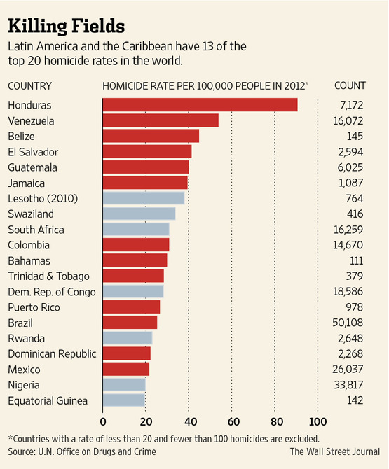

Slide 3
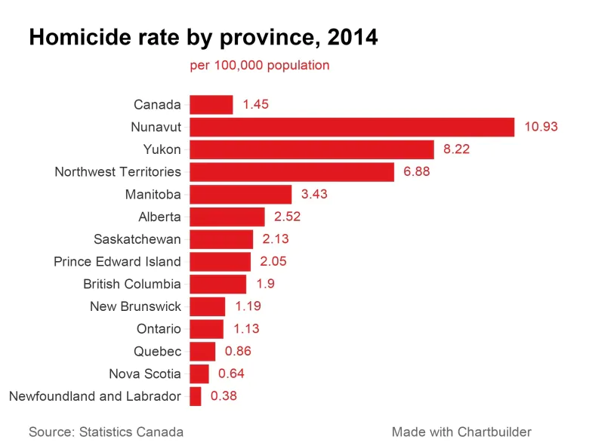

Slide 4
Culpable Homicide
To cause the death of another person with intent (mens rea)

Slide 5
Non Culpable Homicide
To cause the death of another person without intent

Slide 6
3 Types of Culpable Homicide:
Murder
Manslaughter
Infanticide

Slide 7
1st Degree Murder
occurs under any of the following situations:
planned and deliberate
hire of contract with another to commit murder
is an on duty peace officer
killing someone while committing another serious offense
sentence is life in prison, no parole for 25 years

Slide 8
2nd Degree Murder
murder that doesn't fit any situations for 1st degree murder
sentence is life in prison, no parole for 10 years

Slide 9
Manslaughter
The wrongful killing of someone without malice or prior thought
Manslaughter is reserved for killings where the level of intent is less than murder.

Slide 10
Voluntary Manslaughter
Voluntary manslaughter takes place when the perpetrator intentionally kills the victim, though he had no prior plan or intent to kill. Crime committed in the “heat of passion”.
Ex. Colter Wall “Kate McCannon”

Slide 11
Involuntary Manslaughter
unintentional killing of a person that happens when the perpetrator is committing another minor crime, with no intent to kill, or is engaging in reckless behavior that caused the death.
Ex. Killing someone while intoxicated

Slide 12
Vehicular Manslaughter
vehicular manslaughter is defined as the killing of another while illegally, negligently, or recklessly operating a motor vehicle
Ex. Killing someone while fatigued

