Slide 1
The legacy of the second world war

Slide 3
Battle of Hong Kong
First land battle fought by Canadians in WW2
Fought bravely against overwhelming odds

Slide 5
Battle of the Atlantic
Longest battle of the war
Canadians played pivotal role in protecting ships from German U-boats

Slide 7
Raid on Dieppe
Purpose was to gather intel and prepare for D-Day
Canadians sustained heavy losses

Slide 9
Battle of Ortona (Italy)
Nicknamed ‘Battle of Little Stalingrad’
Key objective on the march to Rome

Slide 11
D-Day
Largest amphibious assault in history in which Canada played a large role
Responsible for Juno Beach
Moved further inland than any other force on D-day

Slide 13
Liberation of the Netherlands
While American forces moved on to Berlin, Canadians were responsible for liberating the Netherlands
To this day the Netherlands sends Ottawa thousands of tulips in appreciation

Slide 14
The Legacy of the War
Though the Second World War is not the turning point in Canadian history that the First World War was, Canada again made its mark on the world stage
Following the war, Canada became an important ‘middle power’
Canada ended the war with the Allies’ third largest air force and the world’s fourth largest navy

Slide 15
Women again played a large role at
home and began to secure further
equality in Canadian society.

Slide 16
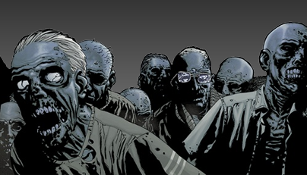
Conscription
Mackenzie King’s government promised it would not use conscription
Asked for a plebiscite on conscription
Every province was in favour but Quebec
Conscripts derogatorily named ‘zombies’

Slide 17
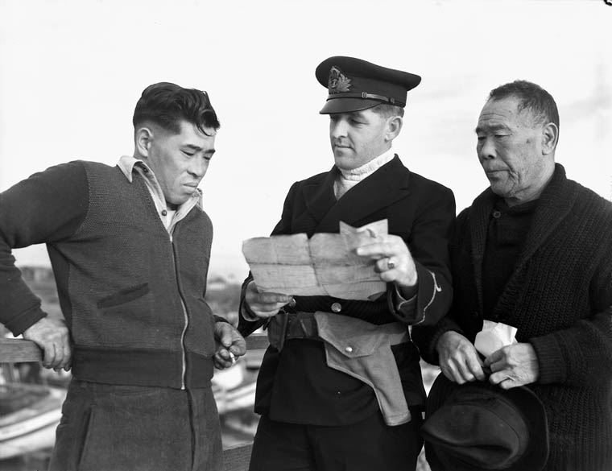
Japanese Internment
Japanese Canadians from Canada’s West coast had their property taken and were moved to isolated areas of BC’s interior
Fear that Japanese Canadians would help Japan
invade Canada’s West Coast

Slide 20
Debate
Should a nation ever have a right to conscript soldiers?

Slide 21
Should Japanese Canadians have been financially compensated?

Slide 22
Do we have any current threats to our freedom?

