Slide 1
The Holocaust: Beginnings
The Nazi ethic

Slide 2
The Holocaust
The Holocaust was not an event that came about on its own during the war. It was the culmination of a series of events founded upon a specific worldview.
Euthanasia
Program
1939
Jewish Ghettos
established
1939
Einstazgruppen
(Nazi Death Squads)
1941
Death Camps
(The Final Solution)
1942
Sterilization
Program
1934
Nuremberg
Laws
1935

Slide 3
Development of the nazi worldview
Steeped in historical anti-Semitism and resentment following the First World War
Foundations laid in eugenics and Darwinism (Social Darwinism)
Many Darwinists then and today would argue that Darwinism proves moral relativism: Was Hitler good or evil?

Slide 4
Italian criminal’s ‘ape-like’ features
Eugenics – a set of beliefs and practices that aim to improve the genetic quality of a human population by excluding certain genetic groups judged to be inferior, and promoting other genetic groups judged to be superior.

Slide 5
Charles Darwin
Darwinism - The theory of the evolution of species by natural selection advanced by Charles Darwin

Slide 6
Darwin and ethics
Many Darwinists argue that Darwinism deals with the “is” not the “ought”
Would also argue Nazism is a form of ‘vulgar’ or ‘distorted’ Darwinism
Darwin himself believed that the worldview he was espousing had moral implications.
What we see in Nazism is a radical devotion to a consistent and uncompromising worldview.
Darwinism removes the traditional Judeo-Christian ethic, that all human life is sacred (Gen. 1:27)

Slide 7
Implications of Darwinism for devaluing human life
Animal ancestry of humans
Rise of ‘speciesism’

Slide 8
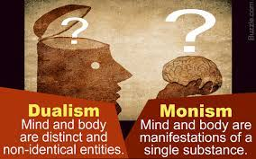
Implications of Darwinism for devaluing human life
Denial of body-soul dualism
Darwin needed to bridge the gap between animals and humans. So, what about the idea of a human soul?

Slide 9
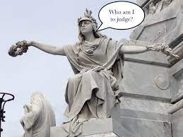
Implications of Darwinism for devaluing human life
Moral relativism undermining human rights
“A man who has no assured and ever present belief in the existence of a personal God or of a future existence with retribution and reward, can have for his rule of life, as far as I can see, only to follow those impulses and instincts which are the strongest or which seem to him the best ones.” Charles Darwin

Slide 10
Implications of Darwinism for devaluing human life
1. Human inequality

Slide 11
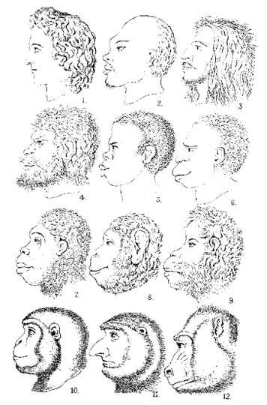
Eugenics chart developed by Ernst Haeckel. A leading
German scientist.
Distance between the highest human and the lowest human is greater than the distance between the lowest human and the lowest primate.

Slide 13
Implications of Darwinism for devaluing human life
2. Human struggle for existence
“Thus, from the war of nature, from famine and death, the most exalted object which we are capable of conceiving, namely, the production of the higher animals, directly follows.”
Charles Darwin, Origin of Species

Slide 14
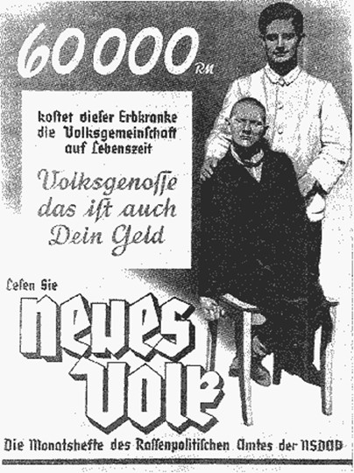
Nazi Poster:
“60,000 marks Is what this mentally
Ill person costs the national
Community in a lifetime
Comrades this is your money, too”

Slide 15
Implications of Darwinism for devaluing human life
3. Death as progress
Death as an engine that drove the evolutionary progress
“Thus, from the war of nature, from famine and death, the most exalted object which we are capable of conceiving, namely, the production of the higher animals, directly follows. There is grandeur in this view of life, with its several powers, having been originally breathed into a few forms or into one; and that, whilst this planet has gone cycling on according to the fixed law of gravity, from so simple a beginning endless forms most beautiful and most wonderful have been, and are being, evolved.”

Slide 16
Contemporary Darwinism
The fall of Nazism dealt a blow to Darwinian ethics and eugenics, however…
Peter Singer – famous Princeton professor and author
Believes Darwinism should have by now dealt a death blow the Judeo-Christian ethic of the sanctity of human life
Advocate of infanticide, euthanasia and animal rights

Slide 17
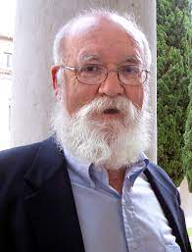
Contemporary darwinism
Daniel Dennett – American writer and philosopher
There a gradations of value in ending human life
“Which is worse, taking 'heroic' measures to keep alive a severely deformed infant, or taking the equally 'heroic' (if unsung) step of seeing to it that such an infant dies as quickly and painlessly as possible?” - Daniel Dennett

Slide 18
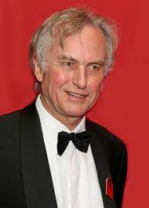
Contemporary darwinism
Richard Dawkins – Oxford professor and author
Argues that we should use genetic engineering to create a missing link that goes back further than “Lucy”. A kind of half ape, half human. This he argues would finally destroy our speciesist illusion.

Slide 19
Contemporary darwinism
James Watson – discovered structure of DNA
“The cruel fact remains that because of the present limits of such detection methods, most birth defects are not discovered until birth. If the child were not declared alive until three days after birth, then all parents could be allowed the choice that only a few are given under the present system. The doctor could allow the child to die if the parents so chose and save a lot of misery and suffering.”

Slide 20
Contemporary Darwinism
The 20th Century teaches us what the implications of a particular worldview can be.
The Holocaust didn’t come about because of a single event, nor were the Nazi death camps an idea that came about on its own. The Holocaust came about as the culmination of a series of events.

Slide 21
Contemporary Darwinism
What is the importance of having a consistent worldview?
Is your worldview consistent?

Slide 22
Sources
Richard Weikart, From Darwin to Hitler: Evolutionary Ethics, Eugenics, Racism in Germany. (2004).

