Slide 1
Treaty of Utrecht

Slide 2
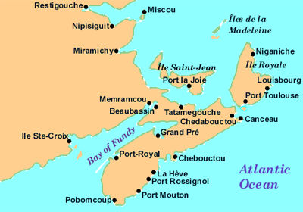
War of Spanish Succession
War over succession of the Spanish throne.
Dominated by conflict between Britain and France.
Fighting spilled over into the colonies.

Slide 3
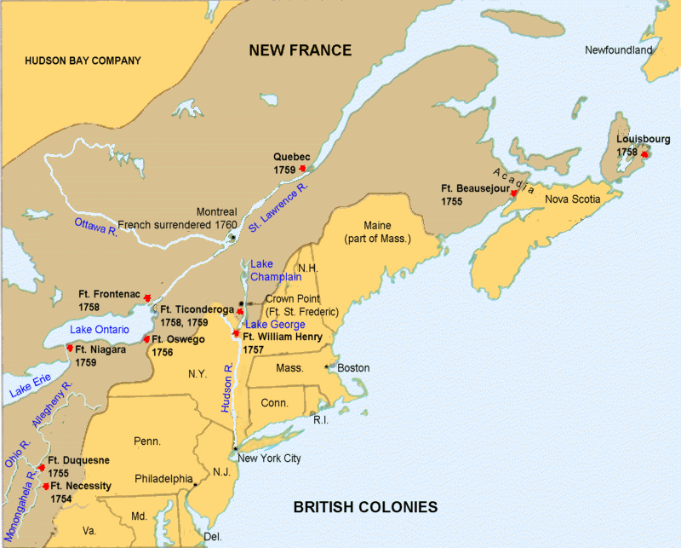
Treaty of Utrecht 1713
Treaty of Utrecht ended the War of Spanish Succession.
Britain won the war and was given Newfoundland, Acadia (Nova Scotia), and the loyalty of the Iroquois.
In response, the French constructed the fortress at Louisbourg to protect the St. Lawrence.

Slide 4
Expulsion of the Acadians

Slide 5
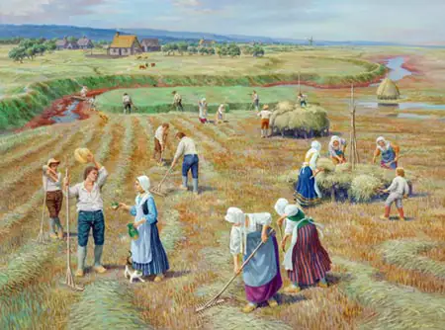
Acadians
The Acadians were ethnically French, though over the last century had developed a very distinct and independent society.
They promised the new British governor that they were loyal to Britain, but would not swear fealty (fight for Britain).

Slide 6
The Great Upheaval
British soldiers removed the Acadians from their land and burned their homes and crops.
Between 1755 and 1763, over 10,000 Acadians were deported.
France, New England, Louisiana
Mortality rate greater than 50%
New Englanders didn’t like the idea of non-British subjects living on prime farmland in a British colony

Slide 7
Genocide?
Convention on the Prevention and Punishment of the Crime of Genocide
Article II
In the present Convention, genocide means any of the following acts committed with intent to destroy, in whole or in part, a national, ethnical, racial or religious group, as such:
Killing members of the group;
Causing serious bodily or mental harm to members of the group;
Deliberately inflicting on the group conditions of life calculated to bring about its physical destruction in whole or in part;
Imposing measures intended to prevent births within the group;
Forcibly transferring children of the group to another group.

Slide 8
Intent is the most difficult element to determine:
To constitute genocide, there must be a proven intent on the part of perpetrators to physically destroy a national, ethnical, racial or religious group. Cultural destruction does not suffice, nor does an intention to simply disperse a group

Slide 9
Ethnic Cleansing?
Ethnic cleansing has not been recognized as an independent crime under international law, there is no precise definition of this concept or the exact acts to be qualified as ethnic cleansing. A United Nations Commission of Experts mandated to look into violations of international humanitarian law committed in the territory of the former Yugoslavia defined ethnic cleansing in its interim report S/25274 as "… rendering an area ethnically homogeneous by using force or intimidation to remove persons of given groups from the area."

