Slide 1
The Roaring 20s and Dirty 30s
History 30

Slide 2
“The Roaring Twenties!”: A Prelude

Slide 3
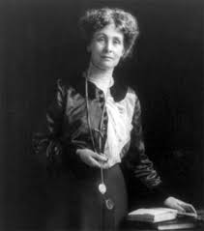
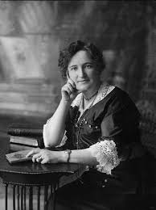
A Time of Change
When Canada was founded only men could be legal citizens of the country and thus have the right to vote.
Suffragists fought for the right of all women to vote.
By 1900, propertied women had won some voting rights.
In 1916 women in Manitoba gained the right to vote.
In 1918 women won the right to vote federally.
Emmeline Pankhurst
Nellie McClung

Slide 4
Overview
The 1920’s were a time of high optimism and economic boom; however, it was also a time of unchecked financial management which leads to a tragic event…

Slide 5
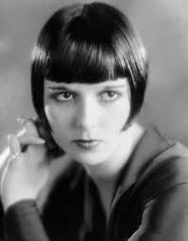
What do you know about the 1920s?
What famous hairstyle became popular in the 1920s?
The bob

Slide 6
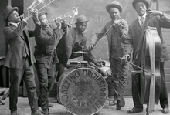
What do you know about the 1920s?
What style of music became popular in the 1920s?
jazz

Slide 7
What do you know about the 1920s?
What was the 1920s most famous gangster?
Al Capone

Slide 8
What do you know about the 1920s?
What is the meaning behind some of this 20s slang?
Bee’s knees
Bunk
Hep
Swanky
Real McCoy
Hooch
Keen
Flapper
cheaters
Wonderful person
nonsense
cool
Elegant, fancy
genuine
liquor
attractive
20s girl (short hair, short skirt)
Eye glasses

Slide 9
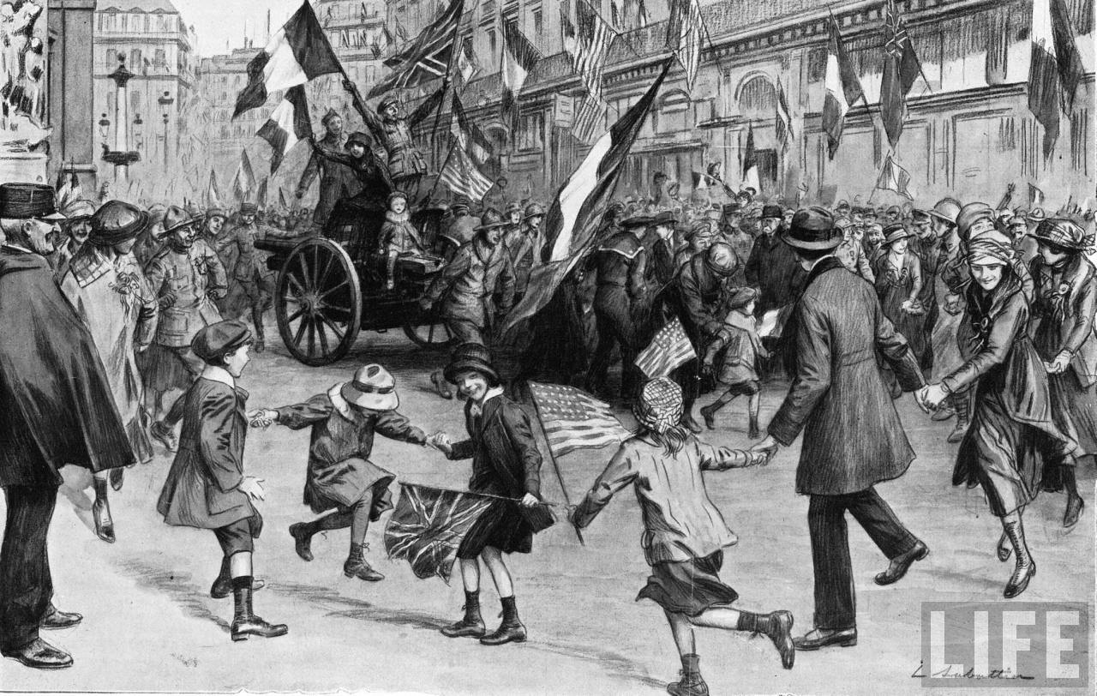
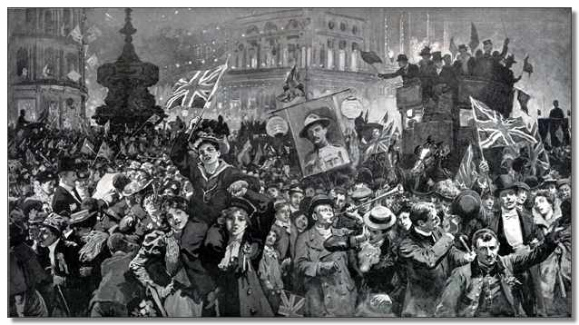
The War is Over!
The Great War has just ended and people look forward to going back to a normal life

Slide 10
New methods of factory production made it cheaper to make everything from cars to radios to telephones.
The North American economy boomed, creating an immense amount of wealth and a huge of range of exciting new products.
Although this did not actually create a large number of new jobs most North Americans felt they were living through golden times.

Slide 11
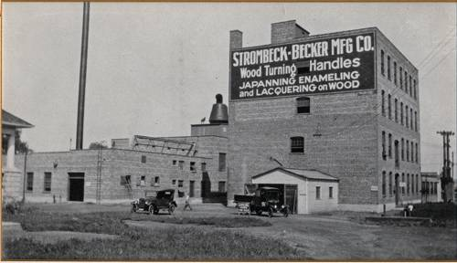
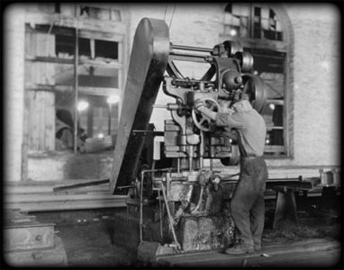
Industry is Booming!
Automobiles are becoming extremely popular resulting in mass production to keep up with the demand

Slide 12
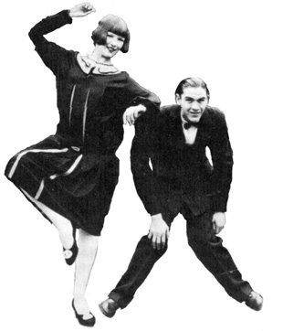
Increase in Wealth
Number of millionaires
1914: 7,000
1928: 35,000
Number of Model T Fords produced:
1900: 4000
1929: 4.8 million.
Average worker’s annual wage
1919: $1,158
1927: $1,304

Slide 13
New forms of Entertainment!

Slide 14
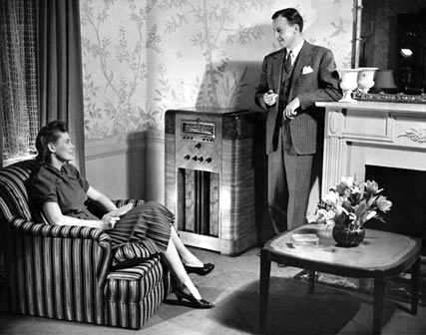
Radio
Radio shows become extremely popular.
People tune in every night to listen to famous radio dramas such as “The Shadow”

Slide 15
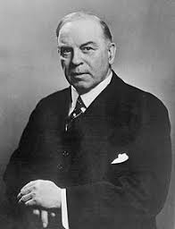
William Lyon Mackenzie King
First elected in 1921 (Liberal Party)
Became Canada’s longest serving PM
Believed that keeping Canada united was of the utmost importance.

Slide 16
Foreign Policy
Canada wanted to stay out of future European conflicts.
“the decision of Canada on any important issue, domestic or foreign, we believe should be made by the people of Canada.” -King
Statute of Westminster, 1931 – gave Canada control over its own foreign policy.

Slide 17
Winnipeg General Strike
There were not enough jobs for soldiers returning from the war.
Robert Borden’s gov’t refused to pay the pensions the soldier’s demanded.
Labour unions were outlawed.
Metal workers, supported by 30,000 tradesmen, tied up the city of Winnipeg for 6 weeks.
Ended on ‘Bloody Saturday’ when the RCMP broke up the strike 9 (2 strikers were killed).

Slide 18
Problems on the Rise …

Slide 19
Economic Problems
Capitalism was thriving but had had very little government intervention (laissez-faire economics) and essentially collapses in on itself
The driving principle behind laissez-faire, a French term that translates as "leave alone" (literally, "let you do"), is that the less the government is involved in the economy, the better off business will be – and by extension, society as a whole.
People had over-extended credit and heavy debt

Slide 20
Stock Market
A large amount of people were investing heavily in the stock market (“the next big thing!”)
Some were even investing their life saving in the market!
The market ran on essentially borrowed money

Slide 21
Stock Market (cont’d)
Buying stocks on Margin—when you borrow money from your stock broker to purchase stocks then pay them back later
Share could be bought from a stock broker for 10 % of their actual price
For example, $8, 000 work of stock for $800
You will eventually get rich!!!

Slide 22
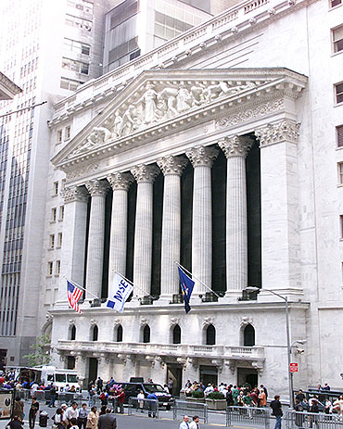
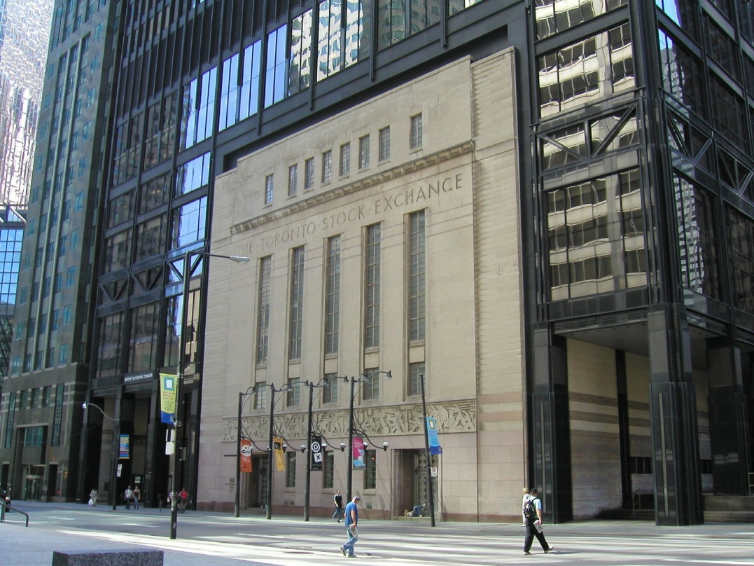
The Toronto Stock Exchange
The New York Stock Exchange

Slide 23
Collapse!
October 24, 1929, the Winnipeg Grain Exchange tumbled.
This was followed by a collapse of the New York Stock Exchange.
People had been buying stocks on borrowed money, and when the markets crashed people couldn’t repay their debts.

Slide 24
Other Economic Problems
Over Production and Under-Consumption: factories were manufacturing more products then were being purchased

Slide 25
The Prairies were the “Bread Basket”—provided 40% of the world’s grain
But….
No longer a big demand, some European countries growing their own grain!!!

Slide 26
Reality Check!
EVEN THOUGH THERE WAS THE BOOMING 20’S IN ACTUAL REALITY ONLY 40 % OF PEOPLE COULD AFFORD LUXURIES!!!
Federal Department of Labour Report—most were making $1, 000 a year when $1, 200 to $1,500 was needed!!!

Slide 27
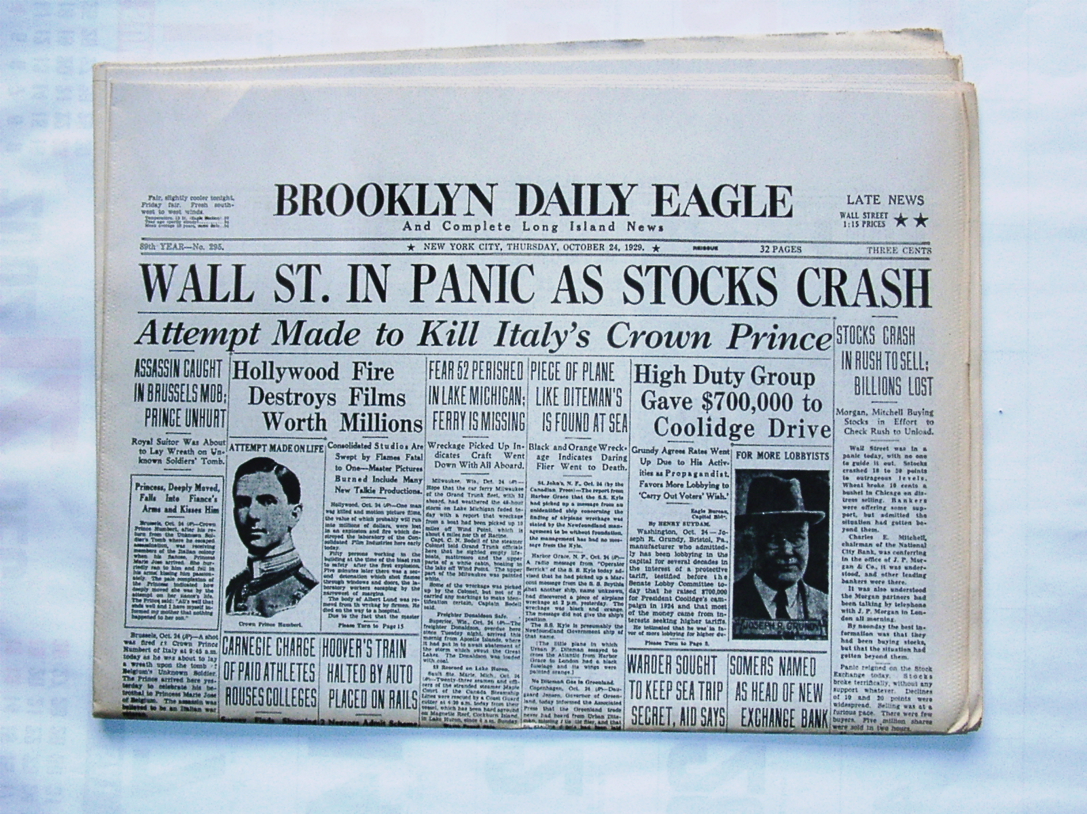
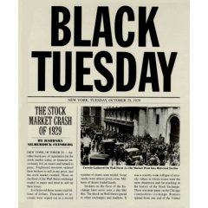
October 24, 1929
The Stock Market Crashes!!!

Slide 28
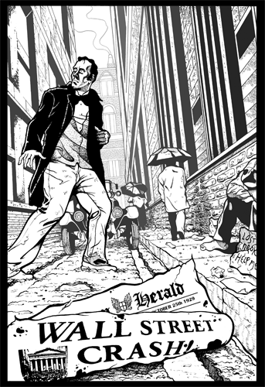
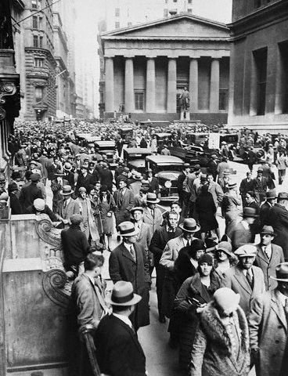
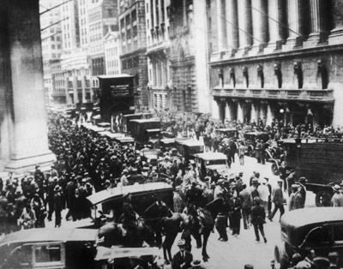

Slide 29
Reality Sets In …

Slide 30
The Depression Hits Home!
The Prairie provinces suffered the most. As stated earlier, demand for wheat was going down which inevitably put a strain on the prairie economy.
To make matters worse, a seven year drought follows
Almost NO rain fell during that time

Slide 31
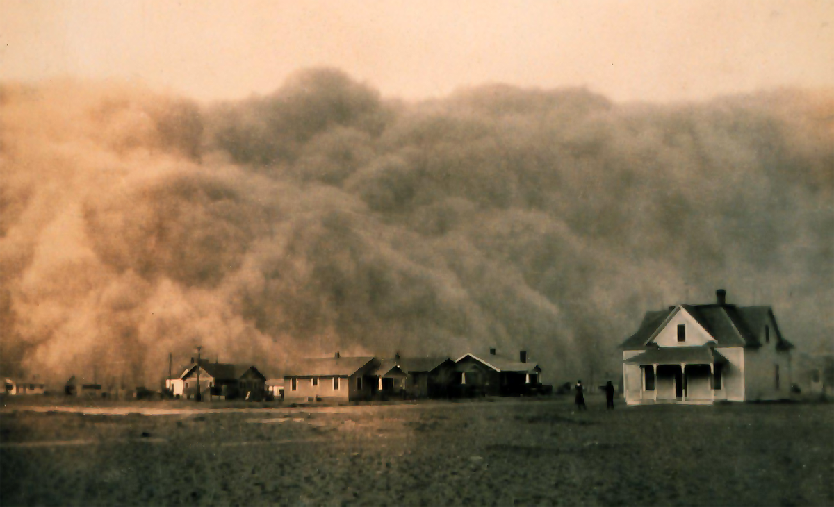

Slide 32
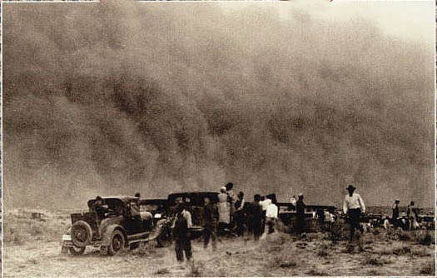

Slide 33
On the Prairies …
More than 200,000 people were forced to leave their farms.
Saskatchewan per capita income fell 71% in just three years!
Two-thirds of the population were forced to go on some form of public assistance

Slide 34
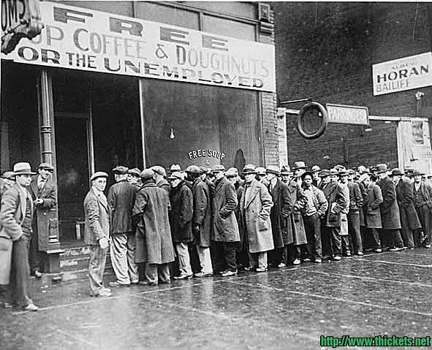

Slide 35
In Canada …
Overall, income in Canada fell almost 50%!
0f 10 million Canadians, 2 million were on relief handouts
The jobless rate went from 4 percent to a 27 percent meaning one in four Canadians were unemployed.

Slide 36
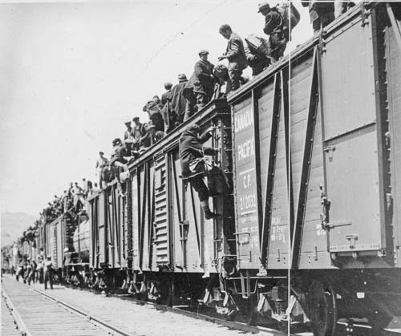

Slide 37
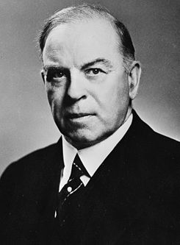
A New Prime Minister
The then current P M, Mackenzie King, refused to provide any relief money of any sort (famously declares that he wouldn’t give a “five-cent piece” to anyone)

Slide 38
Terminology
Protestant Work Ethic (definition): It is a person's duty is to achieve success through hard work
Therefore if you are not successful, it is your fault!

Slide 39
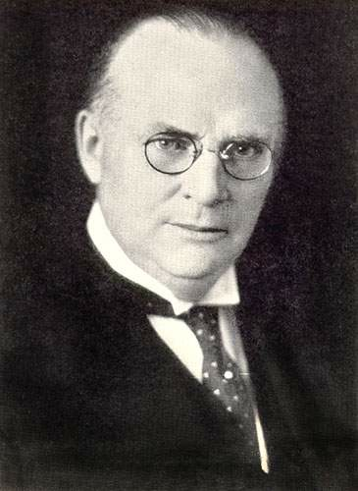
“Bonfire Bennett”
R. B. Bennett campaigns against King and wins, becomes Canada’s new PM
Believes that the answer lies in the capitalist system

Slide 40
Work Camps
One of the solutions being proposed was using forced labour work camps to provide economic assistance to transients (many times against their will)
These camps were run by the Ministry of Defense
Used to keep an eye on would be communists?

Slide 41
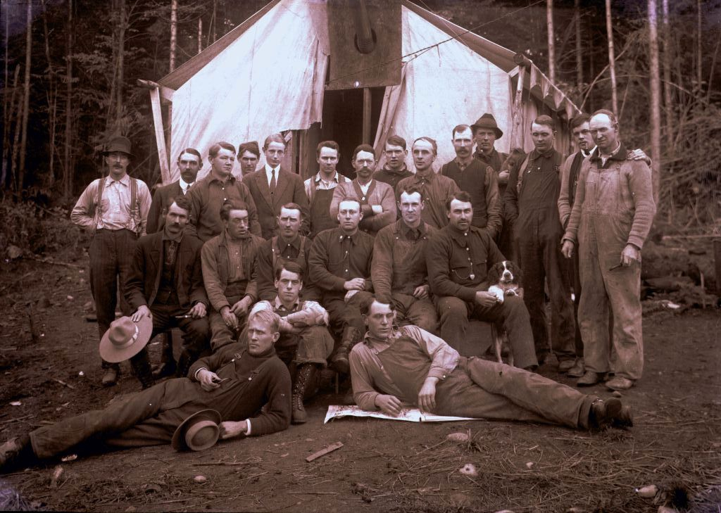

Slide 42
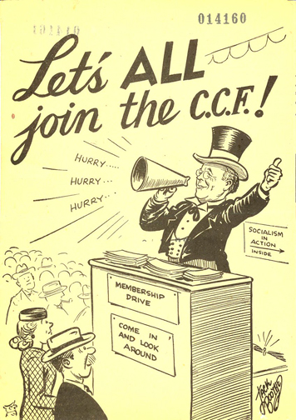
Creation of the CCF
In August 1932, delegates from farmer’s parties and unions met together in Calgary to create a new political party: the Co-operative Commonwealth Federation (CCF)
Contrary to The Communists, the party believed in “democratic socialism”

Slide 43
Last Minute Change?
Similar to U.S. President Roosevelt’s New Deal Bennett proposes a similar radical restructuring of society as follows (Bennett New Deal):
Unemployment insurance
Minimum wages (and limits on work hours)
More farm credit
Funding for research of new agricultural practices
A revamped Wheat Board to control grain prices
Most of these changes were then struck down because they were unconstitutional. They interfered with provincial jurisdiction.

Slide 44
King Once Again in Power
Bennett loses to King in the 1935 election; King once again is PM

Slide 45
Socialism in the Prairies

Slide 46
Communism
During the Winnipeg General Strike, the gov’t introduced Section 98 of the criminal code. The section stated that "Any person who acts or professes to act as an officer of any such unlawful association, and who shall sell, speak, write or publish anything as the representative or professed representative of any such unlawful association, or become and continues to be a member thereof...shall be guilty of an offense...“
Could land you up to 20 years in prison.
It was this section of the Criminal Code that would be used to suppress the spread of communism in Canada.

Slide 47
Communism
During the rise of labour movements and the CCF, Bennett and the Conservatives were deeply suspicious of a communist uprising.
Bennett was nicknamed “Iron Heel Bennett.”
In Toronto, Brigadier General Dennis Draper, began breaking up outdoor meetings with a squad of policemen. They earned the name “Draper’s Cossacks.”
These free-speech fights became a weekly event in Toronto.

Slide 48
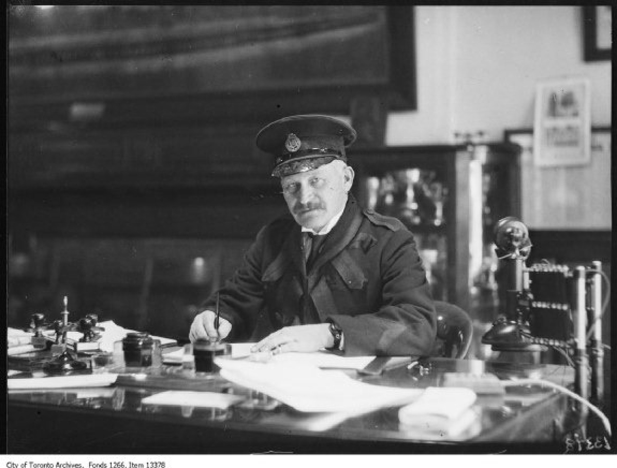
From 1919 to 1936 nearly 20,000 people were deported because of their alleged association with an illegal organization.
Dennis Draper

Slide 49
Both the communist and socialist parties in Canada resisted seeking political office through the electoral system.
Both agreed that social democratic parties, like the CCF, were the greatest enemies to working people because of their adherence to “the system.”

Slide 50
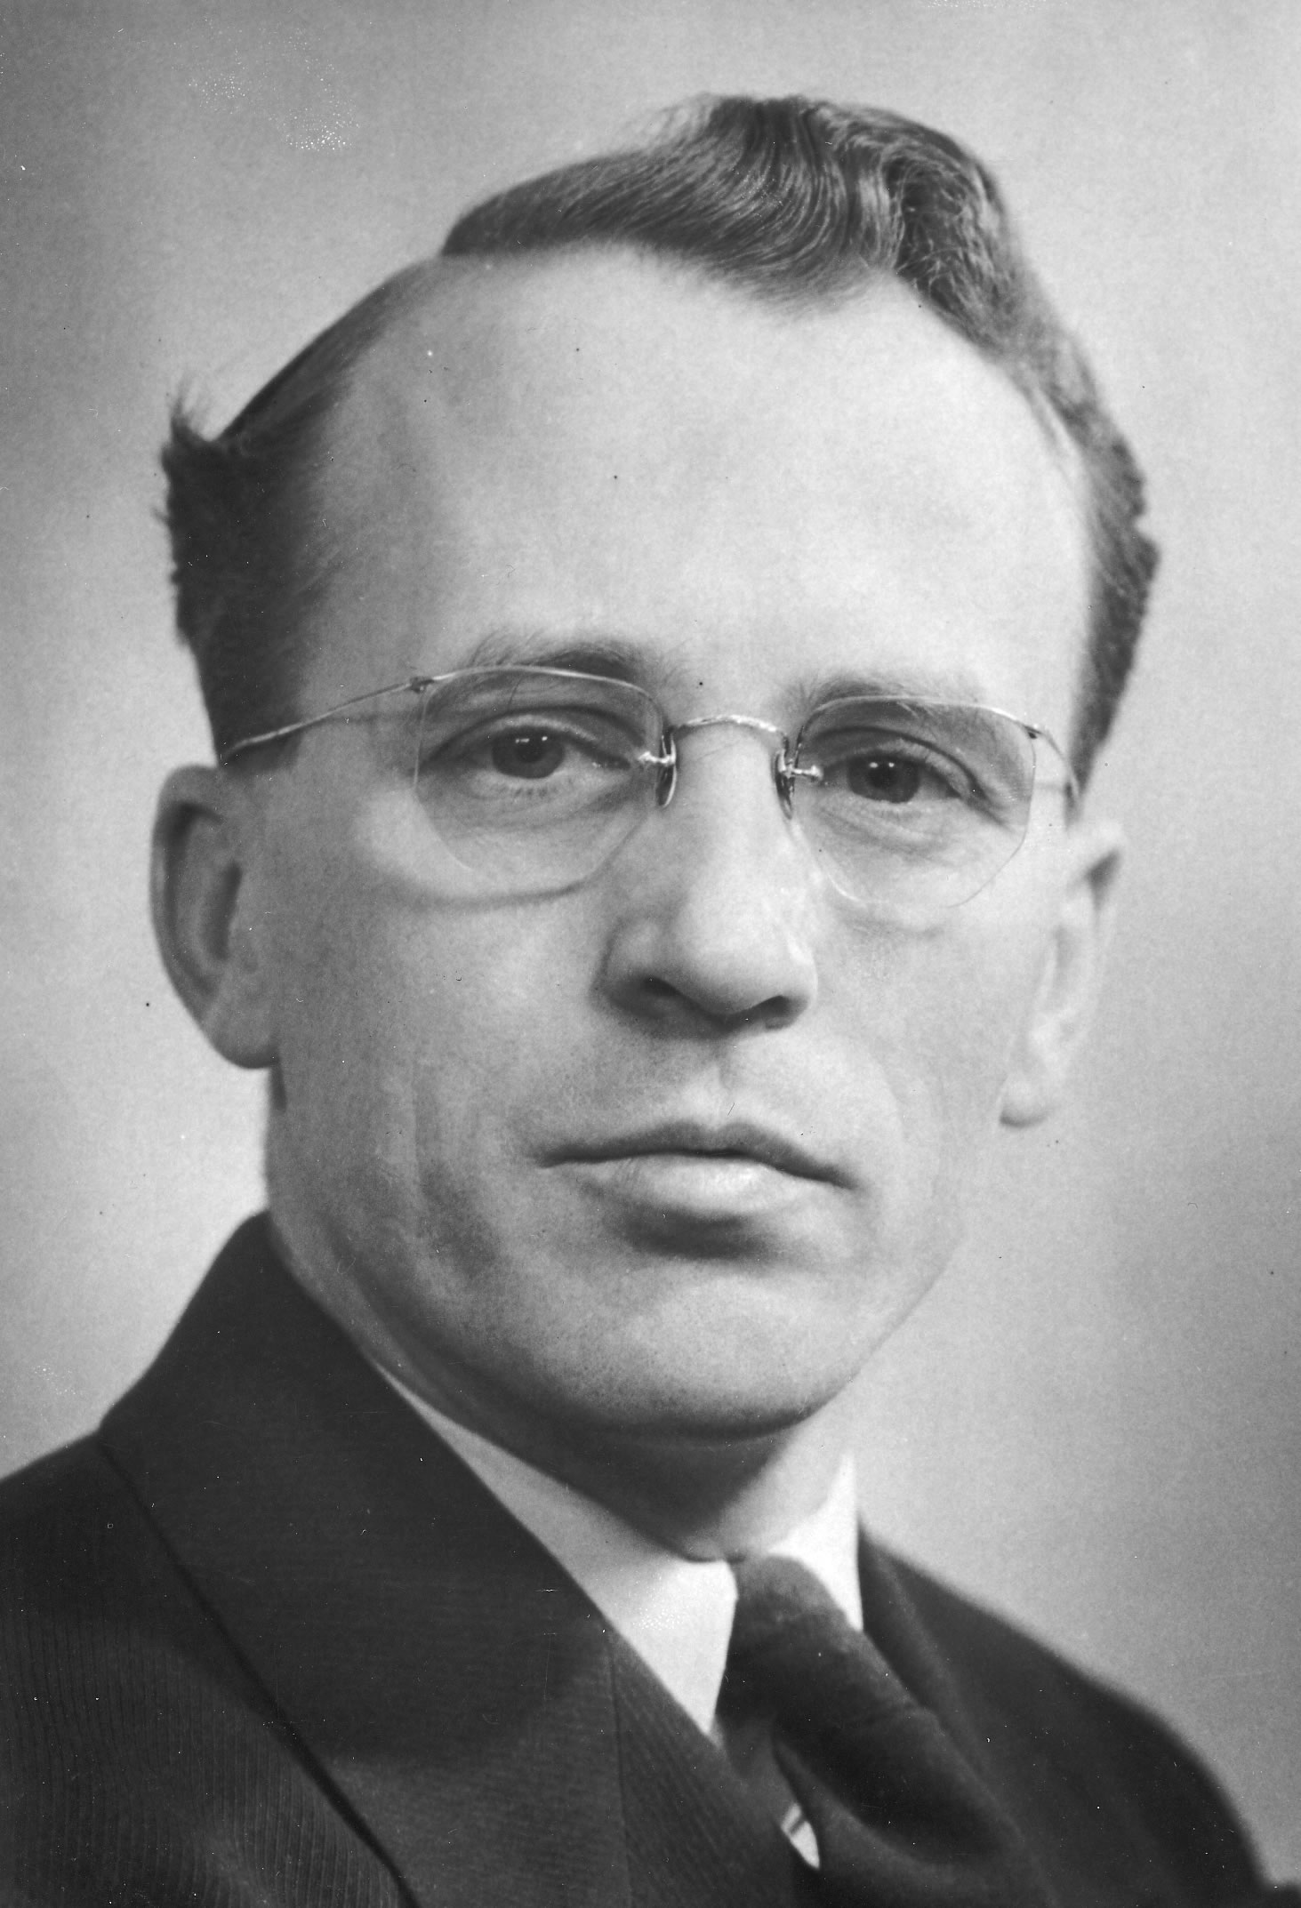
CCF
While the communists refused to work within the system, the votes of working people were split between the CCF of Tommy Douglas and Mackenzie’s Liberals.
Douglas recently voted “The Greatest Canadian”

Slide 51
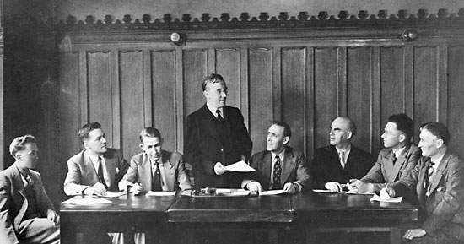
Regina Manifesto
In 1933, the CCF party adopted a platform called “The Regina Manifesto”
The primary purpose of the Manifesto was to replace the capitalist system with a planned socialist economy.
It also called for publically funded health care.
In 1956 the party replaced these policies with the more moderate Keynesian economic model.

Slide 52
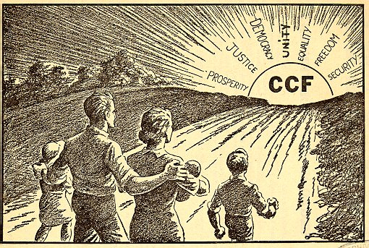

Slide 53
The CCF party will later join with another party and become the New Democratic Party (NDP)

Slide 54
Legacy of the Depression
Mackenzie King (along with MacDonald, Laurier and Borden) is generally regarded as one of Canada’s most influential PMs.
He was PM for 21 years including during WWII
One of only two world leaders that was a head of state of a major power both at the beginning and the end of the war. The other was Stalin.
Despite this he is still usually best remembered for his use of mediums and superstitious nature.

Slide 55
Legacy of the Depression
The Depression changed the way most Canadians viewed the role of gov’t
Bennett and King, like most economists believed the gov’t should maintain balanced budgets and advocate trade agreements and the private sector would eventually recover.
Reform movements grew in response (ex. CCF)
Push to use the state to force recovery
Both Bennett and especially King eventually adopted this approach late in their terms.

Slide 56
Legacy of the Depression
Canadians began to be fearful of extremist political movements but also the role of gov’t in limiting these movements.
Not until the Bill of Rights and the Charter of Rights and Freedoms would Canada’s freedom of speech laws be codified.

Slide 57
So how did the Great Depression end anyway?

Slide 58
ONE

Slide 59
MAN

Slide 60
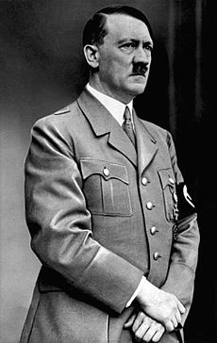

Slide 61
An Overview
Government begins to play a more active role in society (move from Laissez-faire to social welfare (Keynesian))
Emergence of new political parties (CCF) broaden the Canadian political spectrum.
Women get the vote and play a more active role in society.
Canada becomes more independent (Statute of Westminster).
New political ideologies threaten the status quo.

