Slide 1
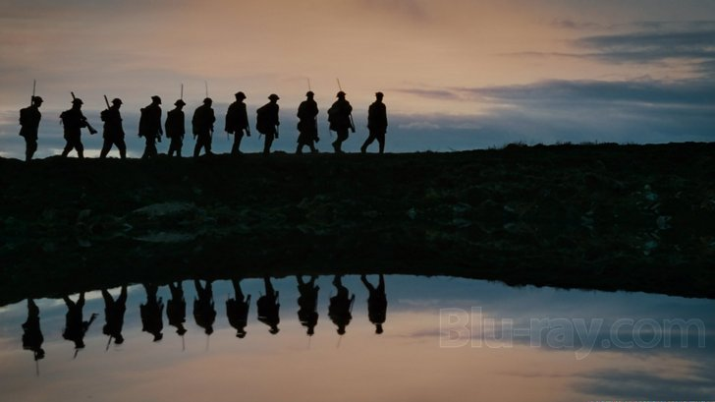
The First World War
The Bloodiest Conflict in Canadian History

Slide 2
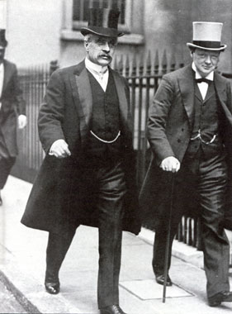
Going to War
Canada didn’t decide to go to war in 1914, but were automatically at war with Germany when Britain declared war
The Liberal opposition under Laurier urged Conservative Prime Minister Robert Borden to use the new War Measures Act
War Measures Act – adopted in 1914, it gave the gov’t broad powers to maintain security during times of war or insurrection. Allowed gov’t to rule by decree.

Slide 3
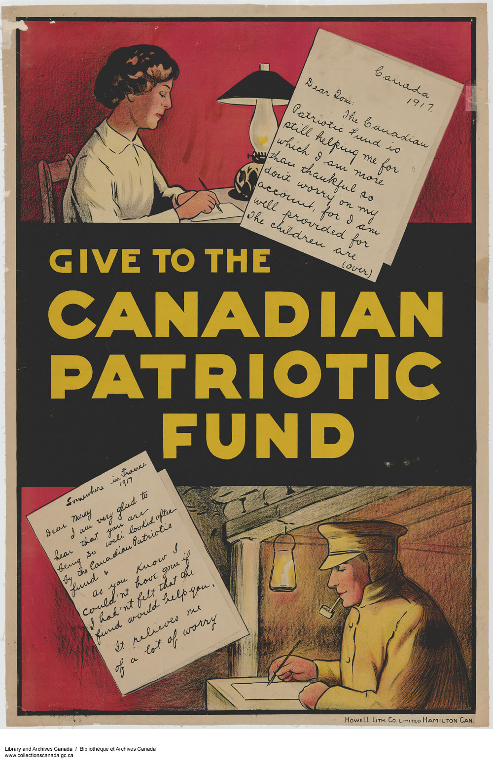
Recruitment
The unemployed flocked to enlist. The target for the Canadian Expeditionary Force was 50,000 men by the end of 1914. By the summer of 1915, it had reached 150,000.
After seeing the front lines, Borden committed 500,000 men to the British, but Canada was running out of volunteers.
Conflict between English and French renewed.

Slide 4
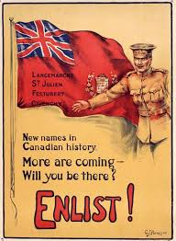
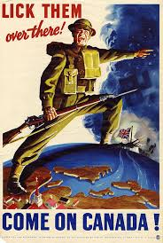

Slide 5
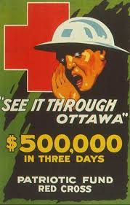
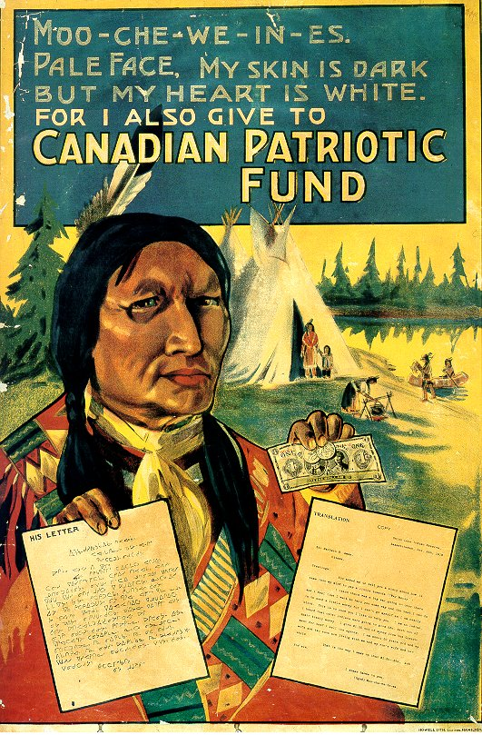

Slide 6
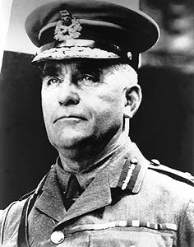
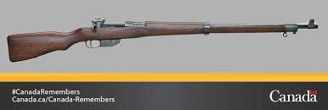
Canadian Expeditionary Force (CEF)
Minister of Militia Sam Hughes insisted on choosing officers and retaining the Canadian-made Ross rifle.
Many of them incompetent
Rifle issues
Ross believed the Canadians would be natural soldiers but early results revealed that they would have many lessons to learn.

Slide 7
Battle of Vimy Ridge
For the first time all four Canadian divisions fought together under a Canadian commander, General Arthur Currie
On Easter weekend 1917 the Canadians captured the ridge, an objective neither the French nor British were able to accomplish
It was the largest territorial gain of the war to that point.
Often celebrated as Canada’s greatest military victory.
“We went up the ridge as Albertans and Nova Scotians. We came down the ridge as Canadians.”
Canadians suffered over 10,000 casualties.

Slide 8
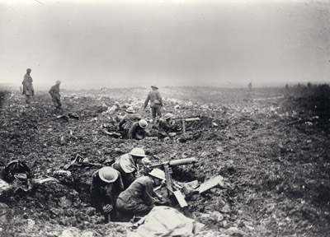

Slide 9
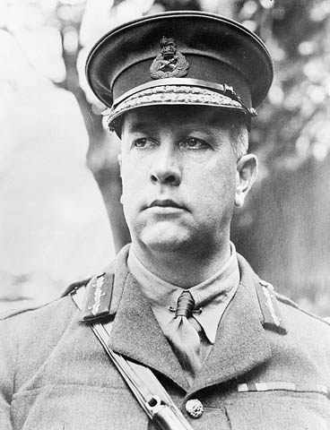

Slide 10
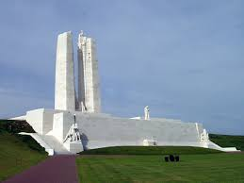

Slide 11
The Battle of Passchendaele
The Canadians were tasked with capturing a hill outside of the village of Passchendaele, Belgium (Hill 70).
The Canadians were eventually successful, though at a great cost.
The campaign would be one of the bloodiest of the war with over 500,000 casualties on both sides.
Though they were successful, this victory did nothing to end the war.
This battle came to characterize the senseless nature of the entire conflict.

Slide 12
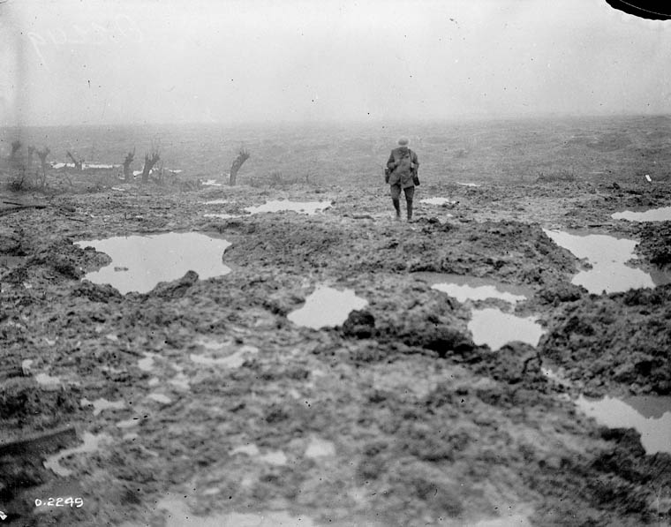

Slide 13
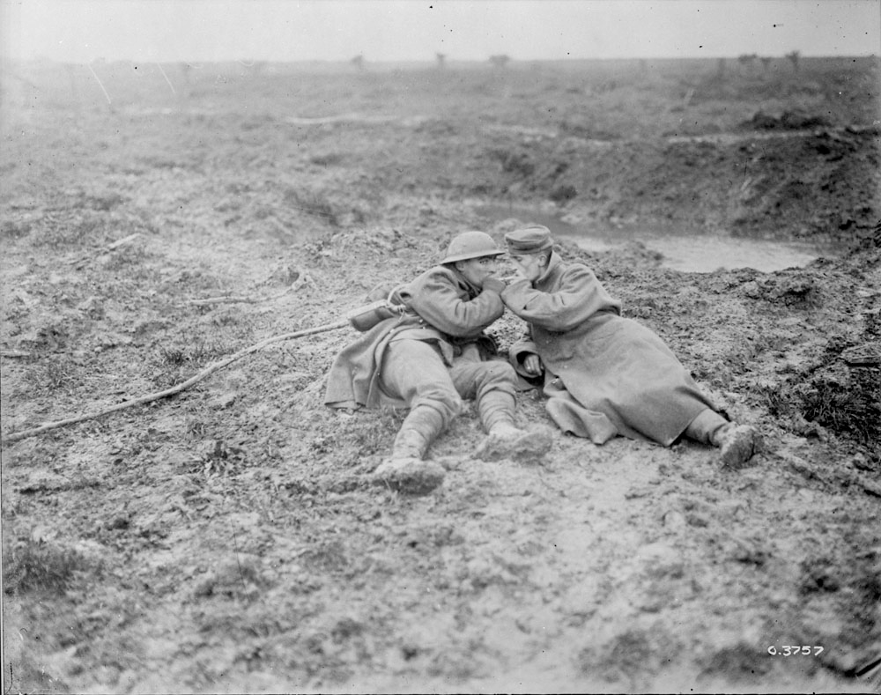

Slide 14
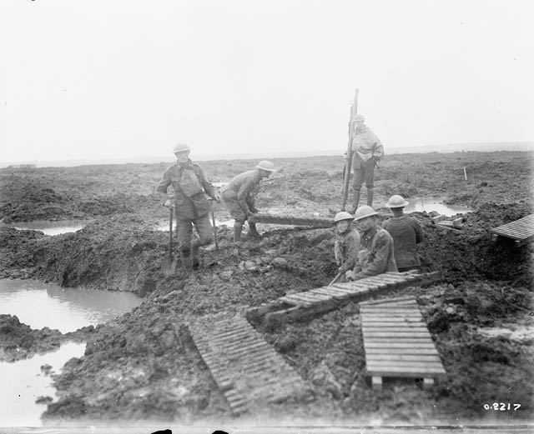

Slide 15
Borden and Conscription
Early in the war the only information Borden could get concerning the war was the newspaper.
Eventually went to Europe and after witnessing the conditions. This persuaded him that conscription was needed despite the fact that he had campaigned against it.
He offered a coalition with Laurier’s Liberals to get support, but Laurier refused.
Borden would create a Union Government to maintain power and pass
Conscription
Universal suffrage for soldiers overseas
Universal suffrage for women
Union Gov’t – 12 Conservatives, 9 Liberals and Independents, and 1 Labour

Slide 16
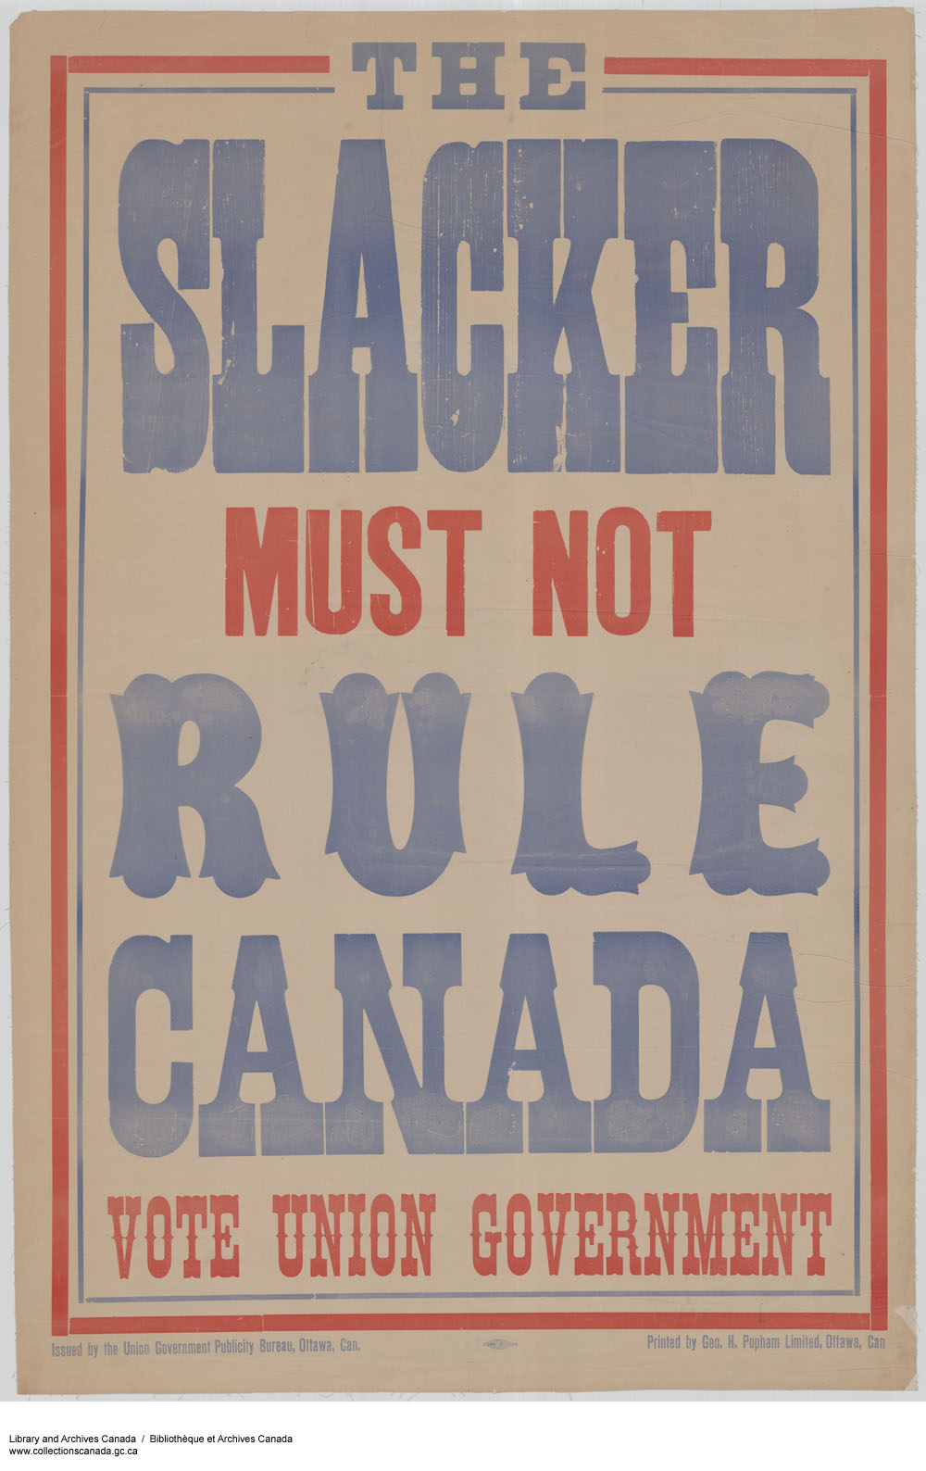

Slide 17
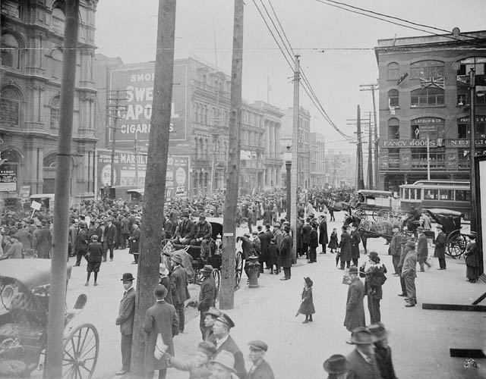
Anti-conscription rally in Montreal

Slide 18
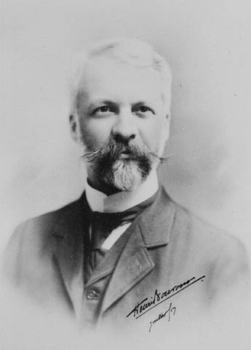
Henri Bourassa Highly critical of the fact that the gov’t did not bring decision to enter the war to Parliament Strong Quebec nationalist anti-conscription

Slide 19
The Final Phase
In 1918 German armies moved from the East to the Western Front after the collapse of Russia.
Quebec Easter Riots– 4 dead at anti-conscription rally in Montreal
Halifax Explosion – Over 1,600 killed
The Hundred Days
The United States entered the war in 1917 and by summer 1918 American forces began to help the Allies push the Germans back.
Final Allied offensive of the war

Slide 20
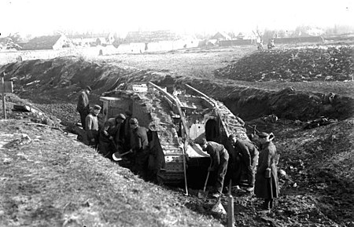
Battle of Cambrai

Slide 21
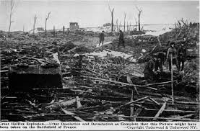

Slide 22
Aftermath
Canada alone had over 60,000 war dead.
Canadian government assumed many roles it had not had before:
Income tax (1913 to 1918 Canada’s debt rose from $400 million to $2.5 billion.)
Many, including women, won the right to vote
New government departments created (ex. Dept of Veteran’s Affairs)
Canadians proved themselves some of the most effective soldiers on the Western Front.
Canada’s standing in the world increased dramatically (signed Treaty of Versailles)

Slide 23
