Slide 1
1.4 The Fall of New France

Slide 2
British-French Hostilities
Between 1701-1713, Britain and France were engaged in the War of Spanish Succession in Europe, but hostilities between the two empires erupted in North American as well.
In 1713, the signing of the Treaty of Ultrecht (which ended both the War of the Spanish Succession in Europe, as well as fighting between the British and French on the East Cost of North America) drastically changed the balance of power and size of territory for Nouvelle-France.
Under the Treaty, France surrendered possession of almost all of Newfoundland (except some fishing rights), Hudson Bay, and Acadia to Britain.

Slide 3
Why did France give up Acadia while keeping the Caribbean islands of Guadeloupe and Martinique during peace treaty negotiations between British and France after the War of Spanish Succession?
Each side agreed to give back some of the colonies it had captured in the war. Britain had offered to either return Acadia or Guadeloupe and Martinique. Those islands grew sugar, which was a very great valuable item in Europe. France agreed to keep them and give up Acadia, thinking it could still get furs from New France.

Slide 4
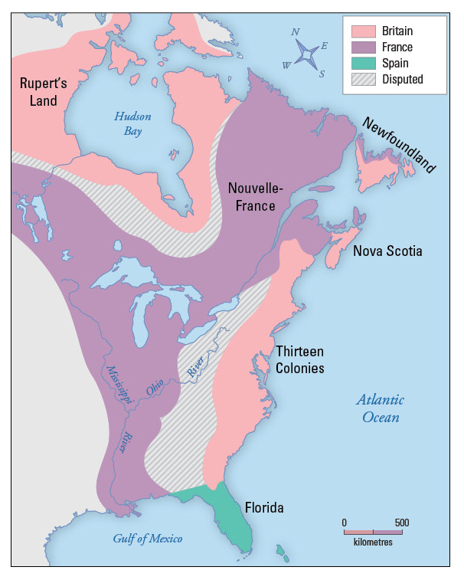

Slide 5
The Seven Years War
The Seven Years War (1756–63) (‘French and Indian War’) was the first global war, fought in Europe, India, and America, and at sea.
In North America, imperial rivals Britain and France struggled for supremacy. Early in the war, the French (aided by Canadian militia and Aboriginal allies) defeated several British attacks and captured a number of British forts.
In 1758, the tide turned when the British captured Louisbourg, followed by Québec City in 1759 and Montréal in 1760.
With the Treaty of Paris of 1763, France formally ceded Canada to the British.

Slide 6
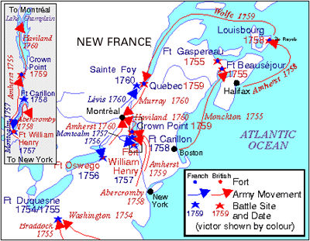

Slide 7
Canada
The name “Canada” likely comes from the Haudenosaunee word “kanata,” meaning “village.” In 1535, two Aboriginal youths told French explorer Jacques Cartier about the route to kanata; they were actually referring to the village of Stadacona, the site of the present-day City of Québec. For lack of another name, Cartier used the word “Canada” to describe not only the village, but the entire area controlled by its chief, Donnacona.
The name was soon applied to a much larger area; maps in 1547 designated everything north of the St. Lawrence River as Canada. Cartier also called the St. Lawrence River the “rivière du Canada,” a name used until the early 1600s. By 1616, although the entire region was known as New France, the area along the great river of Canada and the Gulf of St. Lawrence was still called Canada.

Slide 8
Canada
Soon explorers and fur traders opened up territory to the west and to the south, and the area known as Canada grew. In the early 1700s, the name referred to all French lands in what is now the American Midwest and as far south as present-day Louisiana.
The first use of Canada as an official name came in 1791, when the Province of Quebec was divided into the colonies of Upper Canada and Lower Canada.

Slide 9
Once war was declared, France’s attention was focused on winning the war in Europe. Britain, however, began to concentrate on winning the war in North America.
The area just south of the Great Lakes, known as the Ohio Valley, was the main area of contention. Each side thought it had claim.
When the Seven Year’s War in Europe broke out, the French troops in North America relied heavily on supplies shipped from France; the British, on the other hand, could supply their troops from supplies in North America and used their naval superiority to block French supply lines.

Slide 10
By 1758, most of the Ohio Valley was in British hands.
Later that year, the fortress of Louisbourg (in Nova Scotia) was taken over by the British, meaning they could attack the heart of Nouvelle-France through the St. Lawrence, as well as from the south.

Slide 11
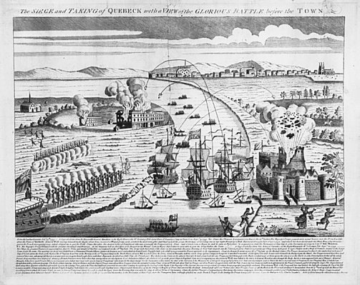
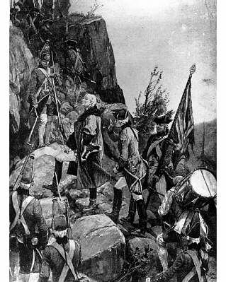
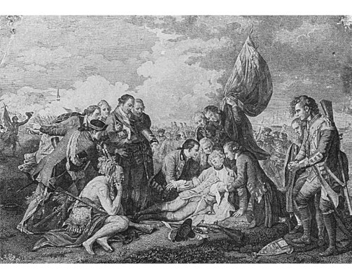
At daybreak, Montcalm mobilized his 4,500 men without waiting for reinforcements from the detachment led by Louis-Antoine de Bougainville. The regular French troops, assisted by inexperienced militiamen who were deployed hastily to the battlefield, found themselves on the offensive.
The English bore fire from the French troops, allowed them to advance, and then responded with heavy fire their own, which created large gaps in the French ranks. In half an hour, the battle was over and the French army was in retreat. Both Wolfe and Montcalm died of wounds sustained in battle.

Slide 12
The French seemed to be in a stronger position. They were in a walled city, high above the river. The British were in ships on the river, and winter was approaching. Why did the British win the battle?
General Wolfe surprised the French, who was expecting him to attack the Beauport shore. Montcalm decided he had to dislodge the British from the Plains, as food was scarce in Quebec because of the British blockade. Rushing the French defenders back to the Plains from Beauport stretched their lines. The British were close together and disciplined. They cut the French down with rapid rifle fire.

Slide 13
The Treaty of Paris, 1763
In 1763, the Seven Year’s War ended with the signing of the Treaty of Paris.
Nouvelle-France was now officially in the hands of the British, except for the two small islands off Newfoundland, St Pierre et Miquelon.
Spain gained the French colony of Louisiana and, in exchange, Britain added Florida to its colonial possessions

Slide 14
First Nations & the Treaty of Paris
For the First Nations people, the Treaty of Paris resulted in a major shift in their relationship with the European colonies.
During the century and a half that the French and British had been battling for control of North America, each First Nation made decisions to form alliances or remain neutral, depending on what it believed was in its best interest.
With the British in control, First Nations lost their strategic bargaining position.
As well, European newcomers were now encroaching farther and father into their lands.

Slide 15
The British conquest of Quebec is considered to be one of the most important battles to take place on Canadian soil. Why is this so? How might different groups of people have different views on the historical significance of the British conquest?

Slide 16
THE FALL OF NEW FRANCE
Top 5 Reasons

Slide 17
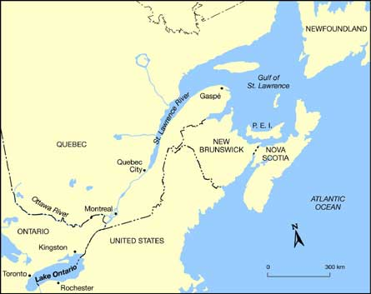
1. GEOGRAPHY
New France relied heavily on the St. Lawrence River.
Once Louisbourgh fell to the English, the colony was vulnerable to attack.

Slide 18
2. ECONOMY
Mercantilism kept the colony dependent on France.
Lack of development kept the population very small (70,000).
The 13 colonies to the South (English) had about 1.5 million people.

Slide 19
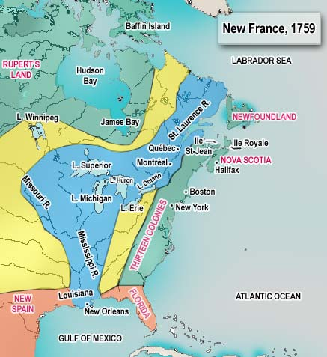
3.AREA OF NEW FRANCE
The colony was
very large in size.
A small population
had to defend a
long frontier.

Slide 20
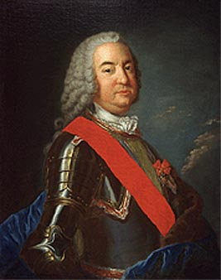
4. DISSENSION
Montcalm and the Governor (Vaudreuil) did not agree on defence policy.
Corrupt officials (Intendant Bigot) took advantage of the colony during wartime. (inflated prices, spent lavishly)

Slide 21
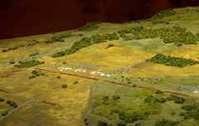
5. TACTICAL ERRORS
Montcalm made several blunders.

Slide 22
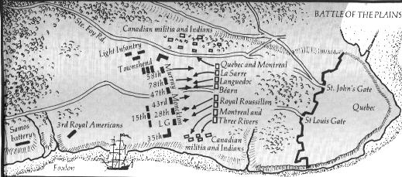

Slide 23
