Slide 1
The Canadian Soldier
World War One

Slide 2
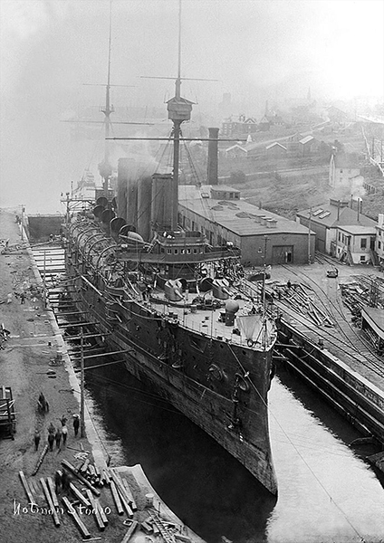
Introduction
At the beginning of the war Canada had no air force, a puny navy and a professional army of 3,100 men.

Slide 3
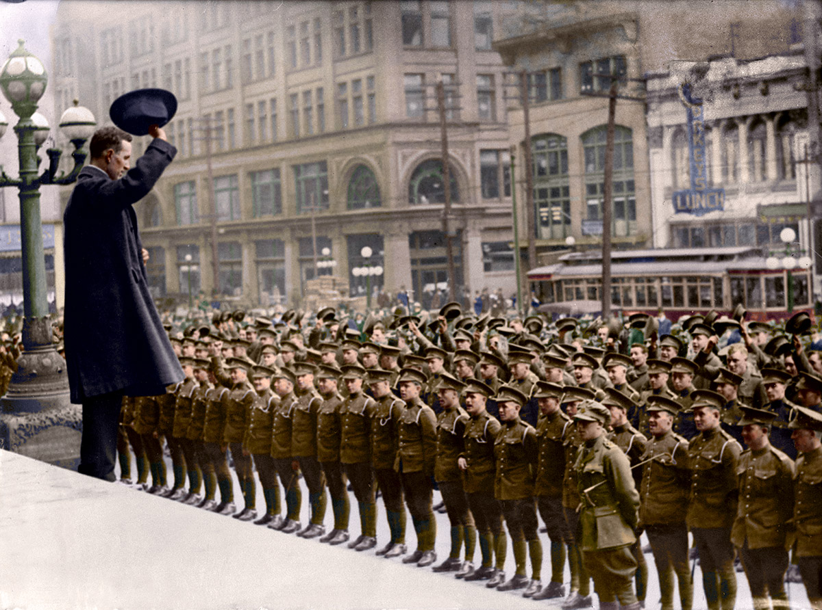
Eager Recruits
There was a surge of patriotism early in 1914.
Even up to 1916 thousands signed up for enlistment indicating that the people of Canada felt the war was just and was a means of supporting liberal ideas and the British Empire.
Privates were paid $1.10/day.

Slide 4
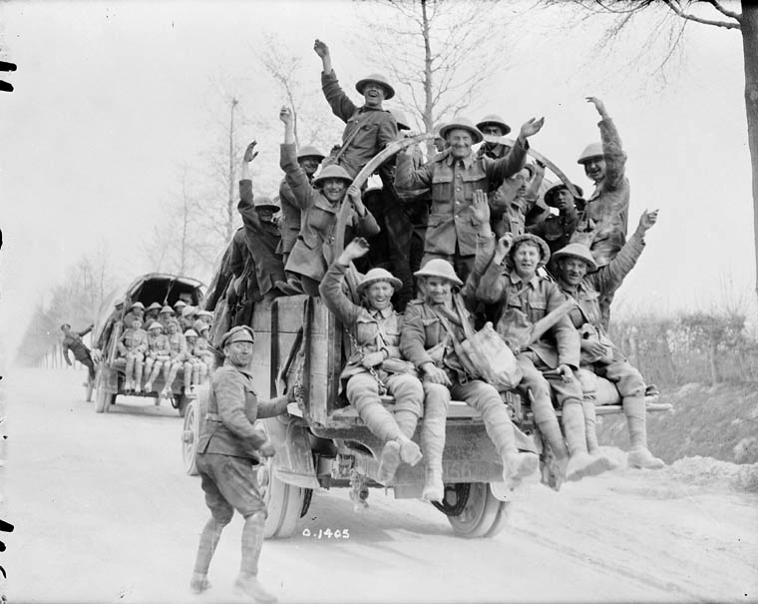
Eager Recruits
The Canadian Army was picky in 1814 and sent over 31,000 men as the first members of the Canadian Expeditionary Force (CEF).
Most of these men were veterans of the Boar War.
About 70 % of these men were British born.
By the end of the war 630,000 men would participate and about 51% of them would be Canadians born in Canada.

Slide 5
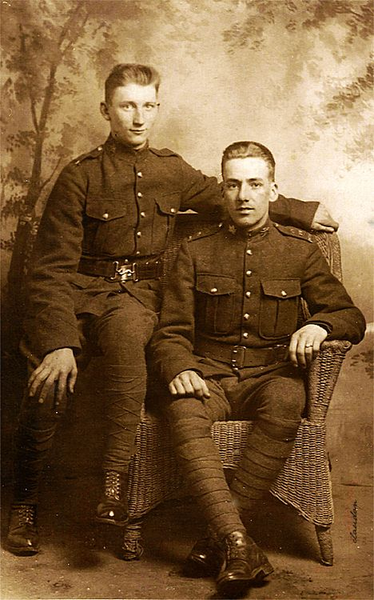
Requirements
Canadian soldiers needed to be at least 5’3”.
Gunners needed to be bigger: a minimum of 5’7”.
Soldiers needed to be between the ages of 18-45.
The average age of a Canadian soldier was 26 years old.

Slide 6
Ethnic Groups
Most Canadian soldiers were of British descent though men from many other ethnic groups took part.
First Nations soldiers initially were denied entry into the army, though by the end of the war over 4,000 served. Mostly as scouts and snipers.
By 1916 Japanese Canadians and Black Canadians were allowed to enlist.
As many as 4,000 Ukrainian Canadians took part even though they were seen as disloyal.
As many as 40,000 Americans joined the CEF during the war.

Slide 7
Internment
the state of being confined as a prisoner, especially for political or military reasons.
More than 8,500 people of Ukrainian and German descent were interred during the war.
The War Measures Act gave the Canadian government the power to withhold the civil liberties of Canadians.
If someone of German or Austro-Hungarian descent was believed to be a spy, they could be arrested.

Slide 9
Name Change
Strasburg Strasbourg
Berlin Kitchener

