Slide 1
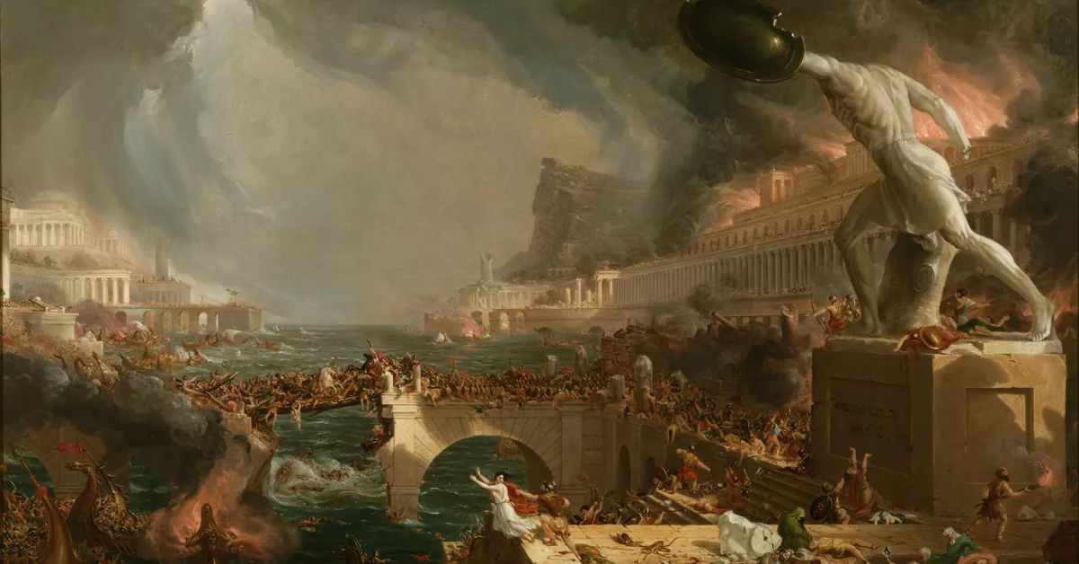
A Study of the
Revelation of St. John

Slide 2
Authorship
John the apostle, the son of Zebedee (Matt. 10:2)
Well-versed in Scripture
A church leader known to the seven churches in Asian Minor (Turkey)
In the third century, African bishop Dionysius argued that the book was written by
John the Presbyter
Today, evidence is overwhelming that the book was in fact written by John the apostle

Slide 3
Date
Written at a time when the church was undergoing persecution. Most likely during
the reigns of Nero and Domitian.
Most believe the book was written around 95 A.D.

Slide 5
Literary Form
Revelation is apocalyptic, a kind of writing that is highly symbolic.
The book provides many clues to interpret the symbols.
The book of Revelation is not as difficult as we often believe. It should be read literally, except when we are specifically told that a symbol is being used.

Slide 6
Interpretation
Preterists – see the book in its first century setting. Most of the events described have already taken place.
Historicists – book described as a long chain of events from Patmos to the end of history.
Futurists – place the book in the end times
Idealists – symbolic pictures of good over evil

