Slide 1
Stalin and the Police State: An Introduction
History 20

Slide 2
Part I: Struggle for Power

Slide 3
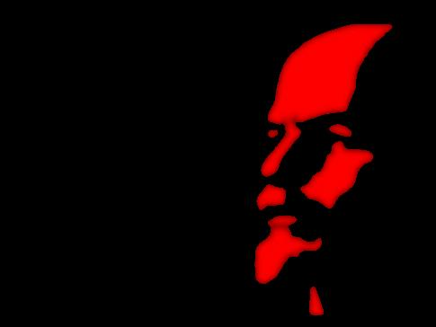
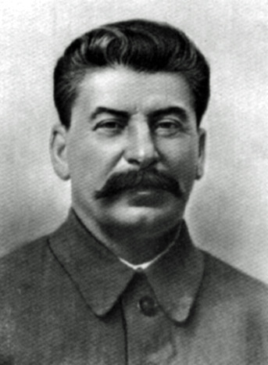
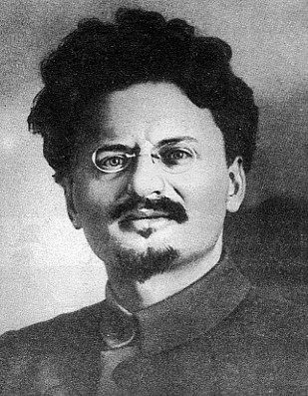
Lenin dies
After suffering a series of strokes, Lenin dies on January 24, 1924 leaving behind a power struggle between two people
VS
Joseph Stalin
Leon Trotsky

Slide 4
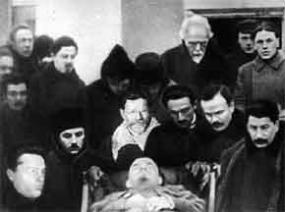
The Debate over who to Rule
Lenin did not declare an official person to succeed him.
Thought Trotsky was too arrogant
Thought Stalin to be too power hungry, specifically stated that he was NOT to rule

Slide 5
Clash of Ideologies
Dedicated to the idea of a world revolution
To Trotsky, the Russian Revolution was merely the first step in a worldwide uprising of the proletariat.

Slide 6
Clash of Ideologies (cont’d)
The Soviet Union was the revolution, and it was up to the Soviet people to fashion a perfect Communist state.

Slide 7
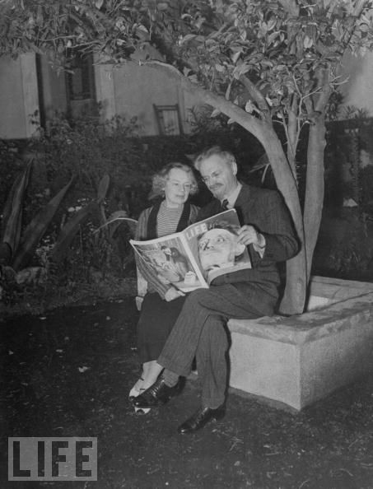
Stalin wins favour
Stalin wins favour amongst members of the party, gains important people’s support
Eventually gets Trotsky exiled to Siberia
Many thought Trotsky too dangerous with his command of the Red Army

Slide 8
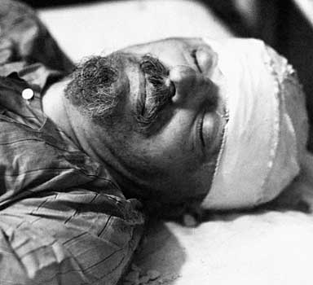
Assassination of Trotsky
Trotsky was assassinated, under Stalin’s secret police, 15 years later in Mexico—death by pickaxe

Slide 9
Part II: Stalin and his “Economic Revolutions”

Slide 10
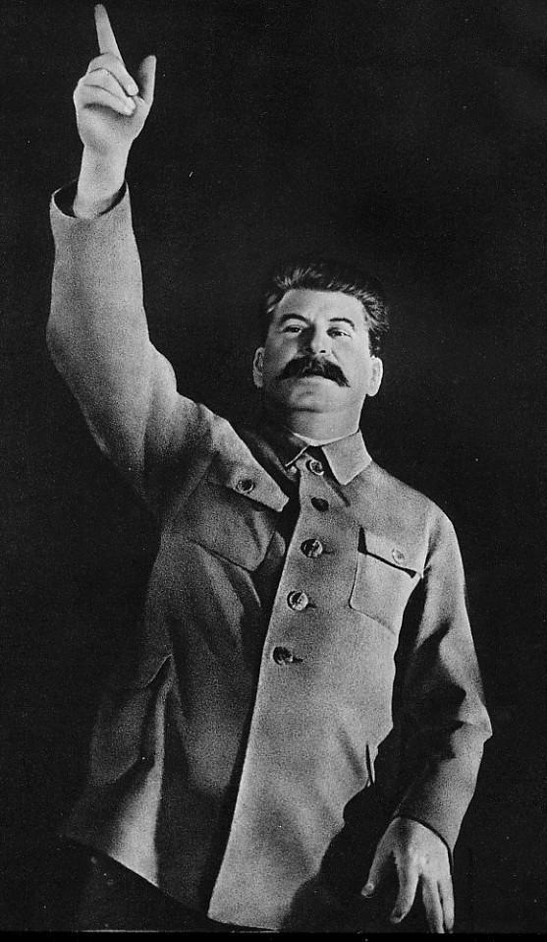
Stalin’s Goal
Stalin was convinced that someday foreign enemies would attack the newly formed Soviet Union, therefore he must make the country strong enough to withstand an attack

Slide 11
“We are 50 or 100 years behind the advanced countries…We must make good this lag in 10 years. Either we do it, or they crush us”
Stalin

Slide 12
Stalin’s Goal (cont’d)
Stalin sought to make the USSR a major competitor in the world. There were two methods he used for this:
Industrialization
Collectivization

Slide 13
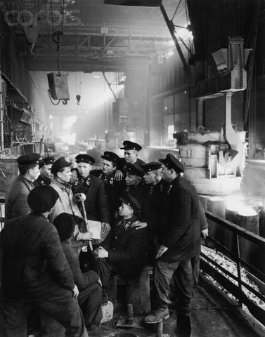
Industrialization
Stalin outlined several Five-Year Plans for the development of the USSR’s economy.
He does through command economy (all economic decisions are made by the gov’t)
He set the production targets absurdly high (almost impossible) on purpose

Slide 14
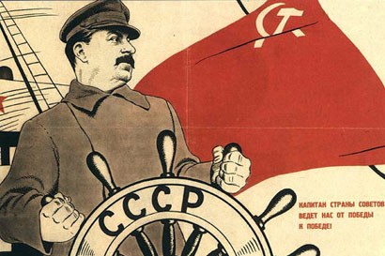

Slide 15
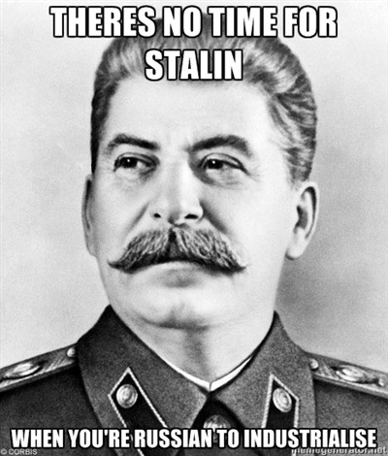

Slide 16
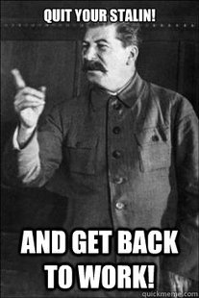

Slide 17
Number Crunching
Output of heavy industry in USSR (in millions of tons)
 | Before Five Year Plan | Five-Year Plan Goals | After Five-Year Plan
Oil | 11.7 | 22 | 21.4
Steel | 4 | 10.4 | 5.9
Coal | 35.4 | 75 | 64.3
Despite the uncertainty of these numbers, there is still clearly a significant increase in the production of USSR

Slide 18
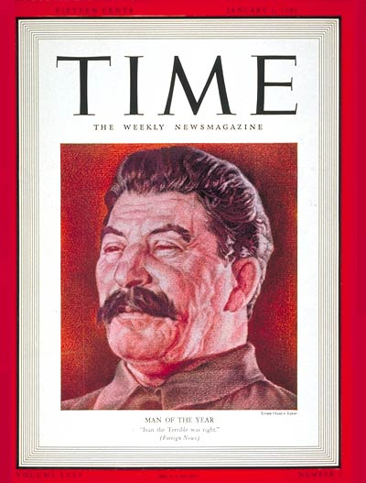
In fact, Time Magazine names Stalin “Man of the Year” in 1938

Slide 19
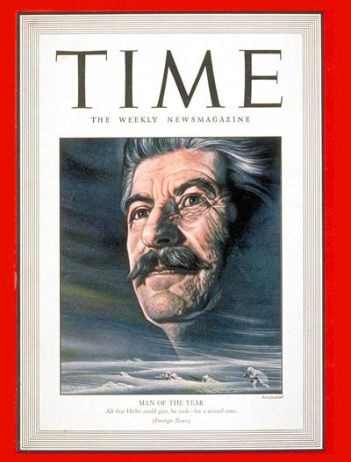
And again in 1942

Slide 20
Guess who they named “Man of the Year” in 1939?

Slide 21
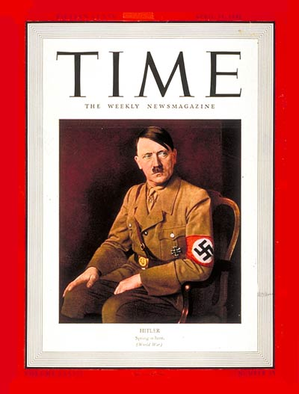

Slide 22
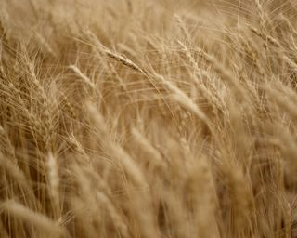
Collectivization
The government has complete control of the agricultural production, meaning they own all the grain produced.
They claimed it, then theoretically distributed it according to people’s needs

Slide 23
Collective Farms
Under collectivization, private farms was abolished and would be replaced by collective farms—large units worked by hundreds of units
This became a huge problem with the fact that there were 25 million farms in the USSR in 1928!

Slide 24
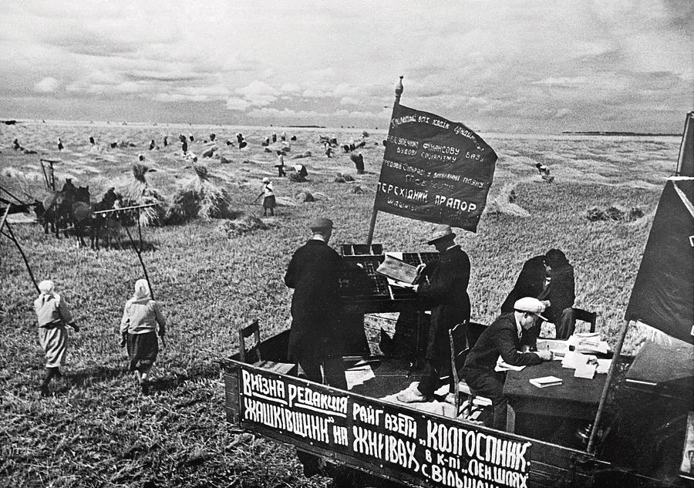

Slide 25
A Totalitarian USSR
Under Stalin, the Soviet Union becomes a totalitarian state—a country in which a dictator or a small group controls every part of the lives of its citizens
Stalin was an absolute dictator, more powerful than the most autocratic Tsar.
For 25 years Stalin controlled the USSR, and was responsible for the the country’s rise to its position as a great world power

Slide 26
“Cult of Personality”
Like many, totalitarian dictators, Stalin creates a cult of personality to boost his public image
TERMINOLOGY:
Cult of Personality (definition) when an individual uses mass media, propaganda, or other methods, to create an idealized and heroic public image, often through unquestioning flattery and praise

Slide 27
Gulag
One of the primary tools Stalin used to maintain power was the Gulag
Gulags were prison camps scattered throughout the Siberian region of the country

Slide 28
Dekulakization
Kulaks – large land owners
To collectivize the land in the Soviet Union, the government had to remove the landowners
"If the kulaks remain untouched, if we don't defeat the freeloaders, the czar and the capitalist will inevitably return.“ Lenin

Slide 29
Dekulakization
All kulaks were assigned to one of three categories:^{[4]}
Those to be shot or imprisoned as decided by the local secret political police (NKVD)
Those to be sent to Siberia after confiscation of their property
Those to be evicted from their houses and used in labor colonies within their own districts
The process of dekulakization lead the deaths of between 500,000 - 7 million people

Slide 30
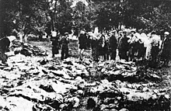
Stalin’s Purges
Between 1936-1938 Stalin purged the government and army to solidify his power
He used the secret police and show trials to condemn his enemies
Looking for relatives among
exhumed bodies

Slide 31
Gulag Archipelago

