Slide 1
Settling the West

Slide 3
Indigenous Populations in the West
Very little is known about the indigenous peoples in the West before the arrival of Europeans
Early aboriginal peoples hunted to survive (Bison, caribou, horse, camel, etc.)
People of the Plains moved between resource zones according to the seasons
Weather was “predictably unpredictable”
Evidence that during the hypsithermal interval (Medieval Warm Period), the bison all but disappeared from the Canadian prairies for almost 500 years.
Roughly 50,000 people were living on the Canadian prairies in 1640

Slide 5
https://native-land.ca/

Slide 6
Fur Trade
Significant changes with the arrival of Europeans
Hunting bands moved into new territories and negotiated new diplomatic arrangements with neighboring groups
Introduction of infectious diseases like smallpox
Indigenous autonomy was reduced in the 19th century through population pressure from Eastern North America, the expansion of the Canadian nation-state, the destruction of the single, crucial element in the plains economy: bison.

Slide 8
Fur trade and change
The Hudson’s Bay Company (HBC) traded from posts on Hudson’s Bay and then was later forced to create forts inland due to competition.
The French, and later the Northwest Company (NWC), created extensive networks in the Canadian interior.
Eventually the HBC and NWC were forced to merge in 1821.

Slide 9
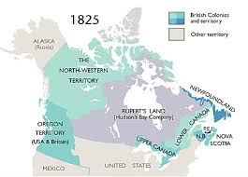

Slide 10
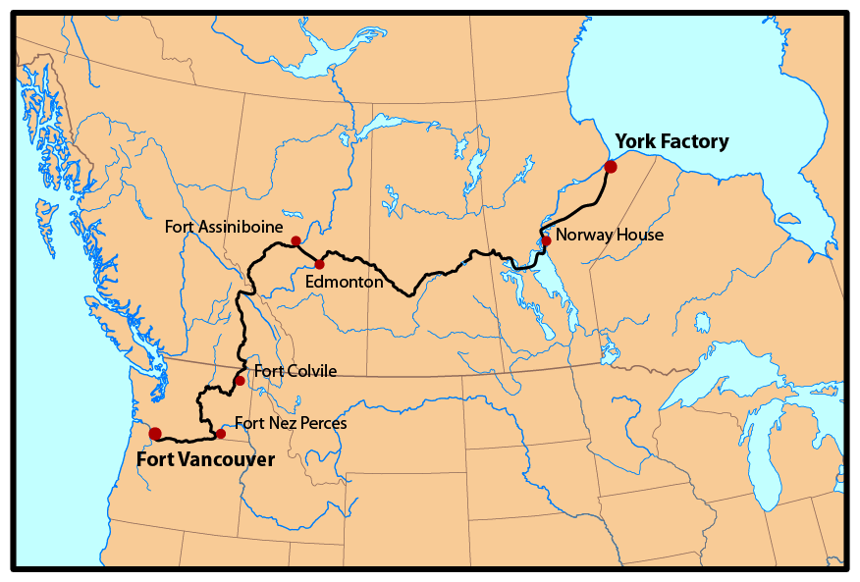

Slide 11
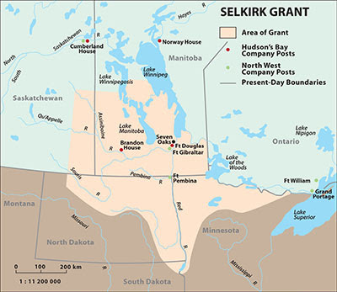
Red River
One of the first Western colonies on the Canadian prairies was Red River.
By 1840, it was primarily populated by metis.
Canada was given sovereignty over Rupert’s Land in 1869, but it was forced to renegotiate terms with the settlers of Red River after the Red River Resistance led by Louis Riel.
This led to the creation of the province of Manitoba in 1871.

Slide 13
Settling the West
Due to the federal government’s great powers, decisions about the West were made in Ottawa. The priorities of the federal government at this time were:
Surveying the land
Dispatching the NWMP
Homesteading and farming
Large scale immigration

Slide 14
The survey system divided the arable prairie lands into square townships, each comprising
36 sections of 640 acres, with the homestead comprising one 160 acre quarter section.

Slide 16
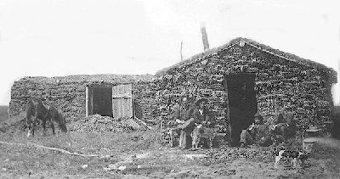

Slide 17
The West As British
The future of the Canadian West would be decided British. This was evidenced by:
The Indian Act, 1874
The failure of the Northwest Rebellion in 1885
The Passage of the Manitoba Schools Act (Public Schools Act)
Saskatchewan and Alberta were created in 1905, carrying on the British tradition of peaceful evolution from colony to self-governing state.

Slide 19
treaties
Seven indigenous treaties were negotiated in the 1870s between the Canadian Government and the First Nations of the Western interior.
These treaties exchanged indigenous sovereignty over the land for government promises of economic assistance, education, and the creation of reserves.

Slide 21
Settling the Prairies
Westerners became troubled by the arrival of hundreds of thousands of non-British immigrants.
Scandinavians and Germans tended to assimilate quickly. Other groups (Mennonites, Jews, Ukrainians, etc.) sought to retain more of their cultural heritage.
Some religious groups (Mennonites, Doukhobors, etc.) choose to leave rather than accept the norms being established.
By the 1950s, the Prairies were far closer to a British Canadian model than any other culture in Canada.

Slide 22
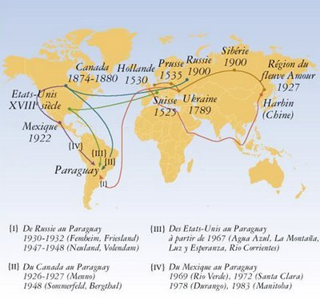

Slide 23
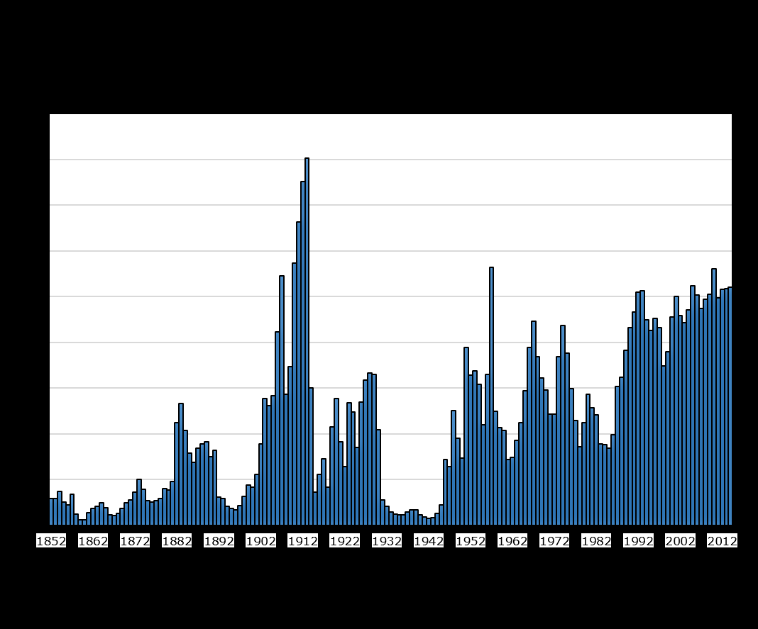

Slide 24
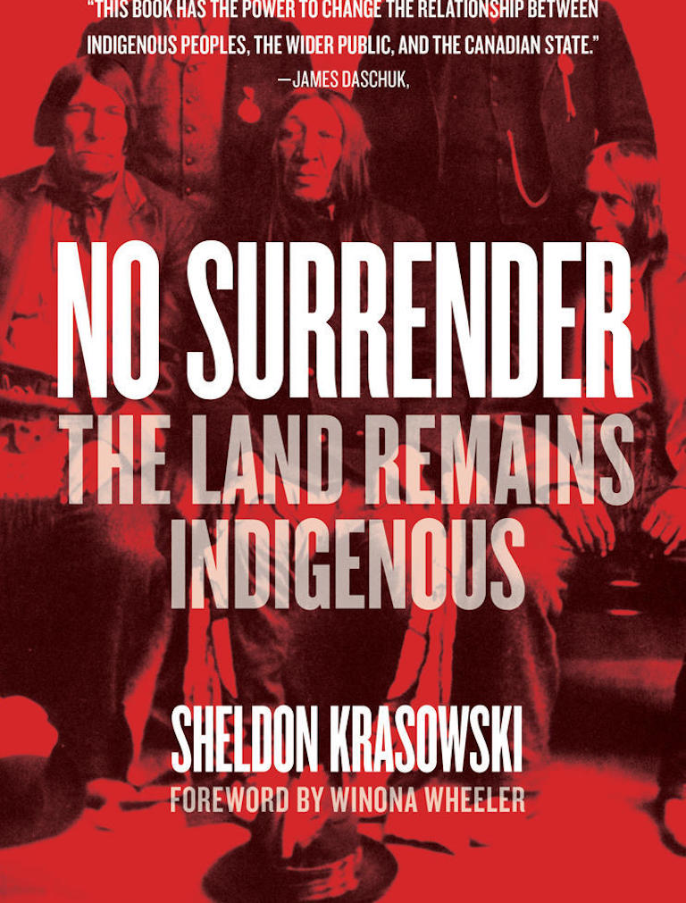
“No Surrender is a detailed account of treaty negotiations and of the differing understandings of the treaty-making process, as seen through an unbiased lens. Indigenous people didn’t lack knowledge and were not ignorant savages — as they’ve been portrayed by some historians. Indigenous people understood sovereignty over territory, even though land ownership in the European sense was unknown. They wanted to use the treaties to build a better life for future generations, while the government wanted the land and saw no intrinsic value in the Indigenous nations that had ruled the land for centuries. That was a tragic flaw that continues to haunt Canada and the First Nations.”
- Doug Cuthand

