Slide 1
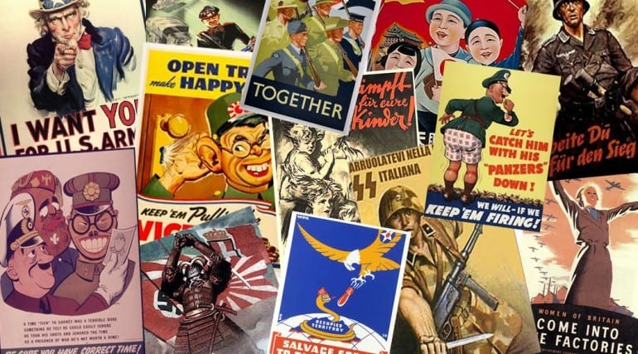
The Second World War

Slide 2
Review: How did we get here?

Slide 7
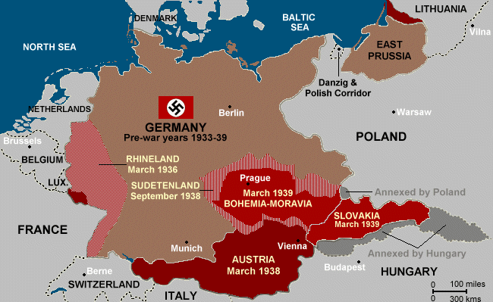
Lebensraum
Hitler wanted to invade Poland
Both Britain and France had guaranteed Poland’s independence
Hitler was afraid of Soviet aggression if he moved East

Slide 8
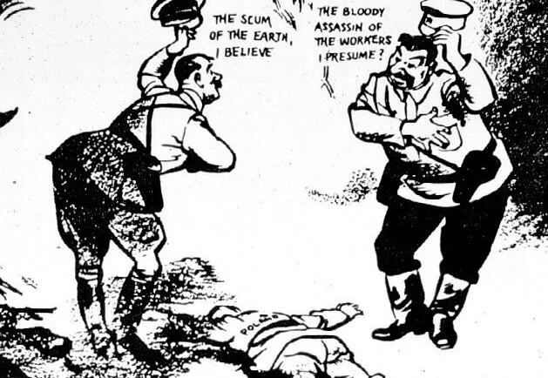
Nazi-Soviet Nonaggression Pact, 1939
Shocked the world
Peace between Fascism and Communism
Hitler and Stalin made a secret arrangement to divide Poland

Slide 10
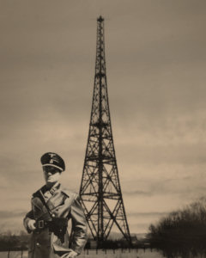
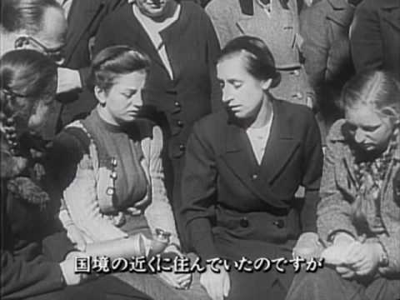
Invasion of Poland
Nazi Germany invaded Poland on August 31, 1939
Gleiwitz Incident -
False flag operation
Nazi propaganda –
Persecution of Germans in Poland

Slide 11
Blitzkrieg - Lightning War
German invasion of Poland used as a test for a new military tactic – blitzkrieg
Blitzkrieg - is a military tactic designed to create disorganization among enemy forces through the use of mobile forces and locally concentrated firepower

Slide 13
WW2 in Color ep.2: 0:00-12:00

Slide 14
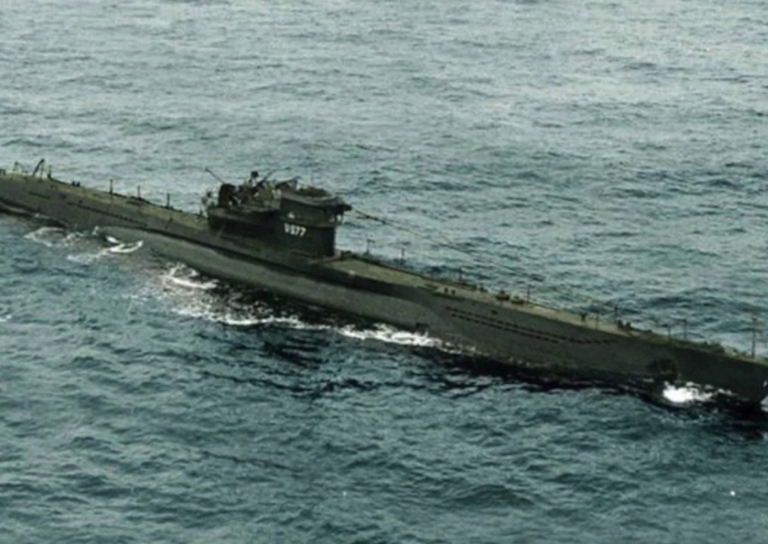
Battle of the Atlantic
British Royal Navy was far larger and better equipped than any other nation
German Navy built on the u-boat (submarine)

Slide 15
Battle of the Atlantic
Longest battle of the war (1939-1945)
2,000 members of the Royal Canadian Navy, 1,600 Canadian merchant seamen and 752 Canadian airmen were killed in the Battle of the Atlantic.

Slide 16
Invasions of Scandinavia
Soviets attacked Finland (The Winter War) in November 1939 to protect its Northern frontier from invasion
Churchill wanted the Allies to declare war on the Soviet Union.
Finnish army led by Marshall Gustav Mannerheim.
Once taught pistol shooting to the Dalai Lama.
Established Mannerheim Line
First use of the term ‘Molotov cocktail’
Germany wanted to protect its source of iron in Sweden and ports in Norway. Denmark (which was in the way), Norway, and Sweden were all invaded in.
One of the greatest consequences of the German invasion of Norway is that it lead to the fall of Chamberlain’s government and the election of Winston Churchill.

Slide 18
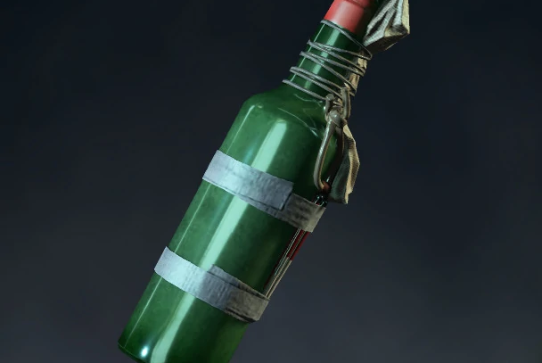

Slide 20
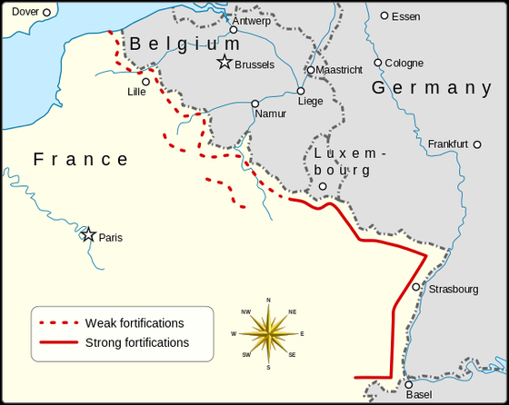
Invasion of France
The Maginot Line
Constructed to defend
against German
aggression
Ep. 2 24:50

Slide 22
Invasion of France
Blitzkrieg perfected
Germany was able to get into France and behind Allied units by travelling through the Ardennes Forest.

Slide 23
Invasion of France
France’s standing army of 800,000 men was seen as one of the most formidable in Europe, though it relied heavily of WW1 tactics and the Maginot Line.
More than 2/3 of the German army was sent through the Ardennes Forest (~1.5 million men and ~1,500 tanks). This was the weakest section of the Allied front.
Germany forces moving through the Netherlands were outnumbered but won a quick victory, exposing the outdated tactics of the Dutch defenders.

Slide 24
Rotterdam was accidentally bombed in 1940

Slide 25
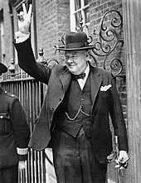
Invasion of France
After debate in the House of Commons about the fall of Norway and the Netherlands, Prime Minister Chamberlain resigned and was succeeded by Winston Churchill.

Slide 26
Invasion of France
The main German army group was lead by German General Heinz Guderian.
His forces burst through the Ardennes and supported by German dive bombers cut through the French defenders at Sedan.
His forces were able to secure a river crossing and on May 15, 1940 broke through the French lines and turned west to the English channel.
German forces cut off the Allied troops who headed for the ports of Calais and Dunkirk.

Slide 28
Invasion of France
Guderian’s tanks moved up into Calais and then onto Dunkirk. Guderian believed that he and his men work quickly move into the city and capture what was left of the Allied forces.
However, Hitler called an advance to German forces and ordered them along the canal at the outer edge of the city.

Slide 30
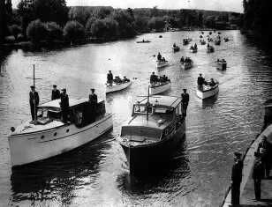

Slide 32
Miracle at Dunkirk
Operation Dynamo
Supported by the RAF, the British navy with the help of civilian ships were able to rescue 198,000 British and 140,000 French and Belgian troops.
They were forced to leave behind almost all of their heavy equipment.

Slide 33
Why did Hitler Halt the Advance on Dunkirk?
What do you think?
Hitler wanted to make peace with England and decided not to destroy the BEF.
Goring wanted to let the Luftwaffe destroy the defenses at Dunkirk.
Hitler’s commanders asked for the halt after facing resistance at Arras.
Supply lines were running thin and the Germans decided to allow the infantry to catch up.

Slide 34
1. Hitler wanted to make peace with England and decided not to destroy the BEF.
Hitler argued that “the English nation will have to be considered the most valuable ally in the world as long as its leadership and the spirit of its broad masses justify us in expecting that brutality and perseverance which is determined to fight a battle once begun to a victorious end, with every means and without consideration of time and sacrifices; and what is more, the military armament existing at any given moment does not need to stand in any proportion to that of other states”

Slide 35
2. Goring wanted to let the Luftwaffe destroy the defenses at Dunkirk.
Just 12 miles away tanks of Guderian’s 1st Panzer Division had reached the Aa Canal, the last real obstacle before Dunkirk. Standing on a hill, Guderian could see the town walls. By the morning of the 25th his men had thrown pontoon bridges across the canal, allowing a few tanks to cross. Just as the advance was ready to resume, however, an order arrived from Army Group A, under General Gerd von Rundstedt: The tanks must halt at the Aa Canal. The destruction of British and French forces around Dunkirk would be left to the Luftwaffe. This order remained in effect for two days while Guderian’s tankers champed at the bit, watching in frustration as 340,000 British and French soldiers prepared to evacuate from Dunkirk right under their noses. The Luftwaffe proved unable to stop the famous Dunkirk armada of destroyers, fishing boats and everything in between from carrying the BEF back to England to fight another day.

Slide 36
3. Hitler’s commanders asked for the halt after facing resistance at Arras.
After days of disorganized retreat the BEF had surprised the Germans on May 21 by staging a counterattack, using tanks and infantry, at the edge of the northern French city of Arras.
That counterattack seems to have unnerved a man who was to become perhaps the most proficient leader of panzer divisions, General Erwin Rommel. Rommel complained to the German commanding general, Field Marshal Gerd von Rundstedt, that his 7th Panzer Division had been attacked by “hundreds of enemy tanks.” In fact, the British had deployed 74 tanks of which only 16 were the latest generation and able to outfight Rommel’s armor.
But the psychological effect of the unexpected resistance was more powerful than the British tanks. Von Rundstedt, with the support of Hitler, stopped the panzers driving toward Dunkirk and ordered that, first, the resistance at Arras should be dealt with.

Slide 37
4. Supply lines were running thin and the Germans decided to allow the infantry to catch up.
Many senior German officers were nervous from the outset about the bold changes made to the original, more traditional plan for the attack on France, and in particular about the envisaged rapid advance of the Panzers that would involve outpacing their infantry, artillery and logistic support. This bold vision was undoubtedly risky; the advancing armour could have faced a serious defeat if the Allies had been able to launch a coherent counter-attack against its flanks or rear. We now know that the German offensive had precisely the effect it was designed to in paralysing the Allied high command, shattering its will and ability to devise and execute an effective counter stroke; but this was not known to the Germans in May 1940. Moreover, there had been a warning sign of precisely what some of the more cautious German commanders feared when the British launched a small-scale counter-attack near Arras on 21 May. This limited and short-lived success played into a growing sense of unease among those German officers inclined to worry that their success was too good to be true, and wary of pushing their attack beyond its culminating point. The Arras counter-attack achieved only local tactical success, but it exerted a decisive influence on a debate that was already underway in the German high command.

Slide 38
Invasion of France
The Germans resumed their move southward into France on June 5th as German General, Erwin Rommel, broke the French defenses in two days and secured a crossing over the Seine.
Once German victory seemed imminent, Italy declared war on France and Britain on June 10th.

Slide 39
Invasion of France
German forces entered Paris on June 14th.
French President Reynaud resigned and was succeeded by Philippe Petain, the hero of Verdun.
France signed an armistice with Germany which split France into two zones. One zone was to be occupied by German troops and controlled by Germany, the other was to be independent. This independent French government was lead by Petain and was called Vichy France.
French General Charles de Gaulle set up his own Free French government from London.

Slide 41
Hitler had the armistice signed in the same rail car as the 1918 armistice

Slide 42
William Shirer, who was present on that day, reports, "I am but fifty yards from him. […] I have seen that face many times at the great moments of his life. But today! It is afire with scorn, anger, hate, revenge, triumph."^{[2]} Then, in the same railway carriage in which the 1918 Armistice had been signed (removed from a museum building and placed exactly where it was in 1918), on 21 June 1940, Hitler sat in the same chair in which Marshal Ferdinand Foch had sat when he faced the representatives of the defeated German Empire. After listening to the reading of the preamble, Hitler – in a calculated gesture of disdain for the French delegates – left the carriage, as Foch had done in 1918, leaving the negotiations to his Oberkommando der Wehrmacht (High Command of the Armed Forces) Chief, General Wilhelm Keitel.

Slide 44
Ep.2 24:50 – 47:00

Slide 45
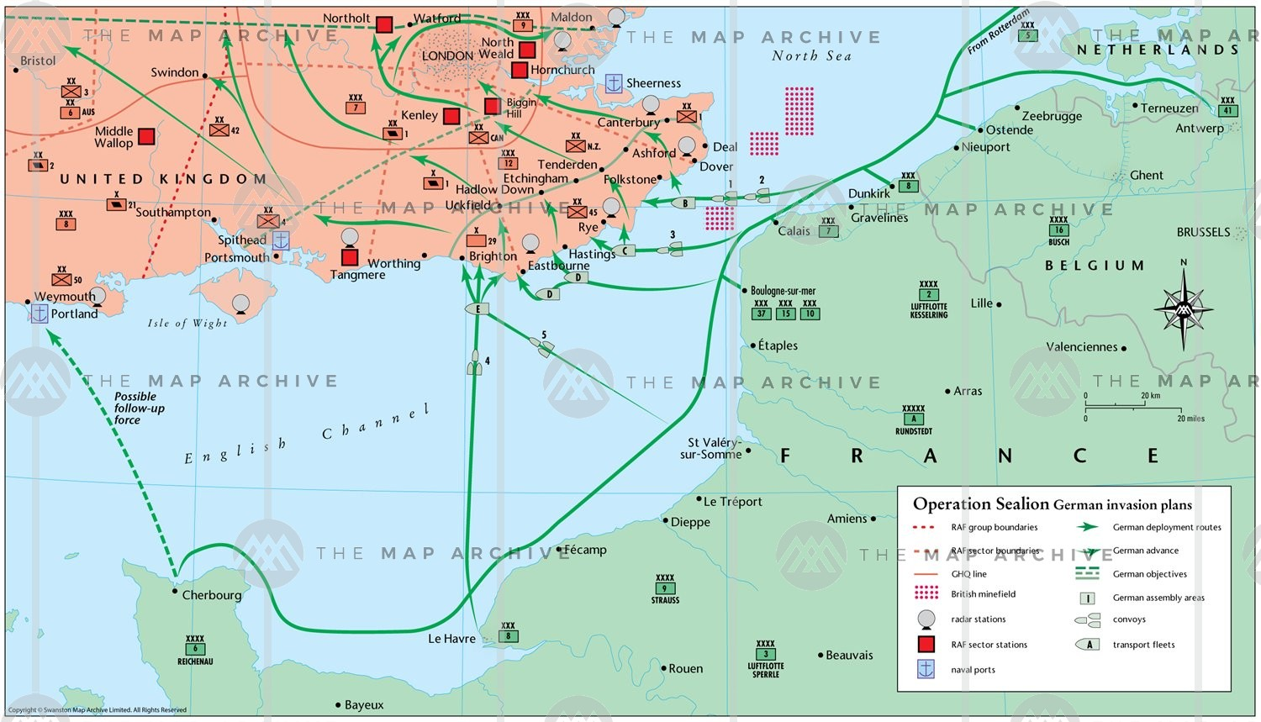
Battle of Britain
Operation Sealion – Hitler’s plan to invade Great Britain
Needed control of the English Channel to allow an amphibious landing.

Slide 46
Battle of Britain
It became clear that the Battle for Britain would be determined in the air.
While the British were far outnumbered in the air, its distinct advantage was the use of radar.
Goring targeted British airfields and manufacturing sectors

Slide 48
Battle of Britain
Just as the RAF (Royal Air Force) seemed to be at its breaking point, London was accidentally bombed.
The RAF bombed Berlin in response.
Hitler was so infuriated he ordered a shift from bombing airfields to the bombing of British cities.
The Blitz – refers to German bombing campaign during the Battle of Britain
Ep. 3 5:40-20:00

Slide 49
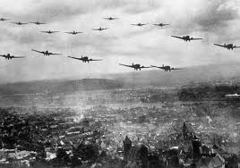

Slide 50
Battle of Britain
The RAF soon began to get the upper hand and it became clear that the Luftwaffe would not be able to win air superiority over Britain.
The RAF had won the Battle of Britain and Operation Sealion was postponed, though the bombing of British cities continued into 1941.
Ep. 3 5:40-20:00

Slide 51
The War in Eastern Europe
Operation Barbarossa
Hitler’s plan to invade the Soviet Union
The Germans expected to achieve another speedy victory
Hitler sent over 3 million men into the Soviet Union
Within weeks the Germans had killed or captured 3 million Soviet troops, destroyed 5,000 aircraft and 15,000 Red Army tanks
However, the Soviets still had over 5 million men at their disposal

Slide 53
The War in Eastern Europe
Stalin had just purged his military. They lacked experience and were low on morale.
By December of 1941, German forces had surrounded Leningrad and were threatening Moscow.

Slide 55
Siege of Leningrad
Leningrad was surrounded by German and Finnish forces.
The siege ended in 1944, lasting 872 days. It caused the greatest destruction and largest loss of life ever known to a modern city.
More than 1,500,000 were killed and 1,400,000 million were evacuated (many of these died of starvation)
At the extreme people were surviving on 125g of bread/day. The bread was made primary from flour, sawdust, malt, soy mill, and husks.

Slide 58
Fetching water for ‘leather soup’

Slide 59
Berta Zlotnikova, a teenager in Leningrad, wrote:
“I am becoming an animal. There is no worse feeling than when all your thoughts are on food.” (Source)
Arkadii Lepkovich, observed:
“Even relations between mother and child, husband and wife, have been made completely inhuman. Fathers would steal bread from their own children. The whole city has become this way because the battle for life has brought despair to every living individual. ” (Source)
Valia Peterson, a 13-year-old girl wrote in her diary about her stepfather who have eaten her dog:
“I hated him terribly. Hunger uncovered his filthy soul, and I have got to know him. When my stepfather died I was ready to jump for joy, but I was too weak and did not have enough strength.” (Source)

Slide 60
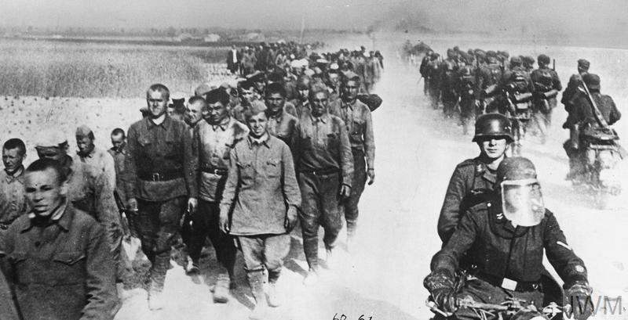
War in Eastern Europe
Though there were great early successes, supply lines were running thin and winter was approaching.
Soviets employed ‘scorched earth’ tactics.

Slide 61
War in Eastern Europe
As German forces invaded Eastern Europe they were followed by special units of the Wehrmacht called the Einsatzgruppen.
These forces were ordered to ‘liquidate’ all communist political commissars and other ‘undesirables’.
Ordinary Men by: Christopher Browning

Slide 62
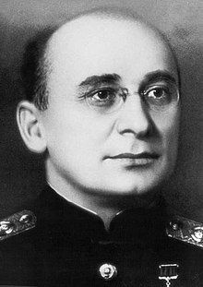
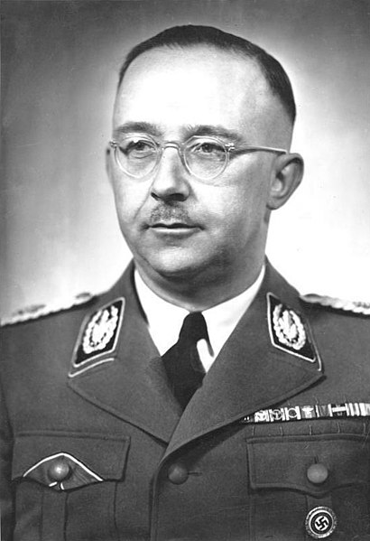
War in Eastern Europe
Head of the NKVD
Lavrentiey Beria
Atrocities committed on both sides:
NKVD executed nationalists and other political prisoners as they retreated.
SS (Einsatzgruppen) executed communists and other political dissidents.
Head of the SS
Heinrich Himmler

Slide 63
The Final Solution to the Jewish Question
The Nazi plan for the genocide of Jews during World War II. The "Final Solution of the Jewish Question" was the official code name for the murder of all Jews within reach.
This policy of deliberate and systematic genocide was formulated in by Nazi leadership in January 1942 at the Wannsee Conference
The Final Solution culminated in the Holocaust, which saw the killing of 90% of Polish Jews,^{[3]} and two thirds of the Jewish population of Europe.^{[4]}

Slide 64
Write these down:
Why were some ethnic groups (Ukrainians, Lithuanians, Latvians, etc.) welcoming to the German invaders?
Why did some of these help the Nazis in the murder of the Jews?
What does the experience of the Holocaust teach us about human nature?
Movies and documentaries about the Holocaust are generally quite graphic (ex. violence and nudity). In your experience do these forms of media go too far? Explain.
Why is remembering these events important today?
Einsatzgruppen: The Nazi Death Squads
Ep. 1

Slide 65
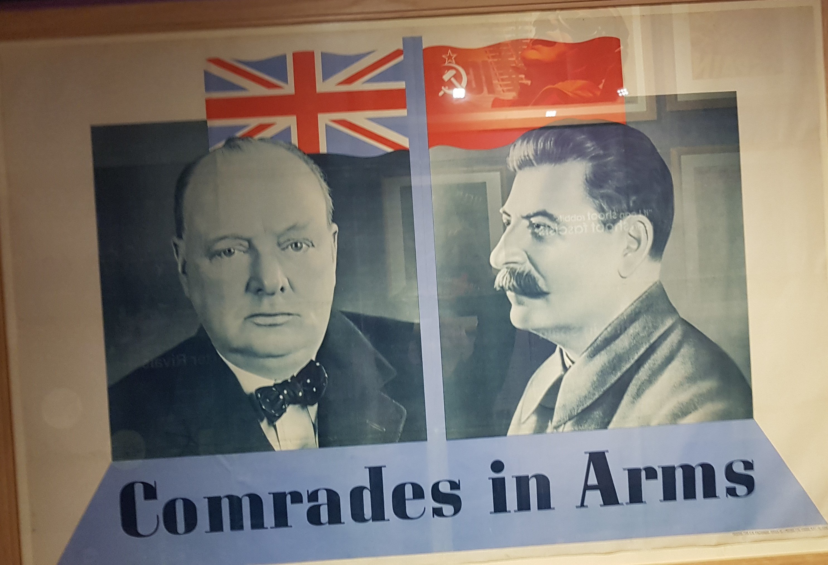
Invasion of Eastern Europe
Under Soviet General Zhukov, the Red Army began a series of winter counter-offensives to push the Germans back.
In July 1941 the nations of the United States, Great Britain, and the Soviet Union signed the Anglo-Soviet Agreement. The Agreement pledged the powers to assist one another against Germany.

Slide 66
The War in the Pacific
When the war broke out in 1939, the Japanese already controlled much of present day China.
It took a great amount of man power to control this area: of the 51 infantry divisions making up the Japanese Army, 38 of them were stationed in China.

Slide 68
The War in the Pacific
In September 1941, Japan signed the Tripartite Pact with Germany and Italy.
This allowed them the security to expand their empire further into East Asia.
Japan moved into British and French territories in Asia prompting the United States to cut of ties with Japan and implement embargos.
embargo - an official ban on trade or other commercial activity with a particular country

Slide 70
Attack on Pearl Harbor
On December 7th, 1941, “a day which will live in infamy” the Japanese attacked the U.S. naval base at Pearl Harbor.
It was ultimately successful as it crippled the US fleet while the Japanese sustained only minor losses.
One stroke of luck for the Americans was that their 3 aircraft carriers happened to be out on an exercise that morning and were not hit.
After the attack on Pearl Harbor, the United States entered the war.

Slide 74
The War in the Pacific
The day after the attack on Pearl Harbor, the Japanese destroyed the British air power at Hong Kong.
British and Canadian troops held out until December 25th, but eventually surrendered Hong Kong to Japan.
554 Canadians were killed in the battle, while 500 more were wounded.

Slide 78
The War in the Pacific
Doolittle Raid
In response to the Japanese attack on Pearl Harbor and its growing power in the Pacific, Col. Doolittle, with 16 bombers attacked Tokyo.
Forced the Japanese to put more emphasis on their navy and expansion of their Pacific perimeter.

Slide 80
The War in the Pacific
The Battle of Midway
The Battle of the Coral Sea was a victory for the Americans but crippled one aircraft carrier and sunk another – a devastating blow.
The Japanese wanted to quickly see an end to American power in the Pacific, the decisive battle would take place at Midway.
Americans had decoded Japanese transmissions and knew they were coming.
Midway was saved and 4 Japanese carriers were destroyed.
This was the turning point in the war in the Pacific.
Strong evidence that this war would be won by carriers and not destroyers as in previous conflicts.

Slide 84
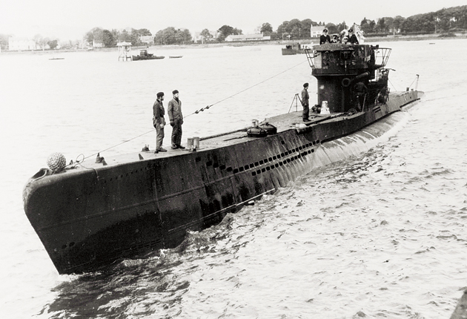
Opposing Strategies in the West
In the West, the Germans employed a strategy to cut off Britain from its Allies. This was done through bombing campaigns, but more importantly, U-boat attacks. They attacked in formations called wolfpacks.

Slide 85
Das Boot Doc video

Slide 86
U-boats sunk by Canadian Navy

Slide 87
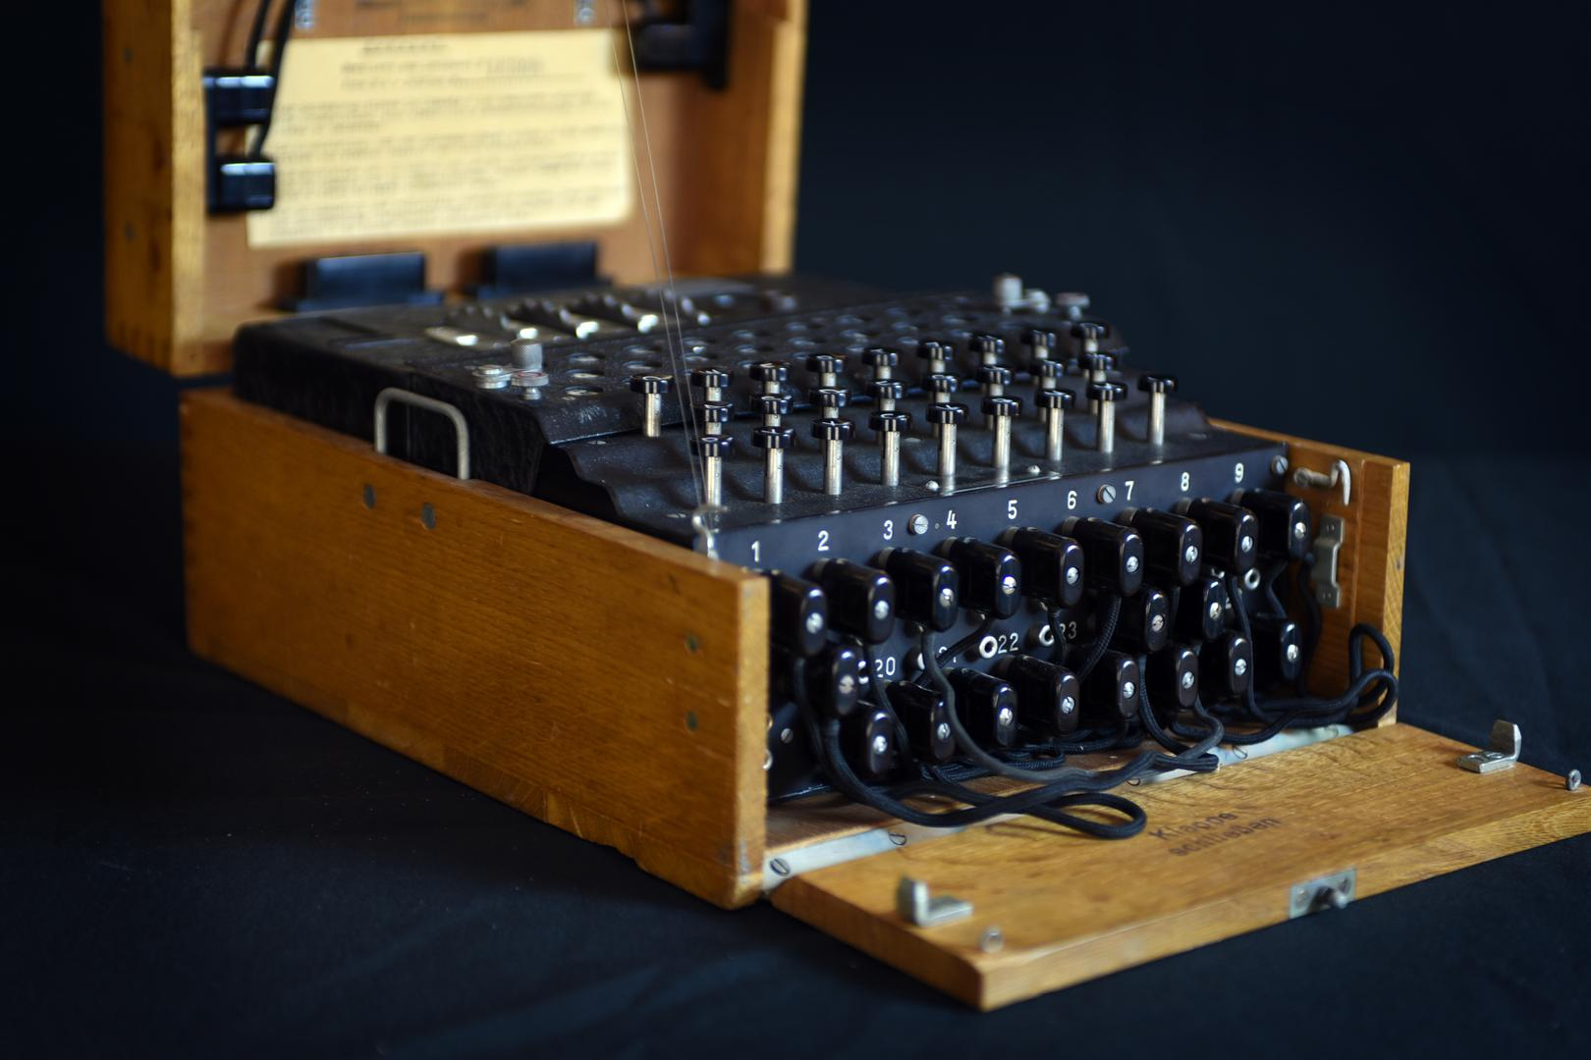
Enigma
The German U-boats strategy hinged upon their ability to communicate with one another. This was done through the enigma coding system.
http://enigmaco.de/enigma/enigma.html
Enigma Video

Slide 88
Opposing Strategies in the West
The Allies believed that they may be able to bomb Germany into submission.
Britain began with ‘targeted bombing’ of industrial areas.
There was some effectiveness, however, the loss rate for British bombers was 1 in 10.
Only 10% of the bombs dropped landed within 5 miles of the target.

Slide 89
Avro Lancaster

Slide 90
Boeing B-17 Flying Fortress

Slide 91
Opposing Strategies in the West
The British changed their strategy and began to use ‘carpet bombing’.
Carpet bombing – the bombing of a large area around target
Bombing of Dresden
Carpet bombing resulted in greater success, but questions were raised about the ethics of carpet bombing.
The German city of Dresden was one the most beautiful in Europe, had not previously been attacked during the war, and offered no military targets.
It was hit by 3,000 tons of bombs from British and US bombers.
Between 30,000-250,000 civilians were killed – mostly women and children

Slide 95
North Africa
The Axis (Italy, Germany, and Japan) knew that if they were able to control the Suez Canal in Egypt, it would deal a huge blow to the Allied war effort.
The Italian army moved East from Libya to attack British forces in Egypt.
The British quickly beat them back and began to push into Libya.

Slide 98
North Africa
The Italian effort to destroy Allied forces in North Africa were a disaster.
Sitskreig
Germany sent over 100,000 troops and one of their top generals, Erwin Rommel.
Rommel found great success in the African theatre (the ‘desert fox’)
African theatre was a tank tacticians dream

Slide 99
North Africa
In 1942, the Allies won control of the Mediterranean Sea and were able to pour more troops into Africa.
The turning point was at the Battle of El-Alamein where the British General Bernard Montgomery defeated Rommel’s forces and pushed them back.
The Axis was soon overwhelmed and surrounded.
Over 270,000 Axis troops were taken prisoner.

Slide 101
Stalingrad
The pivotal battle on the Eastern Front proved to be at the city of Stalingrad.
German troops were able to take much of the city after fierce street battles. The Soviet troops had their backs against the Volga River and were struggling to maintain their positions.
General Zhukov lead a large counterattack.
Hitler ordered his men not to retreat and to fight to the death.
After months of bitter fighting, the German troops eventually surrendered.
Stalingrad (2013) scene

Slide 104
The Soviet Steamroller
By the end of 1943, the Germans were in full retreat in the East.
The Soviets continued to pour in more troops from the East and Hitler had to now move men to Italy where the Allies had recently opened a second front.

Slide 105
Invasion of Italy
The Soviets were pressing the Allies to open up another front to aid them in the fight against Hitler.
In the Spring of 1943, the British and Canadians under General Montgomery and the Americans under General Patton landed on the Southern coast of Italy and began to make their way toward Rome.
At this time Mussolini’s dream of a fascist Roman Empire was dead and Italy was nothing more than a vassal state of its ally Germany.

Slide 108
Mussolini’s End
The Allies reached Rome in July and Mussolini was arrested.
The Italians were promised leniency if they supported the Allies in their war against Germany.

Slide 109
Mussolini rescued by German commandos.

Slide 111
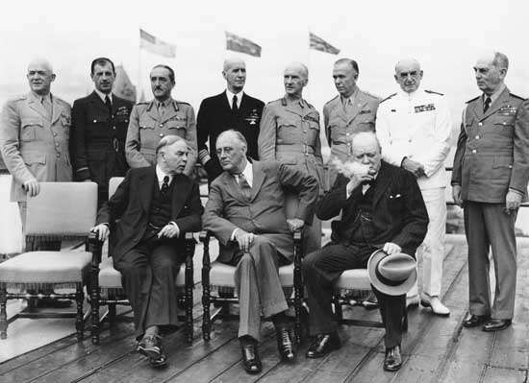
D-Day
Quebec Conference in August 1943
It was at this conference that the Allies formulated much of the coming invasion of France

Slide 112
D-Day
‘D’ literally stands for day. Designation given to important military action.
Hitler knew the Allies would eventually invade France. He just didn’t know where.
He had constructed a massive Atlantic defensive barrier.
Command of France’s defense was given to Generals Rundstedt and Rommel

Slide 117
D-Day
Allied invasion of France was led by American General Eisenhower and was called Operation Overlord.
On June 6, 1944, 83,000 British and Canadian troops and 73,000 Americans landed on the beaches of Normandy.
Despite heavy losses, the landings were a success and the Allies were able to hold a beachhead on the French coast.
Part of the success of the Allied invasion was because the German commanders were unable to get Hitler’s permission to send in the reserve panzer units
Rommel’s car was harassed by Allied planes and crashed. His injuries prevented him from playing a more active role in defense

Slide 123
D-Day
German morale took another hit just after the D-Day landings as there was an attempt on Hitler’s life.
A group of leading right-wing politicians and military personnel lead by Colonel Graf Claus von Stauffenberg plotted to have Hitler killed in his Wolf‘s Lair hideout.
The attempt failed and over 200 conspirators were put to death. Many others attempted suicide, including General Erwin Rommel.
https://www.britannica.com/event/July-Plot/media/308021/193829

Slide 125
Liberation of Europe
Allied troops continued to pour into France and began to push the Germans back.
The Allies were surprised at how quickly the Germans collapsed and they were able drive the Germans 350 miles back in only a matter of weeks.
Part of this success was due to Hitler’s ‘No withdrawal’ orders.
American troops moved West to Paris, while British and Canadian troops moved north to Belgium.

Slide 127
Liberation of Europe
The Allies also employed a large scale bombing campaign aimed at Germany’s industrial hubs. This along with Germany’s loss of Romania’s oil fields to the Soviets crippled the Luftwaffe.
Whereas in 1943, the Allies would lose 10% of its bombers on each sortie, the figure now dropped to 3%.

Slide 128
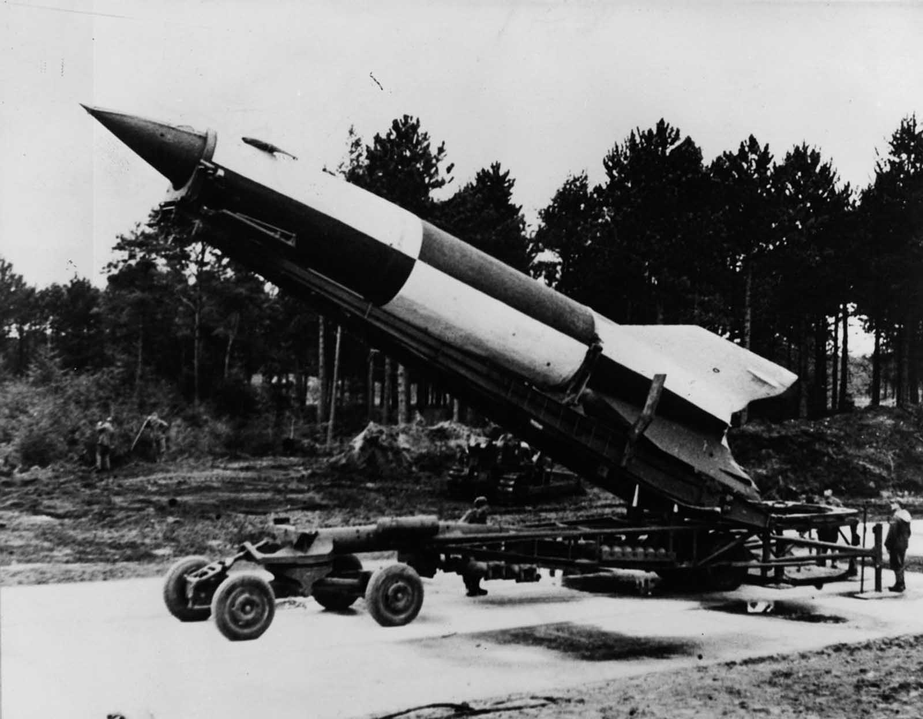
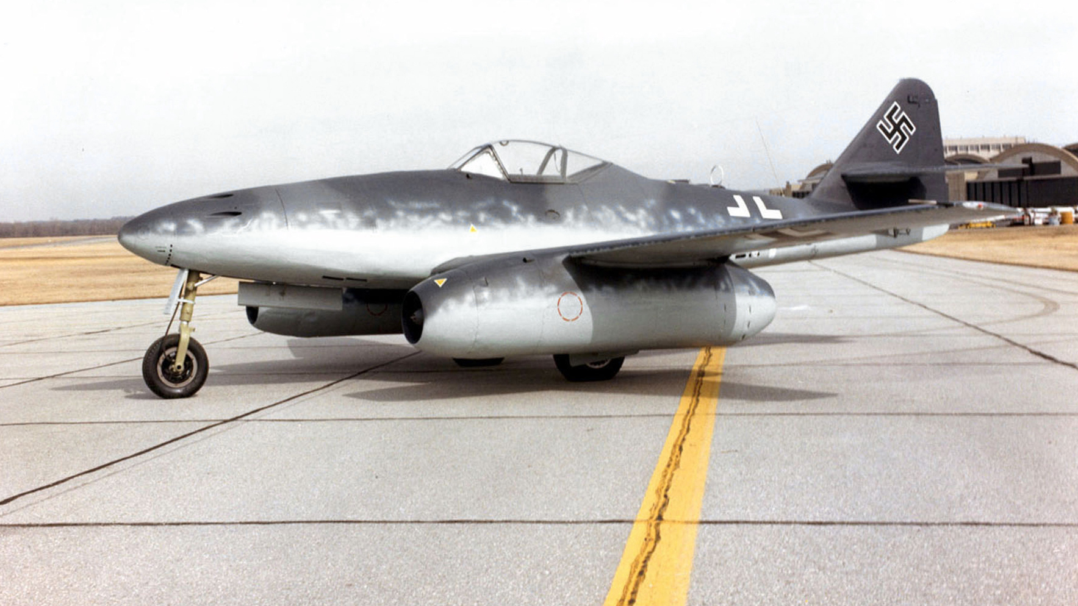
Liberation of Europe
Much of the new technology being pushed by Hitler came too late to affect the outcome of the war.
V2 Rocket
Messerschmitt Me 262

Slide 129
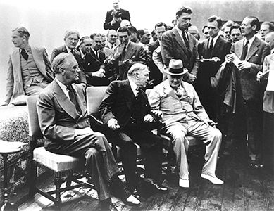
Liberation of Europe
Second Quebec Conference – September 1944
With the fall of Mussolini in Italy, it was clear that the fall of the Axis powers in Europe was inevitable
The conference decided that following the war, Germany would be split into American, British, and Soviet spheres of influence.

Slide 130
Operation Market Garden
September 1944 Operation Market Garden was launched. It’s objective was to liberate the Dutch city of Arnhem.
Allies wanted to use Arnhem as a hub for their invasion of Germany.
The Allied attack failed, slowing the Allied advance.

Slide 134
Liberation of the Netherlands
The Allies decided then to free the Belgian port city of Antwerp. This fell to the First Canadian Army.
The first Canadian Army won Antwerp and moved on to liberate the Scheldt.
The First Canadian Army was now reinforced by various Allied groups including the 1st Canadian Corps from the Italian campaign. For the first time in history, two Canadian army corps fought together. With an international strength of almost 500,000 men, the First Canadian became the largest army ever commanded by a Canadian officer.

Slide 135
Lieutenant- General Guy Simonds – Commander of the 1st Canadian Infantry Division

Slide 136
General Henry Crerar – Canada’s leading field commander during the war. An able commander though General Montgomery believed Simonds the superior commander amongst the Canadians.

Slide 141
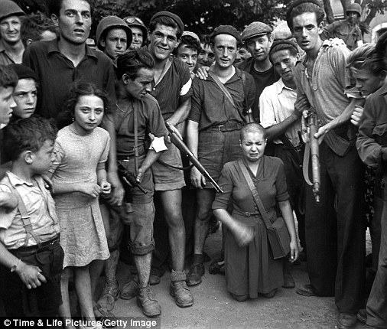
Ethical Dimension
When the Allies liberated Europe, locals rounded up those that had conspired with the Germans (mostly women). These woman would have their heads shaved and would undergo physical and mental abuse, some were killed. Was it the role of the Allied liberators to intervene and stop this abuse?

Slide 142
Battle of the Bulge
In late 1944, Hitler still believed he could push the Allies back.
Employed “total mobilization” – all able bodied men between the ages of 16-60 were conscripted.
The Germans lead a strong counter-attack hoping to cut off the British and Canadians in the West by cutting through the American line.
They pushed through about 65 miles before they were halted and eventually defeated.

Slide 146
The German Collapse
General Zhukov’s Red Army troops captured Warsaw in January 1945.
It was now a race between the Americans and the Soviets to capture Berlin.
It was now the dominant desire of the German people that the American and British armies control as much of Germany as possible before the Soviets moved West.

Slide 148
The German Collapse
Hitler had issued an order declaring that “the battle should be conducted without consideration for our own population.”
Albert Speer, protested against this drastic order, Hitler retorted: “If the war is lost, the German nation will also perish. So there is no need to consider what the people require for continued existence.”
Speer went behind Hitler’s back and persuaded many military commanders to ignore the order, and the Allies faced little resistance moving Eastward.

Slide 149
Hitler and Speer

Slide 150
The German Collapse
In April 1944 Soviet and American troops had surrounded Berlin.
Hitler married his mistress, Eva Braun, on April 29th and on the 30th they both committed suicide in the ruins of the Chancellery.
Soviet troops were less than a mile from his bunker.

Slide 151
The Fuhrerbunker

Slide 152
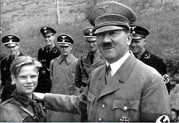
Historical Perspectives
Young boys were used to fight in both the German and Soviet armies. When these young fighters were taken prisoner, did the Allies have a responsibility to treat these youth differently?

Slide 153
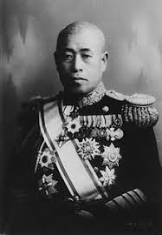
The War in the Pacific
The Japanese had seen great early success against the Americans early in the war with victories at Pearl Harbor and the Battle of the Coral sea.
Isoroku Yamamoto

Slide 155
The Kido Butai

Slide 157
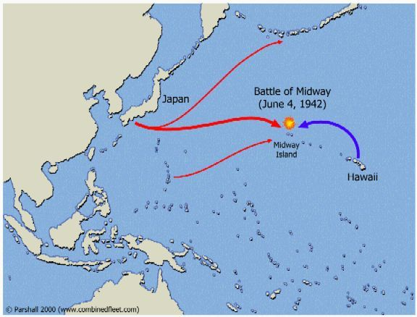
War in the Pacific
One of the great turning points was the American victory over the Japanese at the Battle of Midway in June 1942.

Slide 158
USS Yorktown hit by torpedo

Slide 159
Japanese Aircraft carrier hit

Slide 160
Artist’s impression of the Battle of Midway

Slide 161
Guadalcanal
US Marines landed on the island of Guadalcanal to secure the Japanese airbase there.
In the night the US Naval Fleet was defeated and the Marines were stranded.
Over 6 months of fighting on the island, the Americans eventually forced the Japanese to retreat.

Slide 163
John Basilone – Medal of Honor

Slide 164
USS Enterprise played a leading role in the victory at Guadalcanal and the Solomon Islands

Slide 165
War in the Pacific
The war is the Pacific was characterized by the Americans island hopping toward Japan.
British and American forced also moved through Burma, Borneo and China.

Slide 167
Torpedoed Yamahaze seen through the periscope of the Nautilus

Slide 168
Iwo Jima
Iwo Jima is a 10 sq mile volcanic island within bomber range of Tokyo.
It has been described as the most heavily fortified area in the history of warfare.
Heaviest fighting was around Hill 382, commonly called the ‘meatgrinder’.
Americans raised their flag over Mount Suribachi on February 23, 1945.

Slide 172
The War in the Pacific
The island of Okinawa was seen and the last stepping stone to Japan. It’s invasion was the largest amphibious operation launched during the Pacific War.
The Americans were hit by 355 kamikaze air raids as well as the greatest battleship of the war, the Yamato, which was sent on a one way mission to destroy the American Naval Fleet.
On April 7th, the Yamato was sunk and Okinawa was soon taken.

Slide 175
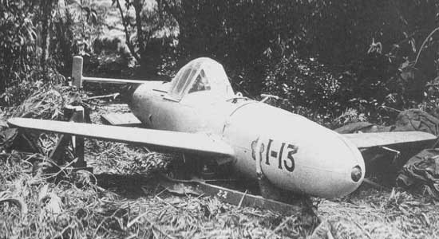
Ohka – rocket powered human guided kamikaze attack aircraft
It would hit its target at up to 600 mph making
them nearly impossible to stop
Baka – Japanese for ‘fool’

Slide 176
Nuclear Question
American General MacArthur was put in charge of the invasion of mainland Japan.
Americans bombed Japan extensively making it look like the precursor to an invasion.
In fact President Truman had authorized the use of a new weapon – the Atomic Bomb.

Slide 177
Trinity Test – First detonation of a nuclear device. Detonated in July 1945 as part of the Manhattan Project. Explosive equivalent of 15,000 tons of TNT.

Slide 178
Hiroshima and Nagasaki
On August 6, 1945 a specially equipped B-29 dropped an atomic bomb on Hiroshima, killing over 100,000 people.
On August 8th, the USSR declared war on Japan.
On August 9th a second bomb was dropped on Nagasaki killing 40,000 people.
August 10th the Japanese government surrendered to the Allies.

Slide 183
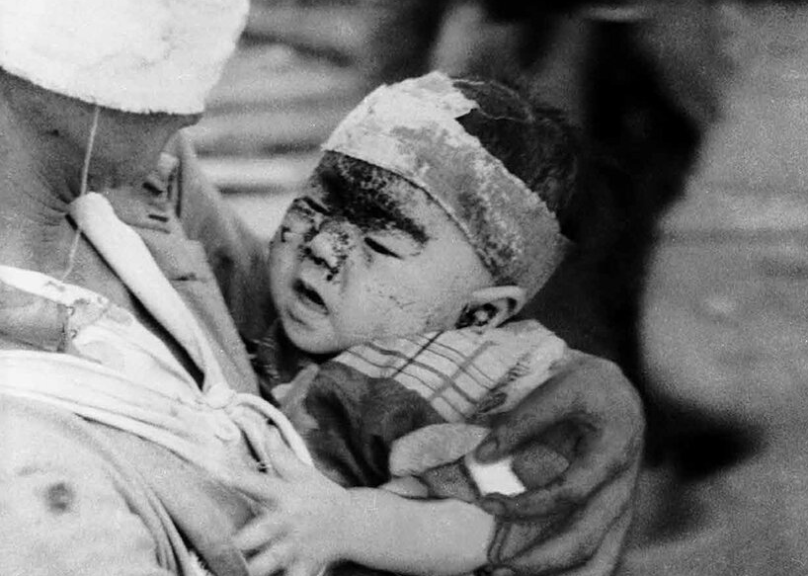
Ethical Dimension
Can the American’s decision to drop the bombs on Japan still be justified today?

Slide 184
General MacArthur receives the surrender from the Japanese aboard the USS Missouri

Slide 185
Works Cited:
https://www.warmuseum.ca
https://www.britannica.com
https://www.thecanadianencyclopedia.ca
https://www.nationalww2museum.org
Ordinary Men By: Christopher Browning

