Slide 1
World War Zero
Russo-Japanese War

Slide 2
Beginnings
The Russian Empire was a significant world power led by the autocratic Tsar Nicholas II.
The Japanese were industrializing quickly and wanted to build an empire of their own.
Russia wanted a warm water port for their growing navy.
Leased Port Arthur from the Chinese.
Wanted to expand in Korea.
Autocratic - relating to a ruler who has absolute power.

Slide 3
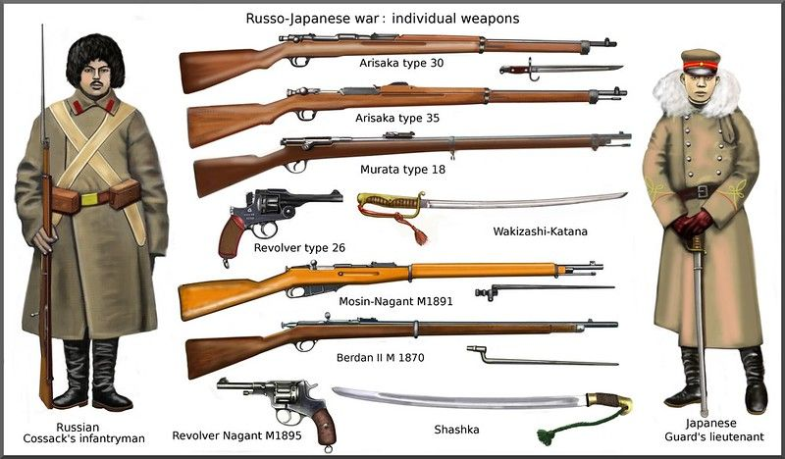

Slide 4
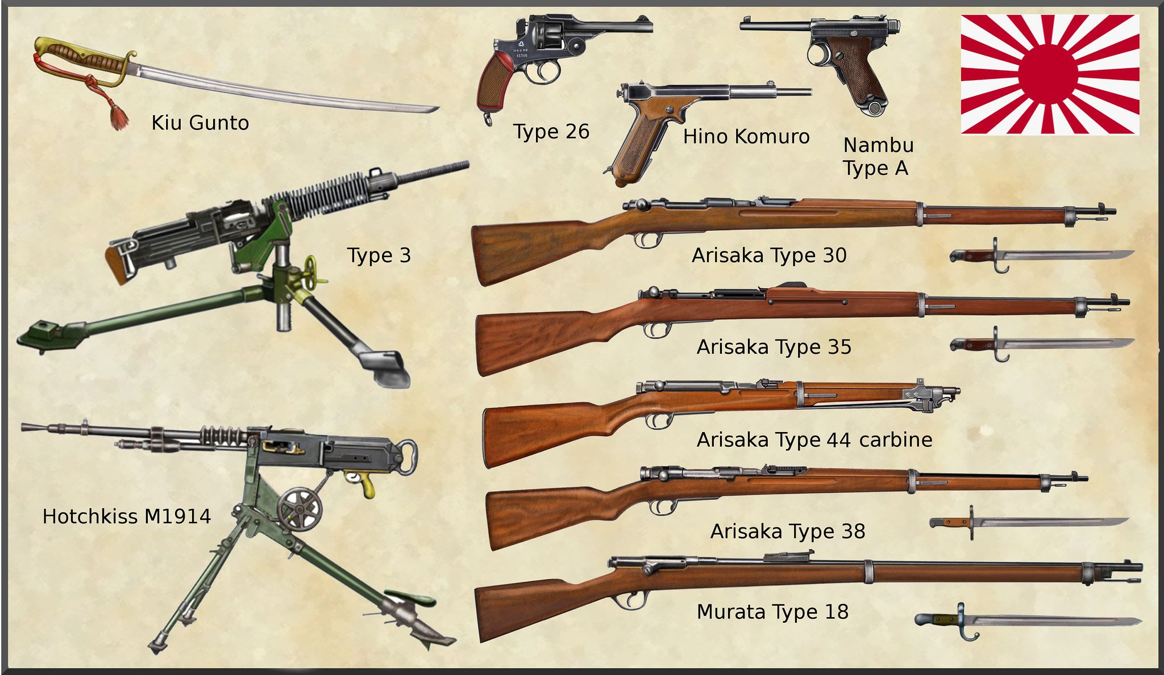

Slide 5
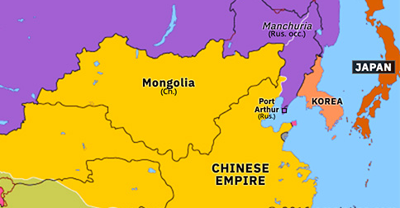

Slide 6
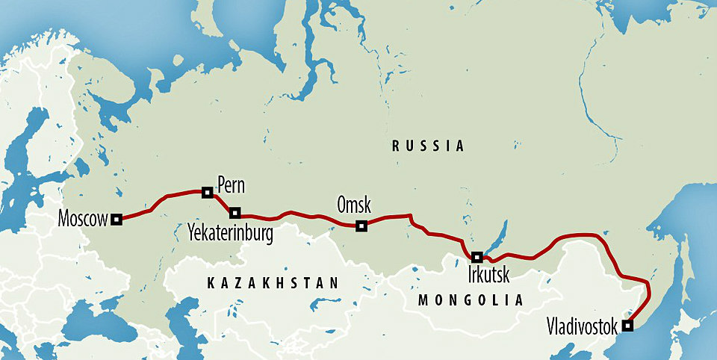

Slide 7
Outbreak of the War
Japan declared war on the day it attacked Port Arthur but news didn’t reach St. Petersburg until the next day.
By the end of 1904 the Japanese had sunk every ship in Russia’s Pacific fleet.
Early in 1905 Port Arthur surrendered.

Slide 8
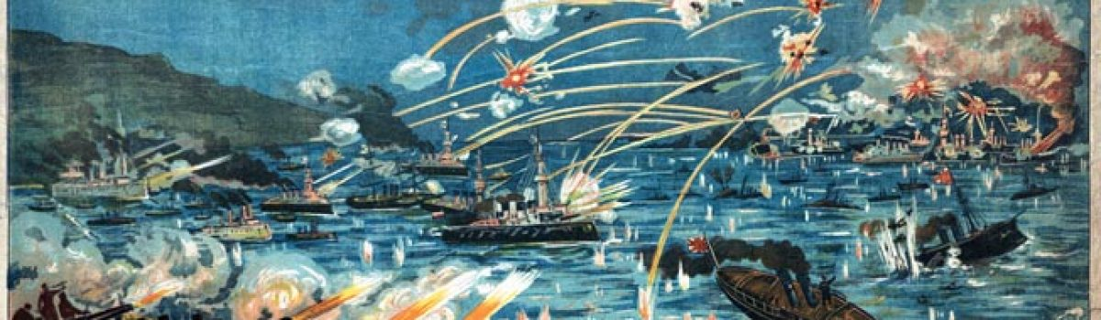

Slide 9
Battle of Mukden
The Japanese pushed into the Korean peninsula and drove back the Russians.
The largest battle of the war was the Battle of Mukden where a superior Russian force was once again defeated.

Slide 10
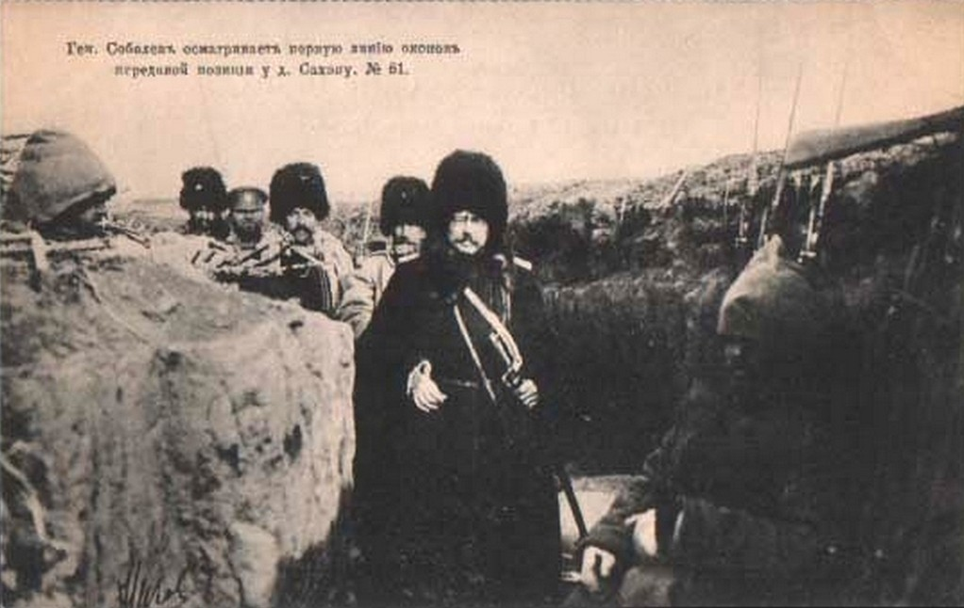

Slide 11
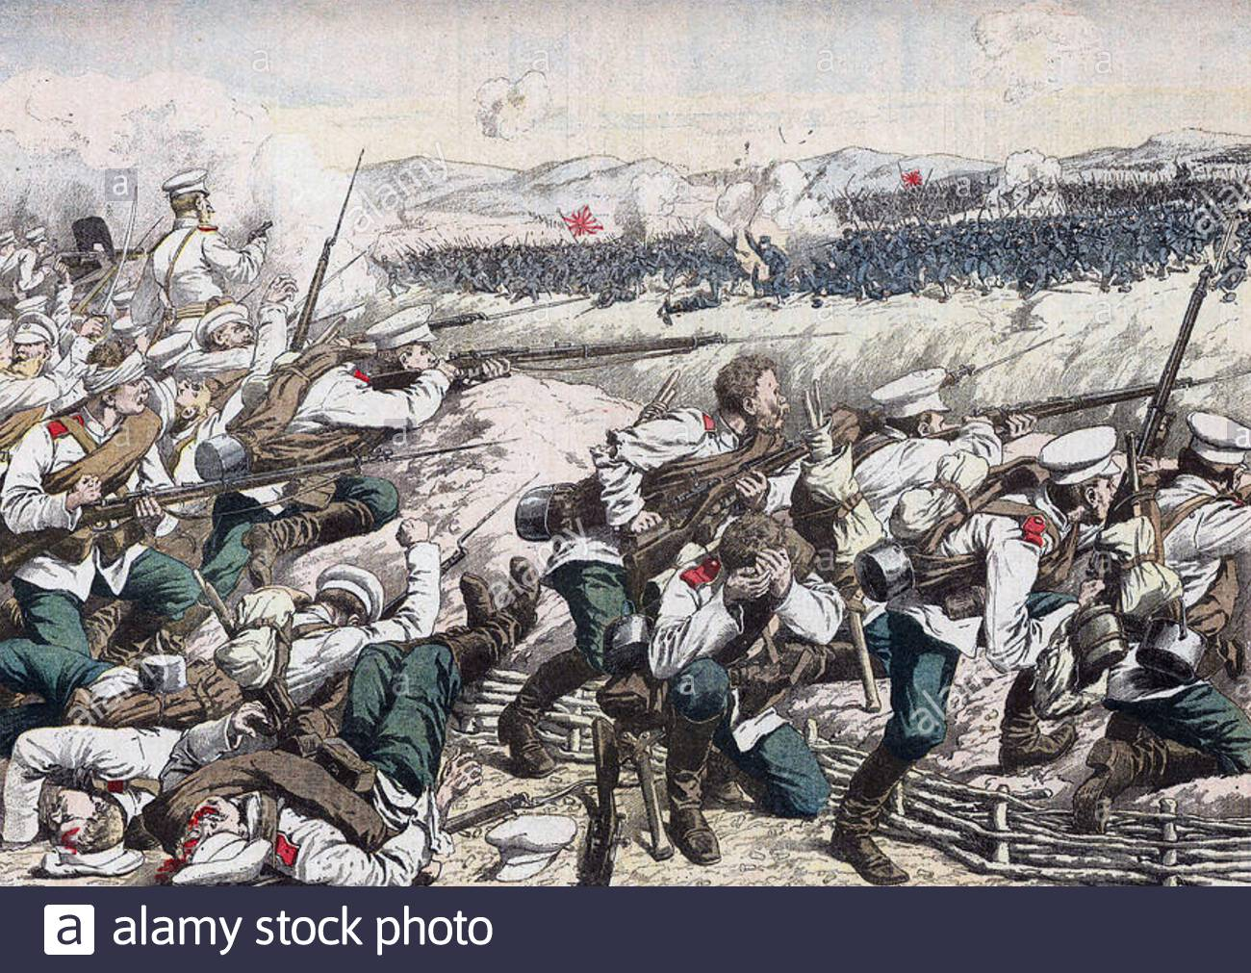

Slide 12
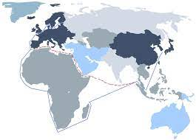
The
Baltic
Fleet

Slide 13
Battle of Tsushima Straits
The Baltic Fleet finally arrived after sailing nearly 20,000 nautical miles.
The sailed at night through the Sea of Japan but were detected.
The Japanese navy sunk eight Russian battleships and the Russians were forced to sue for peace.

Slide 14
Treaty of Portsmouth
Japan had won the war but was broke which weakened their negotiating position.
Russia gave up control of Port Arthur and the Korean peninsula to the Japanese

Slide 15
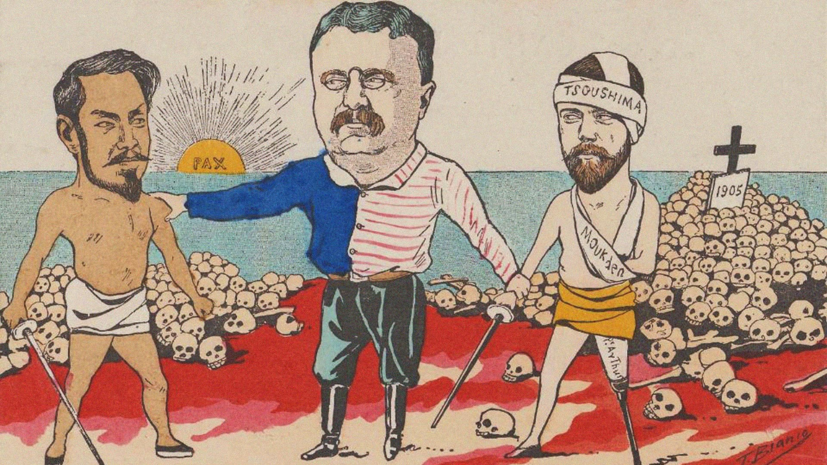

Slide 16
Aftermath
The defeat was humiliating for Russia and Tsar Nicholas II.
The empire was demoralized and the people were restless.
The war shifted the balance of power in the world as it was the first time that an Asian nation had defeated a European on in military combat.

Slide 17
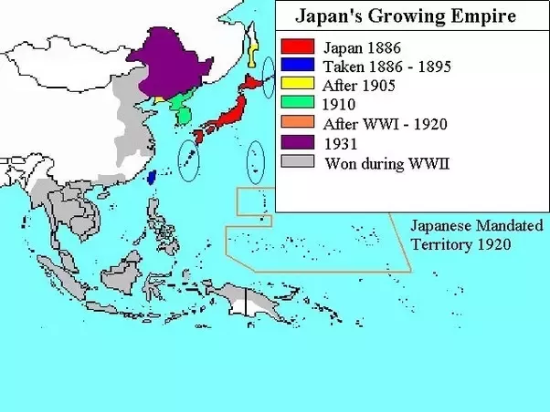

Slide 18
