Slide 1
Russian Civil War

Slide 2
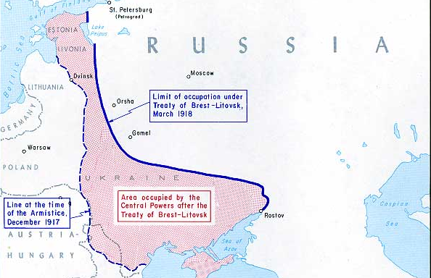
Treaty of Brest-Litovsk
Ended the war between Germany and Russia.
Caused division between the Bolsheviks and the leftist parties (Mensheviks, Social Revolutionaries)

Slide 3
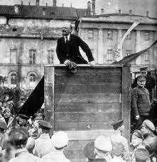
Red Terror
Civil war broke out between the Bolsheviks (Reds) and nationalist movements throughout Russia (Whites).
Pressed from all sides, the Bolsheviks began to use the secret police (Cheka) to maintain order. This included the murder or incarceration of opponents.

Slide 4
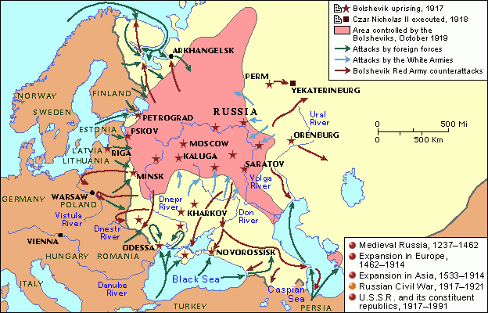

Slide 5
Death of the Romanov’s

Slide 8
Death of the Romanov’s
Why were the Bolsheviks afraid of the royal family falling into the hands of the Whites?

Slide 9
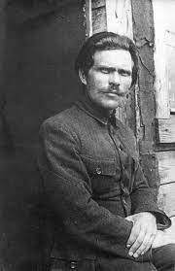
Nestor Makhno
Various nationalist groups and rebels took control of parts of Russia.
Nestor Mackhno was one of the most notorious rebel leaders.

Slide 10
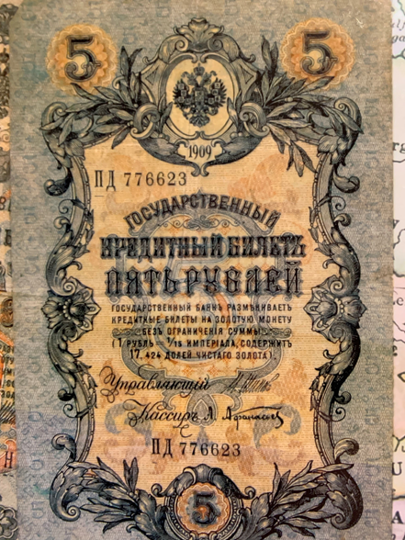

Slide 11
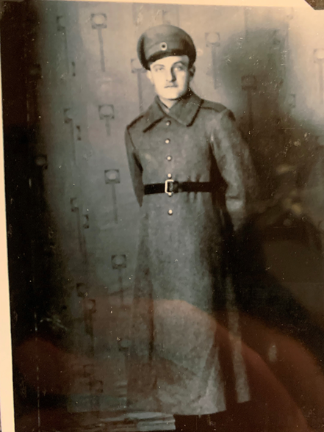

Slide 12
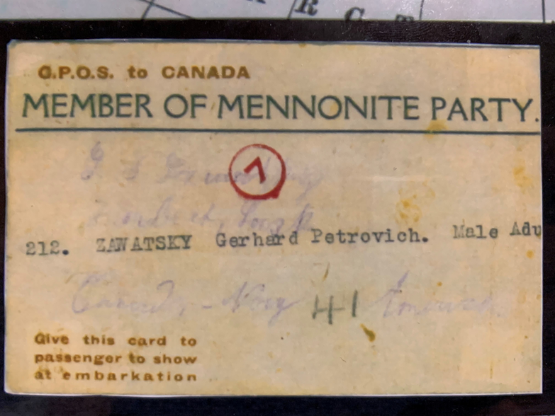

Slide 13
Russian Civil War
By the end of 1920, the Red Army under Trotsky, had successfully defended the Revolution from the White armies.
Over 10 million people died in the conflict. Most were civilians.
Thousands of perceived opponents were murdered by the Cheka.
Disease, particularly typhus, was rampant as was malnutrition due to grain confiscations.

Slide 14
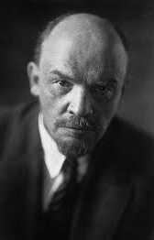
Russian Civil War
Russia became known as the Union of Soviet Socialist Republics.
In fact the soviets held little power. All power belonged to the Communist Party, and the party itself was led by the Central Committee, which was dominated by Lenin.

Slide 15
Russian Civil War
Do conditions ever exist that demand order and security take precedence over individual rights?
Conscription?
Pandemic?

