Slide 1
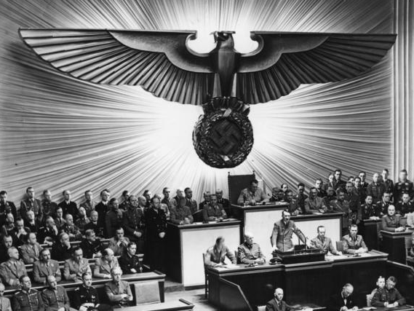
TOTALITARIANISM in Interwar Europe
German Federal Archive (cc 3.0)

Slide 2
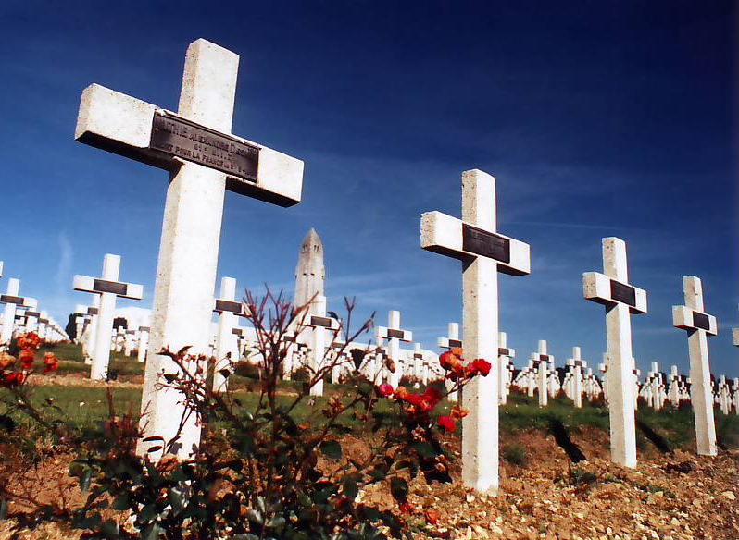
WWI IS OVER
Photo by Ketounette (cc 3.0)

Slide 3
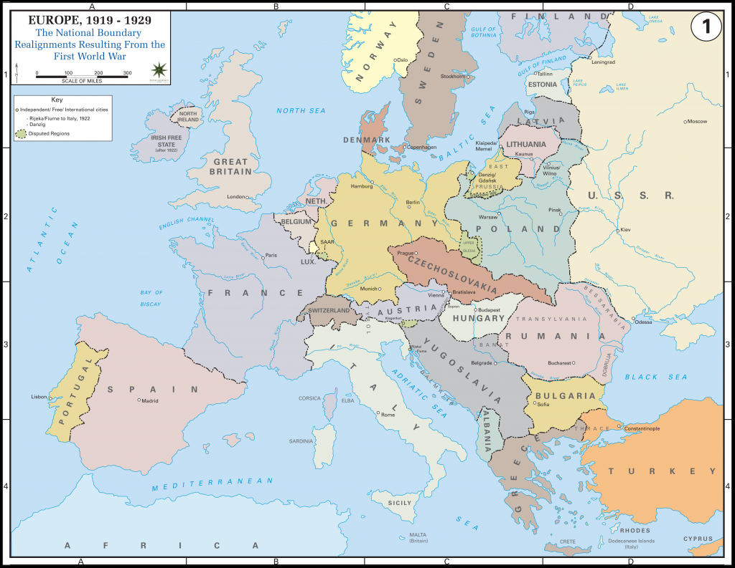
EUROPE IS NOW safe...

Slide 4
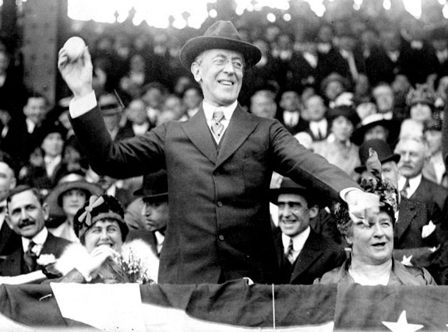
FOR DEMOCRACY

Slide 5
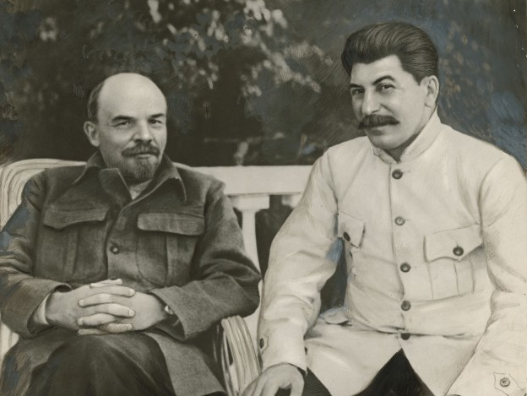
Just Kidding

Slide 6
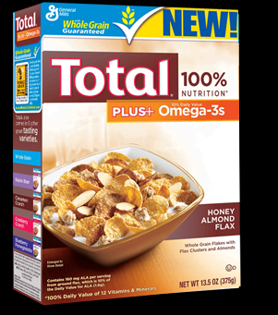
Totalitarianism
Authoritarian & dictatorial governments that control all aspects of public and private life.
State > Individual

Slide 7
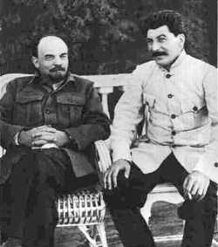
What lead to these totalitarian regimes?
(Russia/Soviet Union) 1917
Vladimir Lenin
Joseph Stalin

Slide 8
STRIKE ONE

Slide 9
Dissatisfaction

Slide 10
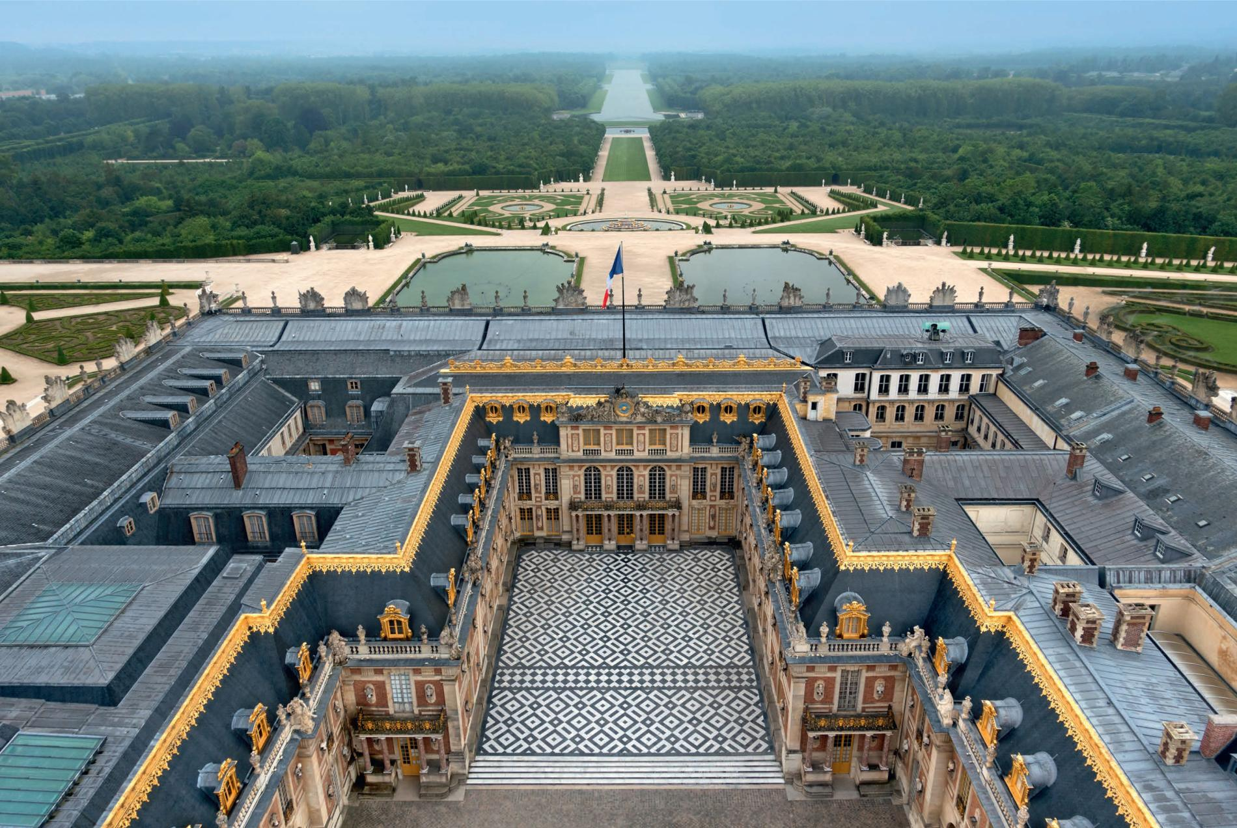
Treaty of Versailles
REVIEW
Photo by Mkonikkara (cc 3.0)

Slide 11
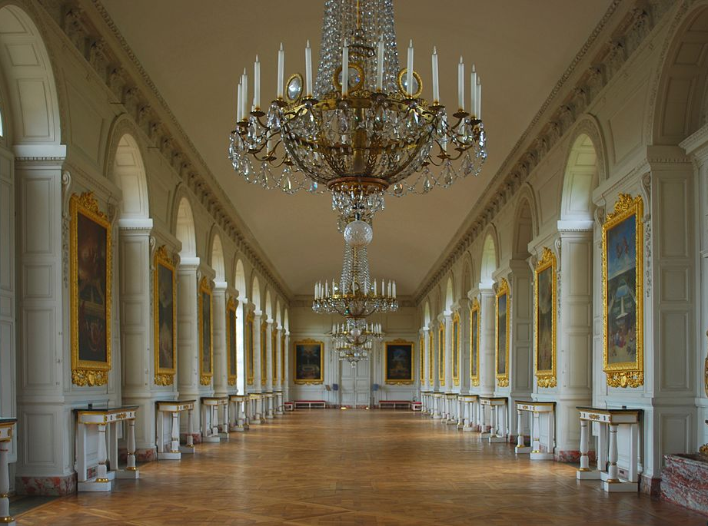
Treaty of Trianon
The OTHER Versailles Treaty
Photo by Mkonikkara (cc 3.0)

Slide 12
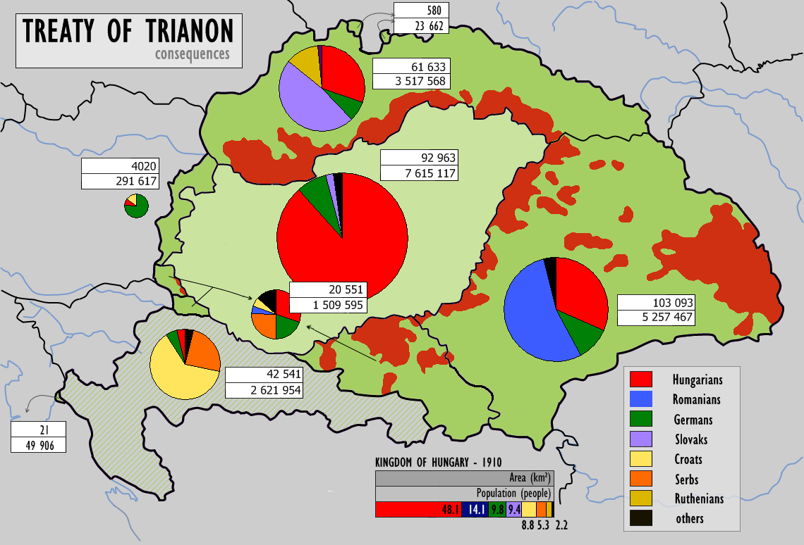
Map by CoolKoon (cc 3.0)

Slide 13
An explanation of the Treaty of Trianon from a Hungarian perspective

Slide 14
STRIKE TWO

Slide 15
Depression

Slide 16
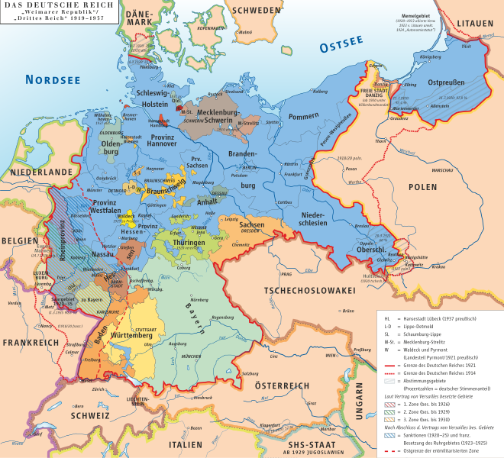
The Weimar Republic
1919-1933
Germany briefly experimented with liberal democracy.
ECONOMIC PROBLEMS
Map by kgberger (cc 2.5)

Slide 17
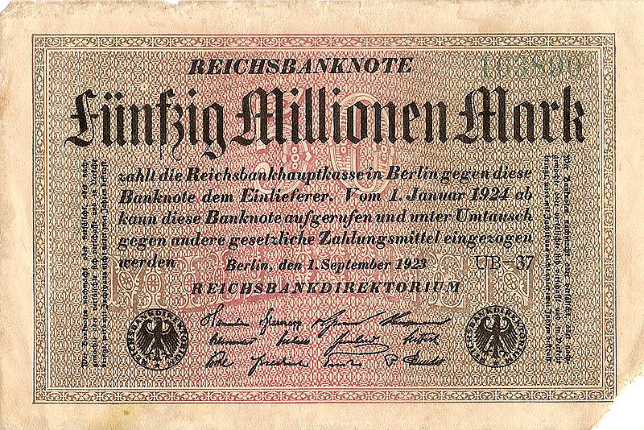
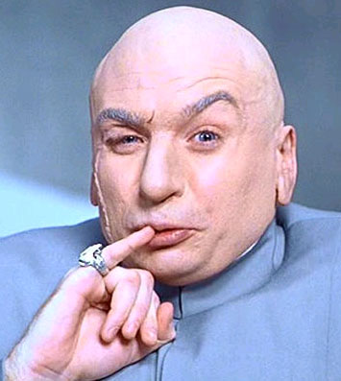
HYPERINFLATION

Slide 18
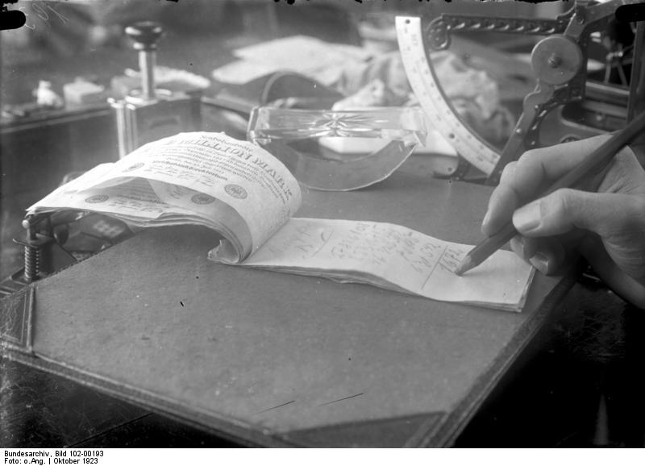
A Million German Marks = NOTEPAPER
German Federal Archives (cc 3.0)

Slide 19
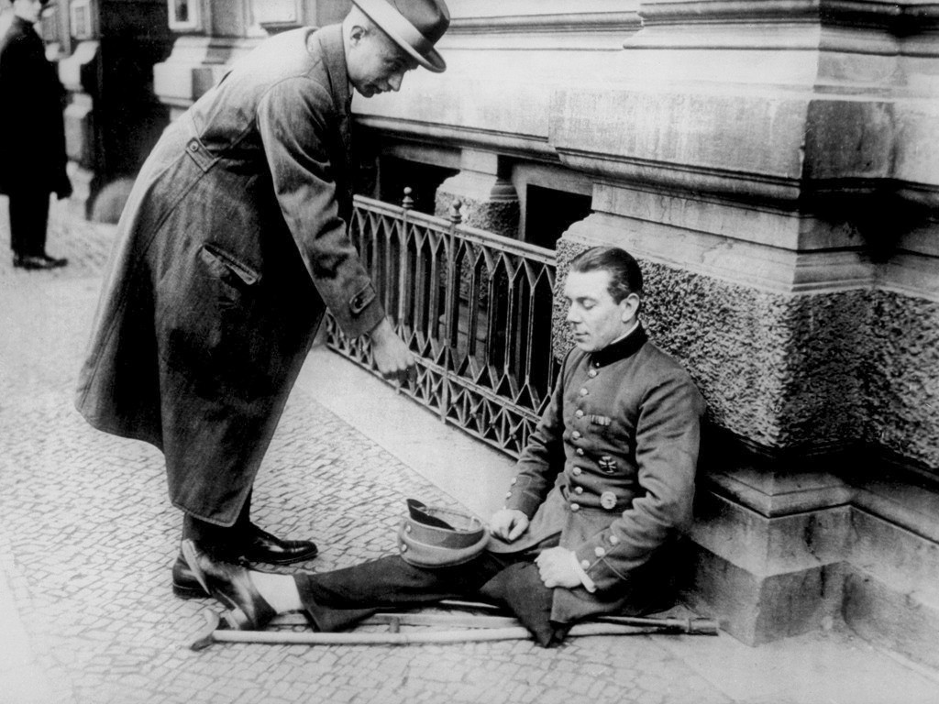
German Federal Archives (cc 3.0)

Slide 20
STRIKE 3

Slide 21
Desperation

Slide 22
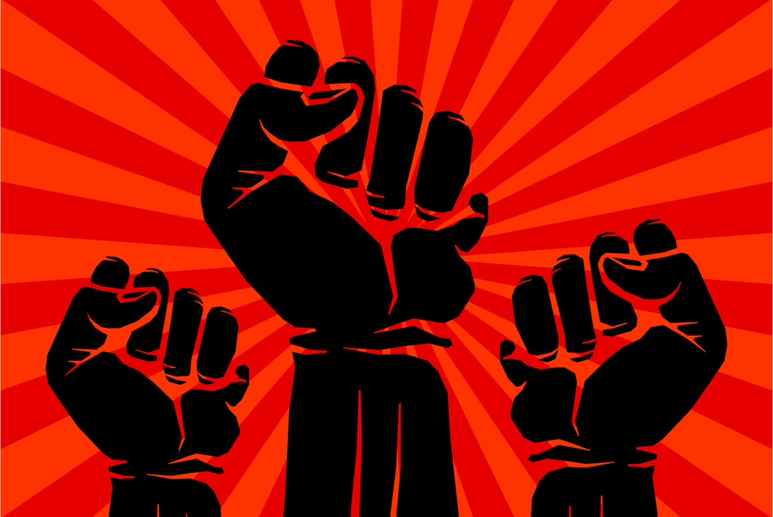
Scapegoat #1
Communists
In Germany and Italy
Fear of a Civil War similar to Russia
Fascists/Nazis need to take control to protect
the people from communism

Slide 23
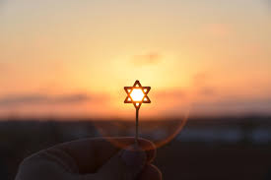
Scapegoat #2
Jews
In Germany
Historic racism
Blamed for surrending to the Allies in WW1
Jew=Communist

Slide 24
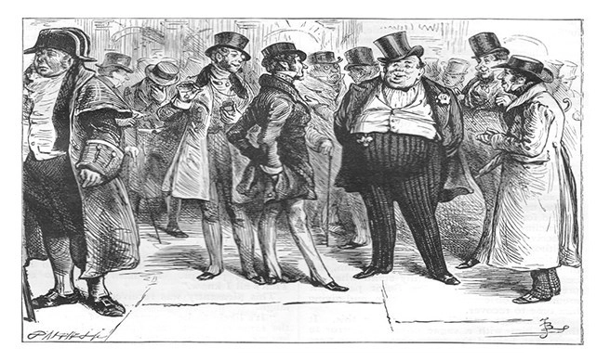
Scapegoat #3
Bourgeoisie/Kulak
In Russia
The wealthy had created a system of
oppression that needed to end
Communist gov’t would redistribute wealth

Slide 26
Democracy is OUT!
Photo by Keith Allison (cc 2.0)

Slide 27
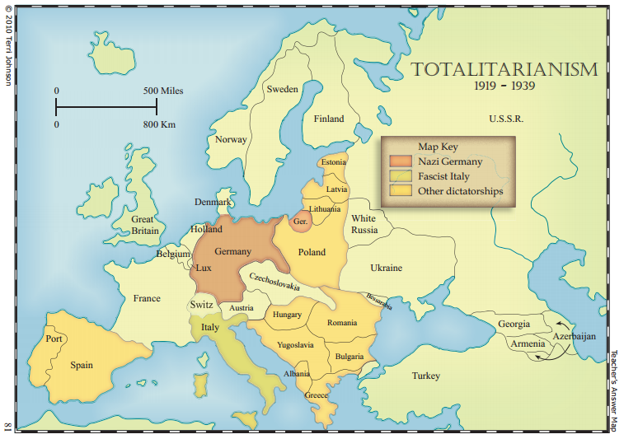
SOURCE: http://www.knowledgequestmaps.com Used With Permission

Slide 28
Totalitarian Regimes
“Left Wing”
Soviet Union
Communism/ Bolshevism/ Leninism
Lenin/Stalin
“Right Wing”
Germany | Italy
National Socialism (Nazism) | Fascism
Hitler | Mussolini

Slide 29
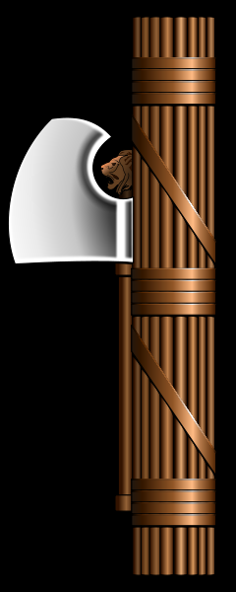
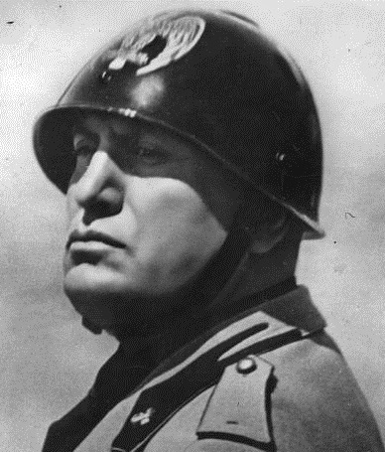
Fascism
(Italy)
RADICAL AUTHORITARIAN NATIONALISM
Benito Mussolini
Il Duce

Slide 30
Statue of Romulus and Remus in Rome, GA

Slide 31
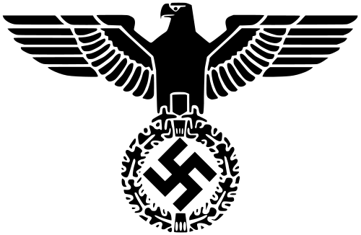
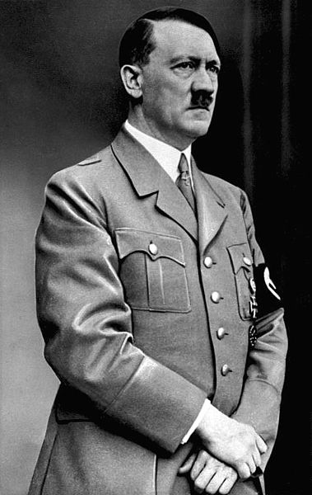
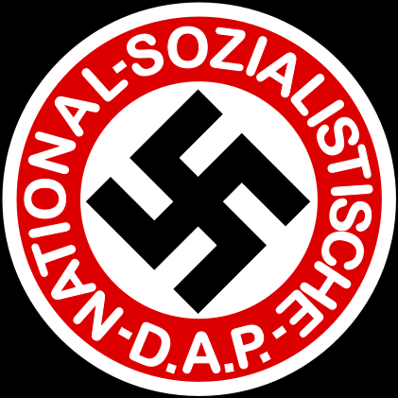
Nazi Party
(Germany)
1933
Adolf Hitler
der Fürher
National Socialist
German Workers Party

Slide 32
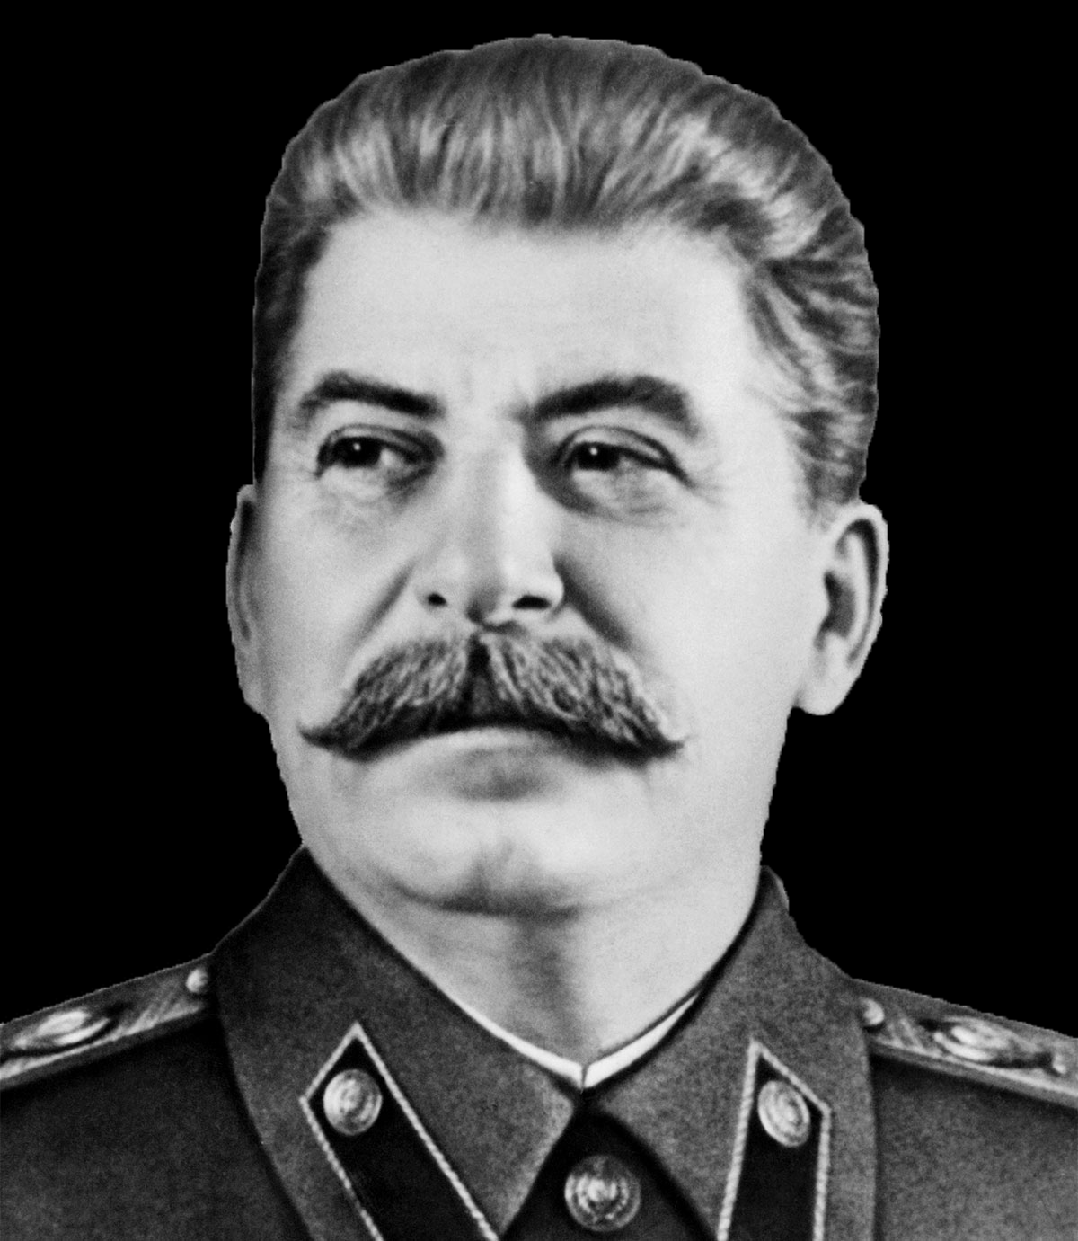
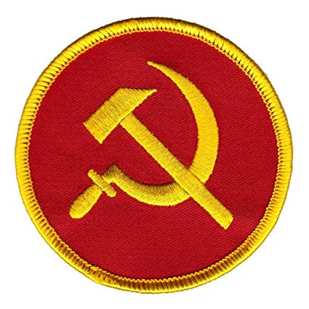
Communist Party
(Russia)
1921
Joseph Stalin
Man of Steel
National Socialist
German Workers Party

Slide 33
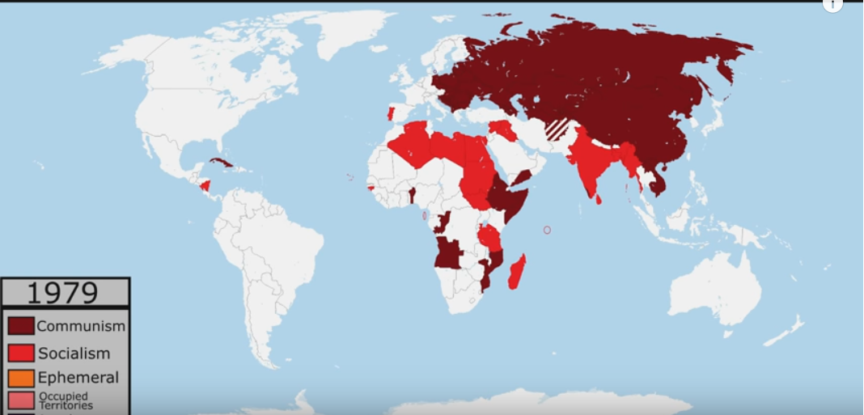
(Russia)
1921
Joseph Stalin
Man of Steel
National Socialist
German Workers Party

Slide 34
Fascism and Communism Common Traits
 |  | Fascism | Communism
1. |  | YES | YES
2. |  | YES | YES
3. |  | YES | YES
4. |  | YES | YES
5. |  | YES? | YES?
Opposition to Liberal Democracy
Unity through Hatred (common enemy)
Government by a Party Elite
The Cult of the Leader
Totalitarianism

Slide 35
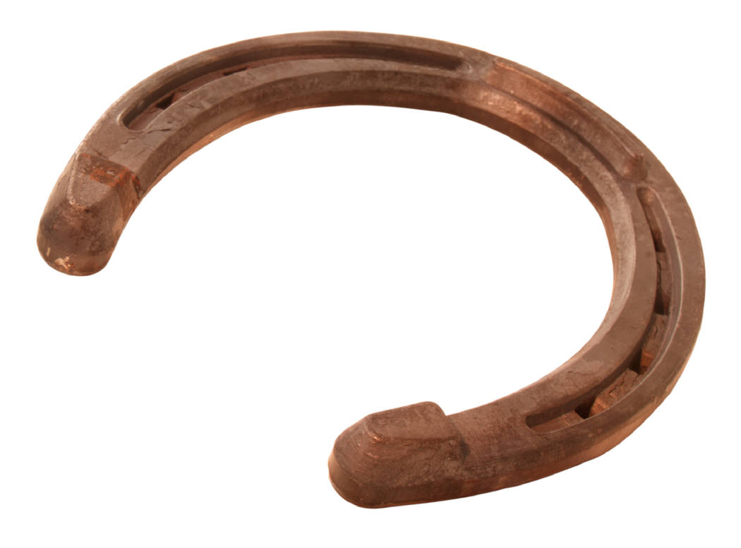
The Problem of the Left/Right Dichotomy
Liberals (CAN)
Conservatives (CAN)
Democrats (US)
Republicans (US)
“MODERATE GOVERNMENTS”
Fascists
Nazis
Communists
“FAR RIGHT”
“FAR LEFT”

