Slide 1
Red River Resistance
History 30

Slide 2
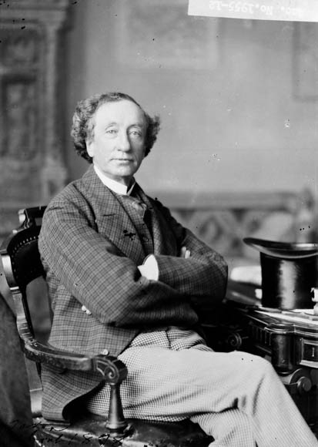
Macdonald as Prime Minister
In the newly created Dominion of Canada, John A Macdonald is made its Prime Minister
Macdonald has a dream of a country that will run from “sea to sea”, to achieve this he will have to unite the West!

Slide 3
Rupert’s Land
In order for Macdonald to expand West, the Canadian purchased Rupert’s Land from the HBC in 1869
They then appointed an English speaking governor, William MacDougall to be in charge of the newly “acquired” land
…but they forget to consult the people already living on it first

Slide 4
Red River Settlement (1812-1845)

Slide 5
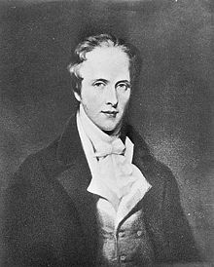
Early Beginnings…
The Red River Settlement had been established by Thomas Selkirk (as the Selkirk Settlement) for poor Scottish immigrants.
Selkirk bought up a 1/3 share in the Hudson Bay Company, and was therefore given 300,000 sq km.
This made him the largest private land owner in the world

Slide 6
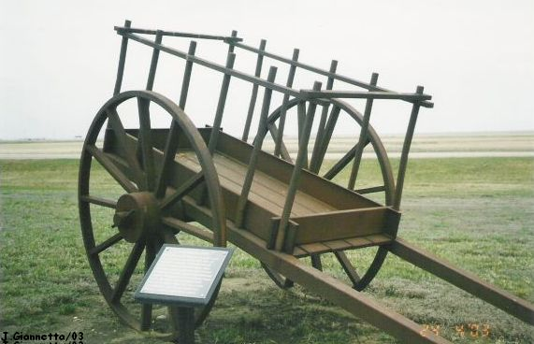

Slide 7
Early Beginnings (cont’d)
Selkirk was smart enough to sign treaties with the Indigenous peoples in the area, but he did not take the Métis into account.
Almost immediately, the new Scottish settlers came into conflict with the Métis in the area

Slide 8
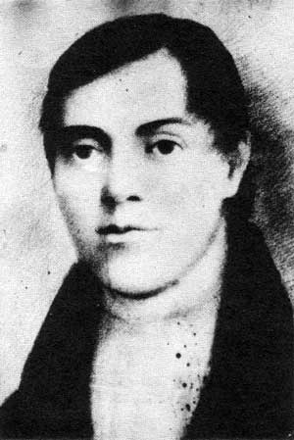
Cuthbert Grant
The Métis were led by Cuthbert Grant. Cuthbert Grant is commonly considered the first leader of the Métis.
They were upset with the Scottish taking over their land, then not knowing what to do with it

Slide 9
Conflict!
The Métis wanted the settlers to leave. They felt they were being pushed further west by white settlers (which was absolutely true).
They also wanted Métis independence.

Slide 10
REVIEW: Metis
The marriage between a white European (initially French, sometimes Scottish) and an Aboriginal woman
This resulted in the Métis people, who unfortunately faced rejection from both groups.

Slide 11
A Métis Nation!
Métis began (for the first time) to see themselves as a new, unique nation; no one would help or speak for them but themselves
The Métis sent letters to the settlers and to Prime Minister John A. Macdonald, but they were ignored.
They were trying to voice their concerns the right way, but their concerns weren’t addressed in any way

Slide 12
Demographics
The Red River frontier, in the area around present-day Winnipeg, had developed into a crossroads culture—a gateway to the West!
With a population of about 12,000, which included Native, French, American, and Scottish settlers, the Red River Settlement one of the largest in BNA
Then the entire territory known as the “Northwest” was sold by the Hudson Bay Company to the Canadian government for $1.5 million.

Slide 13
The Red River Resistance
(1869-1870)

Slide 14
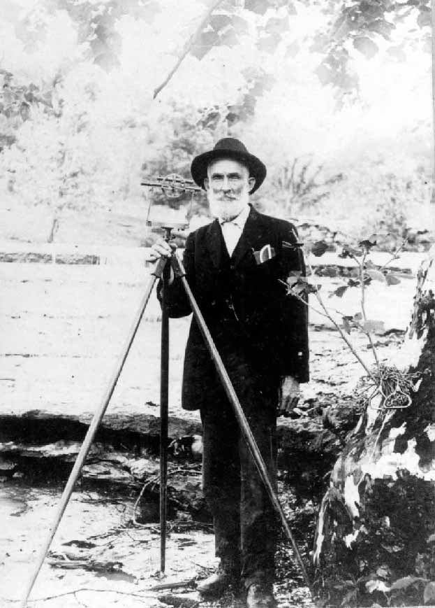
Surveying Conflict
The Canadian government decided to send out surveyors to map out the land in the Northwest. But they didn’t quite own it yet, and they never bothered to inform the inhabitants of the area that they were doing this.

Slide 15
Surveying Conflict (cont’d)
When the federal surveyors arrived to survey the land of André Nault, a Métis, he didn’t understand what they were doing (as he didn’t speak English). So he called his cousin, Louis Riel, to translate.
When they found out what the surveyors were doing, they told them to get off the land (they had no authority to do this!)

Slide 16
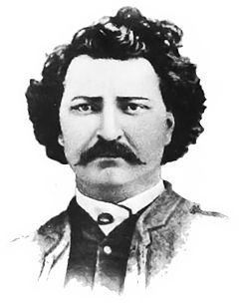
Louis Riel’s Background
Louis Riel was born in Red River in 1844. He was Métis and he had been raised to be proud of his ethnic heritages.
Riel had studied for the priesthood in Montreal.
He returned to Red River in 1868.

Slide 17
Capture of Fort Garry
The Metis seized the HBC trading post of Fort Garry and declare a Provisional Government
Provisional Government: a temporary government until a legitimate one succeeds it

Slide 18
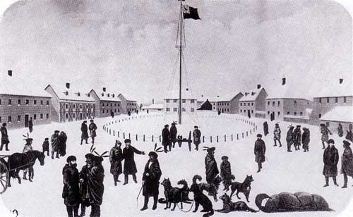

Slide 19
National Committee of Metis
The National Committee of Métis, led by Riel, came up with a list of conditions to be met before they would join Canada.
This strategy worked, since the Northwest was not yet officially Canadian, but still under the terms of the sale (there was a “power vacuum”, as no one was really in charge of the area yet).

Slide 20
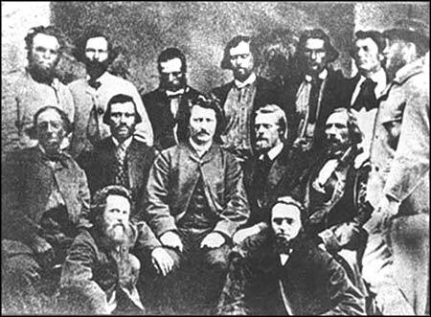

Slide 21
‘Orangemen’ Opposition
But a group of Orangemen (English Protestants) from Ontario were outraged that “savages” were making demands to the Canadian government.
A group of them tried to lead a force to take back Fort Garry, but they failed and were captured and taken prisoner.

Slide 22
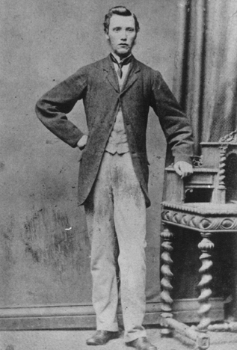
Execution of Scott
Riel ordered the execution of one of the men, Thomas Scott.
Apparently, Scott almost brought it on himself. He was reportedly deliberately rude and continually made racist remarks to his captors.

Slide 23
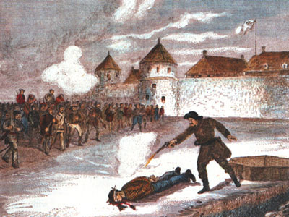
Reaction in the East
Scott’s execution caused tremendous racial and religious outrage: an English Protestant was executed by a group of French/ Catholic/ Aboriginals.
Has been called the “shot that set the West ablaze”
5Ws

Slide 24
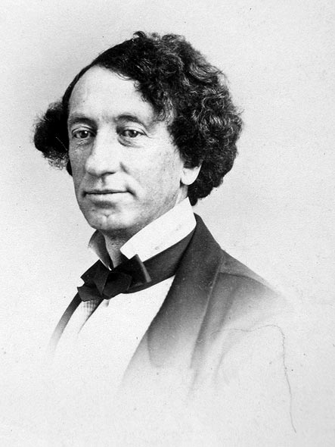
Reaction in the East (cont’d)
But more significantly, the Canadian government was afraid that the Red River settlement might call on the U.S. for assistance against the Canadian government.
There was no way Macdonald was going to allow the Americans to come into this new Canadian territory.

Slide 25
Manitoba Act-Manitoba becomes a Province!
The Manitoba Act (1870) passes and met almost all of the conditions laid out by the National Committee of Métis:
Responsible government for all citizens
Both French and English as official languages
Catholic rights guaranteed
Limited land ownership, with approximately 1.5 million acres reserved for the Métis.

