Slide 1
Economic Theories Review…with Farm Animals
History

Slide 2
DIRECTIONS:
In your groups, look at each scenario and determine which economic theory matches each scenario
Communism
Fascism
Socialism
Capitalism

Slide 3
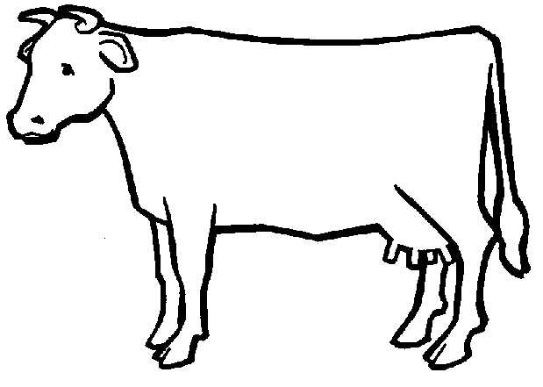
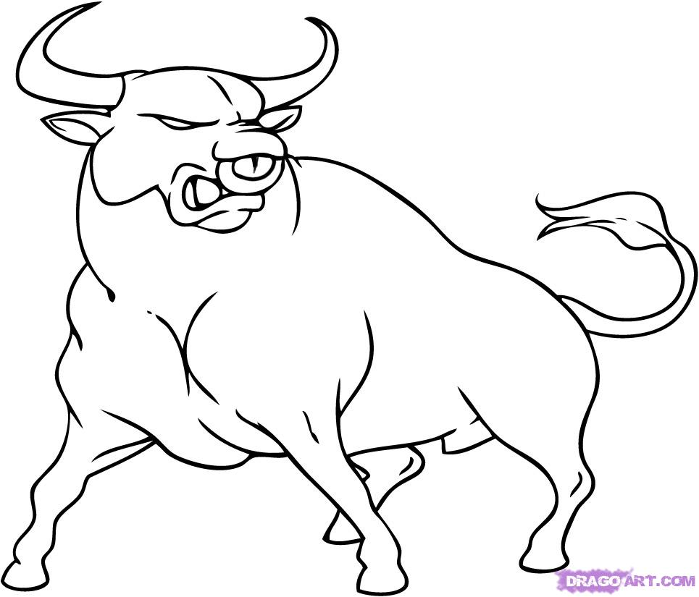
You have two cows. You sell one buy a bull.

Slide 4
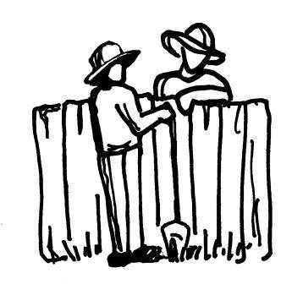
You have two cows. The government takes one and gives it your neighbor.

Slide 5
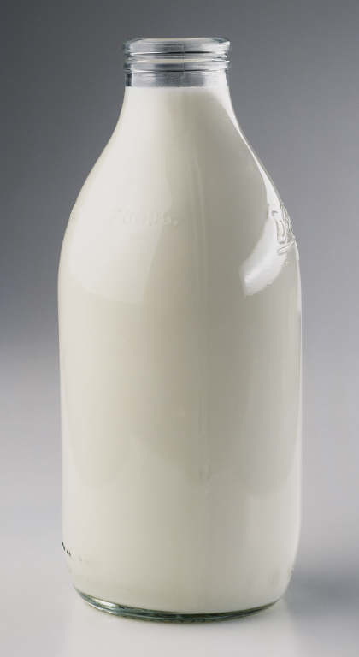
You have two cows. The government takes them both and gives you some milk.

Slide 6
You have two cows. The government takes them both and sells you the milk.

Slide 7
Answers

Slide 8
Capitalism
You have two cows. You sell one buy a bull.

Slide 9
Socialism
You have two cows. The government takes one and gives it your neighbor.

Slide 10
Communism
You have two cows. The government takes them both and gives you some milk.

Slide 11
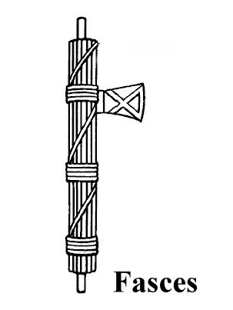
Fascism
You have two cows. The government takes them both and sells you the milk.

Slide 12
Collectivism vs. Individualism

Slide 13
Fundamental Question
Does the individual’s life belong to him/her – or does it belong to the group, the community, society, or the state?
Romans 14:8

Slide 14
Individualism
My life belongs to me and I have a right to live it as I see fit, to act on my own judgement, to keep and use the product of my labour and to pursue the values of my choosing.

Slide 15
Collectivism
My life belongs to the group of which I am a part of. I have no rights of my own and I must sacrifice my values and goals for the group’s “the greater good”. The group is my moral concern and my value is reflected in how I can best serve the group.
“Man has no rights except those which society permits him to enjoy. From the day of his birth until the day of his death society allows him to enjoy certain so-called rights and deprives him of others; not…because society desires especially to favour or oppress the individual, but because its own preservation, welfare, and happiness are the prime consideration.”

Slide 16
Which idea is correct?

Slide 17
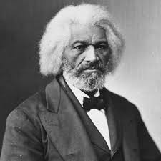
Frederick Douglass
“I am myself; you are yourself; we are two distinct persons, equal persons. What you are, I am. You are a man, and so am I. God created both, and made us separate beings. I am not by nature bound to you or you to me.”

