Slide 1
Battle of the Plains of Abraham
Death of General James Wolfe

Slide 2
Historical art
Although initially used to describe paintings with subjects drawn from ancient Greek and Roman (classical) history, classical mythology, and the Bible; towards the end of the eighteenth century history painting included modern historical subjects such as the battle scenes painted by artists Benjamin West and John Singleton Copley.
The style considered appropriate to use for history painting was classical and idealised – known as the ‘grand style’ – and the result was known overall as High Art.

Slide 3
Benjamin West, The Death of General Wolfe, 1770, oil on canvas (National Gallery of Canada)

Slide 4
Context
Historical paintings were generally reserved for narratives from the Bible or the classical past.
West’s patron, Archbishop Drummond, urged West to avoid painting Wolfe and others in modern costume. He wanted them wearing togas.
West replied, “the same truth that guides the pen of the historian should govern the pencil [paintbrush] of the artist.”

Slide 5
How does West use the background to show the audience
where this event is taking place?

Slide 6
Analysis
Why do you think West included
the image of the indigenous
warrior?
What is the warrior doing in
the painting?

Slide 7
Analysis
How is West portrayed in the painting?

Slide 8
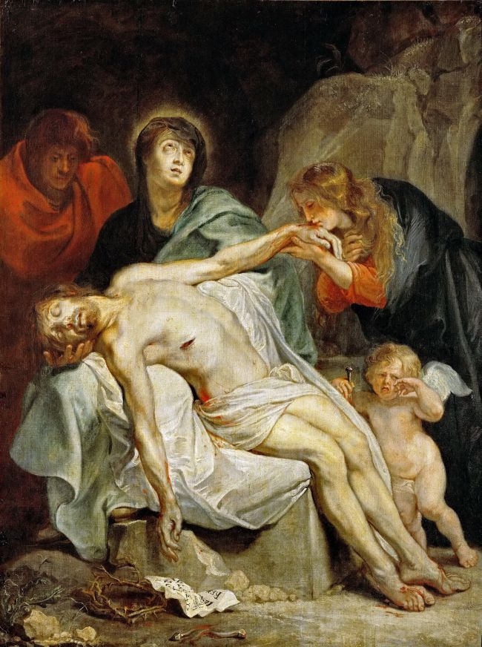
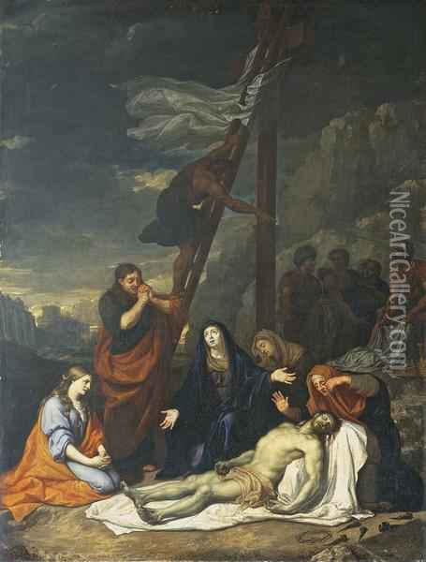

Slide 9
Analysis
What do you think the purpose of this painting was?

