Slide 1
5 Phases of the Fur Trade in Canada

Slide 2
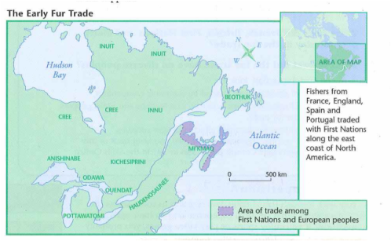
Phase 1: The Early Fur Trade 1500s-1603
Cod fishing began the early fur trade
First Nations people began to trade with
Europeans coming for fish
Early fur trade benefitted both Europeans
and First Nations people

Slide 4
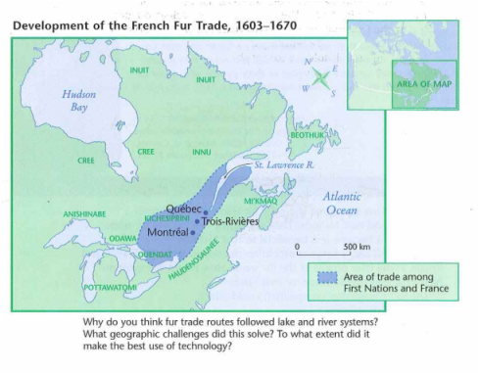
Phase 2: Expansion Inland (1603-1670)
France dominated North America
Fur Trade essential to economy of New France
Jesuit missionaries come to the ‘New World’
French-Haudenosaunee (Iroquois) War
Beaver Wars
Britain aided the Haudenosaunee in their fight
against the French and their allies (Wendat)
Haudenosaunee defeat the Wendat
1701 ‘Great Peace of Montreal’

Slide 6
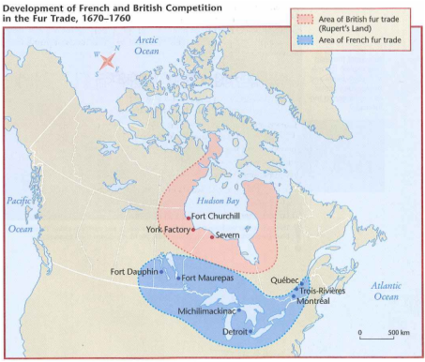
Phase 3: Rival Networks (1670-1760)
Britain established the Hudson’s Bay Company
(HBC) in 1670
HBC competed directly with France
Britain gave a group of merchants a monopoly
in Rupert’s Land
It’s at this point we see the development of the Metis
Voyageurs
After the Haudenosaunee defeated of the Wendat
the French needed men to get furs.

Slide 7
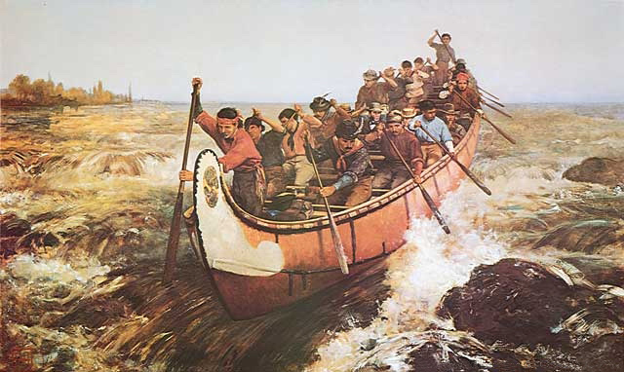

Slide 8
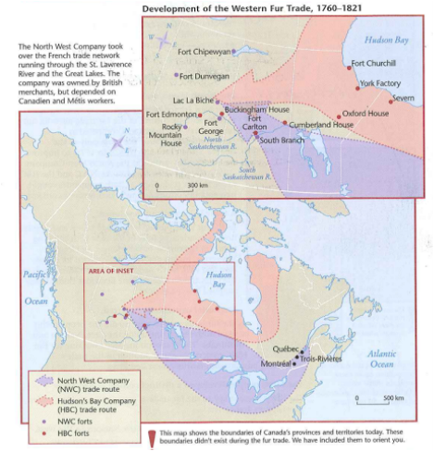
Phase 4: The Drive West (1760-1821)
Northwest Company took over French trade
New France became a British colony in 1763
Cree, Nakota, and Blackfoot supplied food to
voyageurs
Metis
People moved west with the fur trade
Metis at Red River became vital to this network

Slide 9
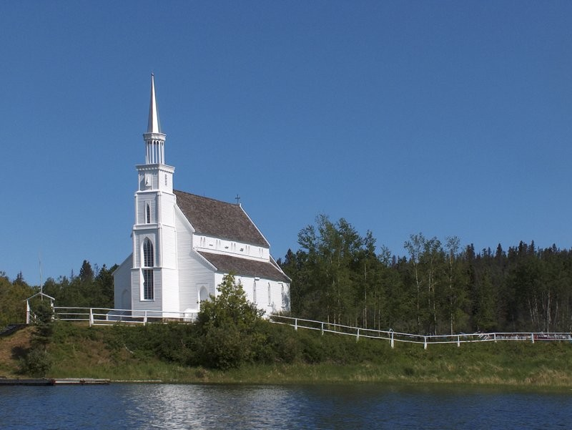

Slide 10
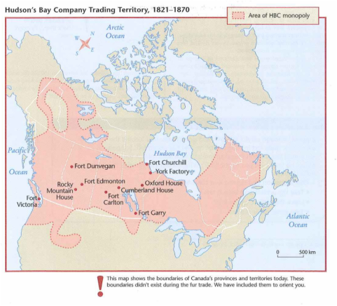
Phase 5: Monopoly in the West (1821-1870)
HBC and Northwest Company merged
Fur trade eventually began to lose its importance
Buffalo began to disappear
In 1869 Rupert’s Land was sold to Canada

Slide 11
