Slide 1
The Numbered Treaties

Slide 2
Looking back
In 1763 King George III signed a Royal Proclamation that recognized indigenous sovereignty over the land West of the British colonies.
Treaty of Niagara, 1764 – 24 First Nations accept the Proclamation. Others reject it and carry on their war against the British led by Pontiac.
Unnamed Treaties, 1775-1850 – secured land in Upper Canada
Douglas Treaties, 1850 – Colony of Vancouver Island negotiates 14 treaties on the southern part of Vancouver Island.

Slide 3
Opening up the west
The Canadian government was interested in signing treaties with the First Nations people of the West. For a number of reasons:
Were currently paying a fee to cross territory
Construction of the railroad
Ability to move military into the West (Red River Resistance)
Open up the land to immigrants (farming)

Slide 4
First nations and treaties
The First Nations had a long history of treaty making with Europeans.
They saw that they were in a strong negotiating position as the Canadian government wasn’t hiding the fact that they wanted to open up the West.
This eventually changed as new waves of disease began to hit. Drought also became common in the 1870s and 80s.
FN people trusted the Canadian government more than the Americans because of their connection to the British crown and because FN were fleeing to Canada from the south in the wake of the American military moving West.

Slide 5
The numbered treaties
11 treaties were signed between the First Nations and the Canadian government between 1871 and 1921.
Treaties 1-7 focused on assimilating indigenous peoples.
Some of the primary provisions of the treaties:
Continued access to hunting lands
Annuity payments
Reserves
Farm equipment
Education
Medicine (treaty 6)

Slide 6
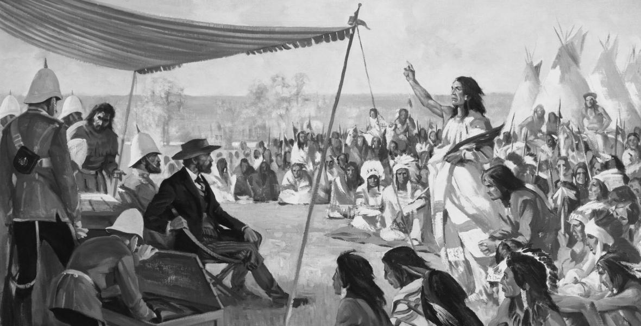

Slide 7
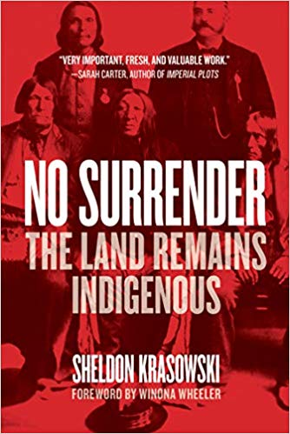
No surrender
Argues that First Nations land in the treaties was not in fact surrendered to a government, but rather the First Nations people believed they were entering into a relationship with the Canadian government.

Slide 8
No surrender
Primary arguments:
FN were not naïve or ignorant. They wanted the treaties and used past negotiations to inform future negotiations.
Negotiations were done orally and then documents were signed
Treaty commissioners intentionally limited FN ability to physically touch document
Signed by touching the pen of clerk
FN trusted that what was discussed orally was identical to the written document

Slide 9
No surrender: Questions
If the government purposely kept the FN from the treaty document so that they were ignorant of the specific details, does this constitute fraud on the part of the Canadian government?
Is it a contradiction to say that Indigenous negotiator knew what they were doing, but then claim they were deceived when it came to a land surrender?
What about the advisors and interpreters that were with the FNs; doesn’t this mean that they would have had to have been in on the ploy, or also would have had to have been deceived?

Slide 10
Your turn:
Working in pairs or small groups, you will read and examine the text of Treaty 6.
As a group you will complete the 5ws chart.
Discuss the following questions:
What questions would you ask the Indigenous chiefs who signed by marking an x?
Is there any way to find their perspectives on the treaties?
Complete handout: Treaty 9 Case Study

Slide 11
Heritage minute: naskumituwin
https://www.historicacanada.ca/content/heritage-minutes/naskumituwin-treaty

