Slide 1
North-west rebellion

Slide 2
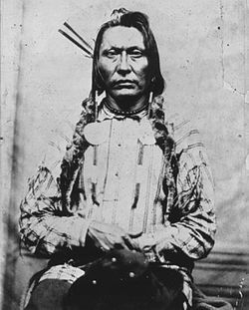
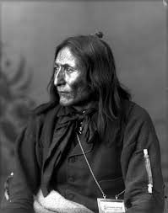
Disaffected peoples: indigenous nations
The disappearance of the bison were pushing people to the point of starvation.
Much of their land had been signed away in treaties.
In 1880, chief Big Bear and Crowfoot founded a confederacy to try to solve these issues.

Slide 3
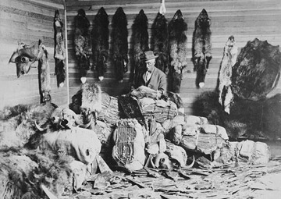
Disaffected peoples: metis
The Metis were also seeing their way of life disappearing with the shrinking bison herds. They were no longer able to survive as HBC traders and trappers.
They were waiting for waiting for reassurance from the gov’t that their land rights would be protected.

Slide 4
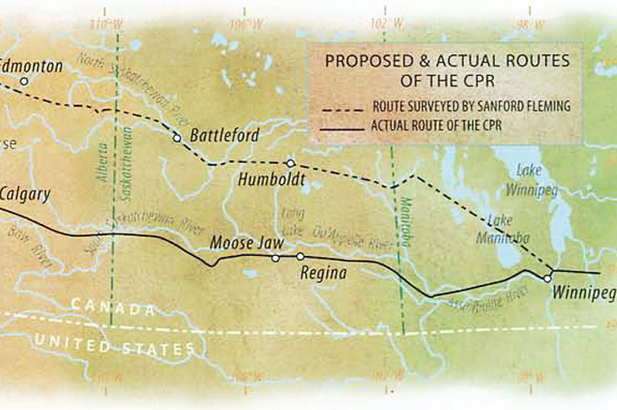
Disaffected peoples: European settlers
Settlers had purchased land in the Northwest, but soon found out that the new railroad would be going from Winnipeg to Calgary, not to Edmonton.

Slide 5
Riel
In 1884, the Metis brought Riel back from exile to help them with their grievances.
Metis prepared a petition and urged Metis and non-Metis alike to sign it.
It called for recognition of Metis land procession and that a Land Department be set up in Winnipeg as opposed to Ottawa.
March 1885, Riel and the Metis seized the church at Batoche and declared a provisional government.

Slide 7
The Battle of duck lake
Metis occupied Duck Lake in preparation for government response to their demands.
They didn’t know that NWMP were already on their way and they met on the Carlton Trail just outside of Duck Lake.
Negotiations quickly broke down and a fire fight ensued.
The battle lasted less than an hour.
12 NWMP and volunteers were killed or injured. Five Metis and one First Nations warrior died.

Slide 9
mobilization
In less than a month the government was able to mobilize over 5,000 troops and transport them across the new railroad to Fort Qu-Appelle, Saskatchewan.
They were led by General Frederick Middleton.
A large group of Cree and Assiniboines moved in around Fort Battleford, forcing settlers to rush into the fort for safety.

Slide 10
looting of fort battleford
Big Bear had been the last chief to sign Treaty 6 and was still resisting moving to their reserve hoping to get a better deal.
The government cut off rations for Big Bear’s people to force them to settle.
On April 1-2, some of Big Bear’s men, along with the Cree and Assiniboines, attacked the area around Fort Battleford killing a number of settlers and government officials.
They took supplies from the area and fled.

Slide 12
Battle of fish creek
Riel wanted to concentrate all of the Metis forces at Batoche, but Gabriel Dumont, the Metis military commander, wanted to set an ambush outside of Batoche.
Dumont won the argument and 150 Metis and First Nations warriors met Canadian troops at Fish Creek (Tourond’s Coulee).
Fighting lasted for most of the day, but the Canadians were unable to drive them back.
The Canadians had over 50 casualties to the Metis’ 4.

Slide 13
Battle of cut knife
Another contingent of government troops under Col. Otter met the force of Cree and Assiniboine at Cut Knife.
The Indigenous force had the advantages of terrain, and surrounded the government troops.
Otter’s forces were eventually forced to retreat.
Casualties would have been much higher had Chief Poundmaker not persuaded his warriors not to pursue the troops as they retreated.

Slide 15
Battle of batoche
Middleton’s troops attacked Batoche on May 9th 1885. He was cautious and kept his attackers at a distance.
After failing to make any headway the troops built a fort just outside of Batoche.
The next two days were much like the first. Government troops attacked with little success and then retreated.
On May 12th, Middleton tried a two-pronged attack but there was miscommunication and again the attack was unsuccessful.
In the afternoon, two colonels, without specific orders, let a militia charge and overran the weary Metis ending the battle.

Slide 17
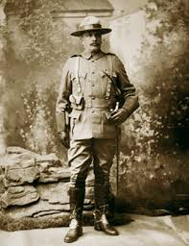
Final shots
The final shots of the rebellion were fired at Loon Lake when NWMP under Sam Steele skirmished with retreating Frog Lake Cree. Four indigenous warriors were killed.
Poundmaker surrendered to Middleton at Fort Batteford. Big Bear was at large, but after some indigenous warriors were released by the NWMP, he also surrendered.
Gabriel Dumont fled Batoche but Riel was captured and put on trial for treason in Regina.

Slide 18
Who to prosecute?
“The North-West Resistance had not been a concerted effort by all groups in the North-West. Even most Métis communities stayed out of the fighting. The Plains Cree of Big Bear’s band had participated, but the neighbouring Woods Cree had not. Some Cree from the Batoche area fought with the Métis, as did Dakota warriors from a reserve from south of present-day Saskatoon. The Siksika had remained neutral, the Kainai refused to abandon their traditional animosity towards the Cree. Meanwhile, almost every settler had rallied to the government cause, even though their vocal anti-government agitation before the shooting started had helped to create the environment that made the resistance possible.”

Slide 19
Trial
Riel’s lawyers failed to convince the jury that Riel was insane (and there was evidence to prove this claim). Mostly due to his eloquence in delivering his defense.
He was found guilty of treason, but the jury recommended lenience. However the judge sentenced Riel to be hanged.
Many others were found guilty of the less serious crime of treason-felony. Chiefs Poundmaker and Big Bear were both sentenced to 3 years in prison.
Chief Whitecap was the only prominent First Nations lead to be acquitted.

Slide 21
Hanging
After 3 postponements due to appeals, Riel was hanged in Regina on November 16 1885.
There was widespread anger in French Canada over the hanging.
Future prime minister Wilfred Laurier, passionately denounced the government’s actions, which became an important step in his political career.
On November 27th, 8 other First Nations leaders were also hanged in Fort Battleford, including Cree chief Wandering Spirit.

