Slide 1
Anabaptists Gone Wrong

Slide 2
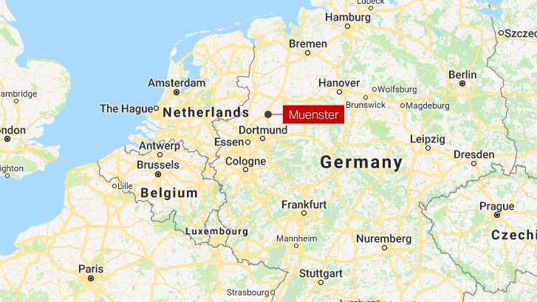
Refuge
The city of Munster, in Germany, became a place of refuge for the anabaptists as they faced intense persecution throughout Europe.

Slide 3
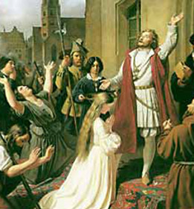
Jan van Leiden
Came to Munster in 1533.
He believed he could run the city better than the elected officials – many of them Catholic.

Slide 4
Jan Takes Over
Jan an his followers took over the city and forced out the bishop by knifepoint.
They believed that the end of the world was going to come, and that Jesus was going to descend at Munster.
They were going to establish a city based on Jan’s interpretation of the anabaptist teachings.

Slide 5
Seige
The bishop brought in troops and surrounded the city in an attempt to starve them out.
Anyone that attempted to break through the blockade was mutilated and put on display.
One of Jan’s followers believed he saw a vision that he and 10 others were to break through the blockade and defeat the army themselves.
They all lost their heads

Slide 6
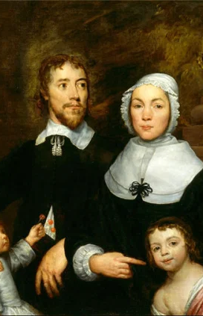
Jan’s Teachings
As they were surrounded, Jan and the other city leaders became more radical in their teachings.
Any woman of marrying had to be wed immediately.
Jan often told them who to marry
Polygyny became common (Jan got married over 15 times)
Summary execution became law. Jan had his 16th wife beheaded for calling him out on his extravagant lifestyle.

Slide 7
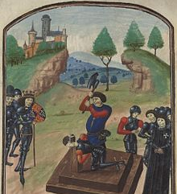
Beheading
You could be executed for:
Refusing to marry
Showing disrespect to the city leaders

Slide 8
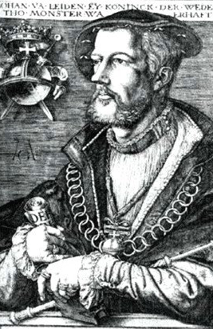
The End
After intense fighting and a truly remarkable defense, the city was taken back by the bishop and his men.
Jan and his two highest ranking officials were sentenced to death.
They were sentenced to half and hour of torture, hot tongs, and then were killed with a dagger.

Slide 9
Today
Jan and his followers’ bodies were suspended in large metal cages for all to see.
They were eventually moved to hang from St. Lambert’s church.

Slide 11
Radicalism
Do people fall victim to radical ideas today?
Jim Jones
KKK
ANTIFA
How can we ensure that we don’t fall victim to radical ideas?

