Slide 1
MAIN
Causes of WW1

Slide 2
M

Slide 3
Militarism
Total military expenditure of the six great powers (Britain, France, Germany, Austria-Hungary, Russia, and Italy) totaled 94 million pounds in 1870.
Increased to 398 million pounds by 1914
Germany military expenditures increased by 73 % (Britain – 13%)
After Russia’s defeat to Japan in 1905 the Tsar began to reallocate money to the military. By 1910 45% of gov’t spending went toward the military (5% went to education).

Slide 4
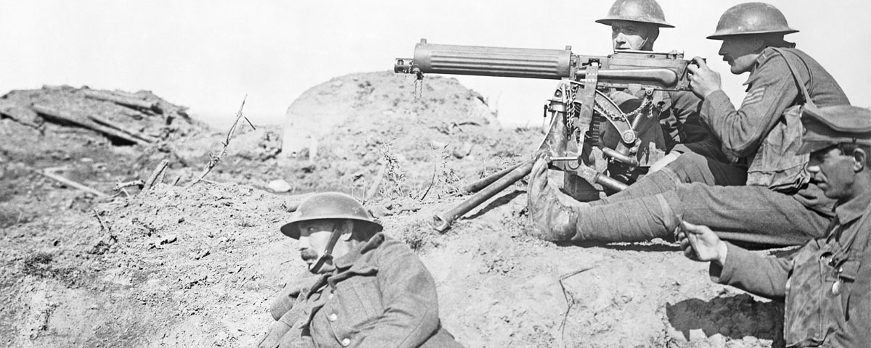
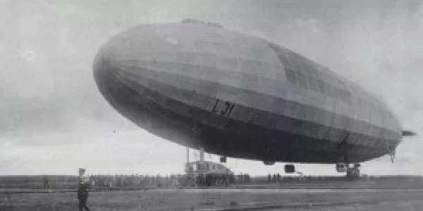
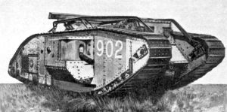

Slide 5
A

Slide 6
Alliances
Serbians kill the Archduke of Austria-Hungary
Austria-Hungary declares war on Serbia
Russia declares war on Austria-Hungary
Germany declares war on Russia
France declares war on Germany
Germany invades Belgium
Britain declares war on Germany

Slide 8
I

Slide 9
Imperialism
Imperialist competition for power, influence and prestige grew and is most famously exemplified in the Scramble for Africa of the 1880s and 1890s.
Competition as many new nations (Germany, Italy, etc.) sought to claim land for themselves.

Slide 11
N

Slide 12
Nationalism
German nationalism was a new sensation sweeping across Germany. This was a result of the unification of Germany in 1871. Germany was obsessed with imperial expansion, trying to emulate the British Empire.
These trends of nationalism also gave citizens overconfidence in their nation, governments and the military strength. It gave them a false sense of fairness and righteousness. It demonized rival nations, portraying them as aggressive, shrewd, deceitful, barbaric and uncivilized.

Slide 13
