Slide 1
The Korean War
An Introduction

Slide 2
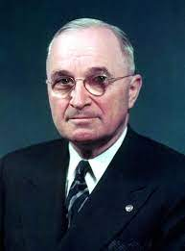
Beginnings
The Korean war began on June 25, 1950, when 75,000 soldiers from the North Korean People’s Army poured across the 38th parallel.
The 38th parallel was the boundary between the Soviet-backed Democratic People’s Republic of Korea in the north and the pro-Western Republic of Korea to the south.
This was the first military action of the Cold War.
“If we let Korea down, President Harry Truman said, the Soviets will keep right on going and swallow up one place after another.”

Slide 3
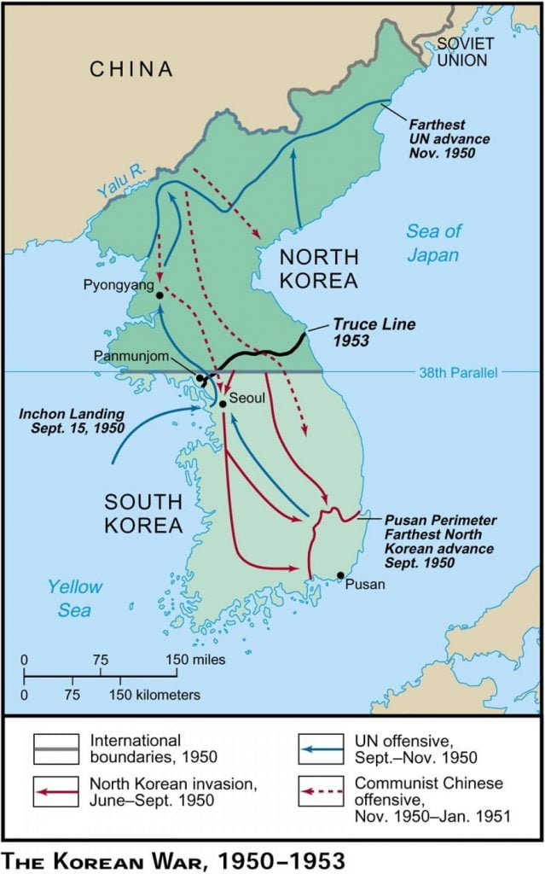

Slide 4
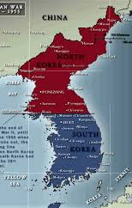
The War Moves Forward
At first the conflict was one of defense, but soon the Americans decided to ‘liberate’ the entire Korean peninsula from the communists.
This was an initial success until Mao Zedong of China send troops into North Korea fearing Western aggression.

Slide 5
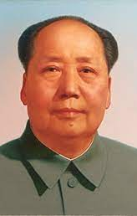
Mao and the People’s Republic of China
Mao took control of China after a long civil war.
He wanted to model China on Soviet principles.
Great Leap Forward was one of Mao’s economic policies to reconstruct China’s rural economy into a communist society based on people’s communes.
Mao forced brutal quotas on Chinese farmers. The Great Leap Forward led to the death of over 50 million people.

Slide 6
Mao and the People’s Republic of China
Near the end of Mao’s life, he became concerned about his legacy. Especially after the de-Stalinization that occurred in the USSR under Nikita Krushchev.
Mao solidified his legacy with his Cultural Revolution.
Attempt to destroy China’s past and replace it with communist principles instituted by Mao.
Created the Red Guard
The 4 olds - Old Ideas, Old Culture, Old Habits, Old Customs
Around 1.5 million people were killed during the revolution

Slide 7
Cultural Revolutions Today
Are we experiencing any cultural revolutions today?
Evergreen College
Donald Trump
?

Slide 8
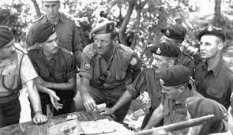
The War Moves On
The Western nations were now locked in a war of attrition with the North Koreans and the Chinese.
American Gen. MacArthur was relieved of command by Truman for insubordination.

Slide 9
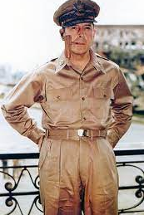
Nuclear War or Conventional War?
Gen. MacArthur was a proponent of using American end power (napalm, nuclear weapons) to quickly end the conflict. Truman wanted a more conventional war. Which was the right decision?
Bomber mafia

Slide 10
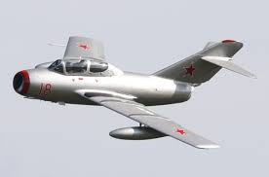
F86 Sabre MIG 15 New Technologies

Slide 11
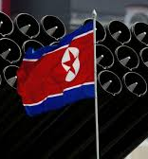
Both sides agreed to a ceasefire at the 38th parallel.
26,000 Canadians served in Korea. 516 were killed, making it the 3rd deadliest war in Canadian history.
A peace treaty has never been signed, so officially the Korean War has not ended.

