Slide 1
Know Your Rights
Part 1

Slide 2
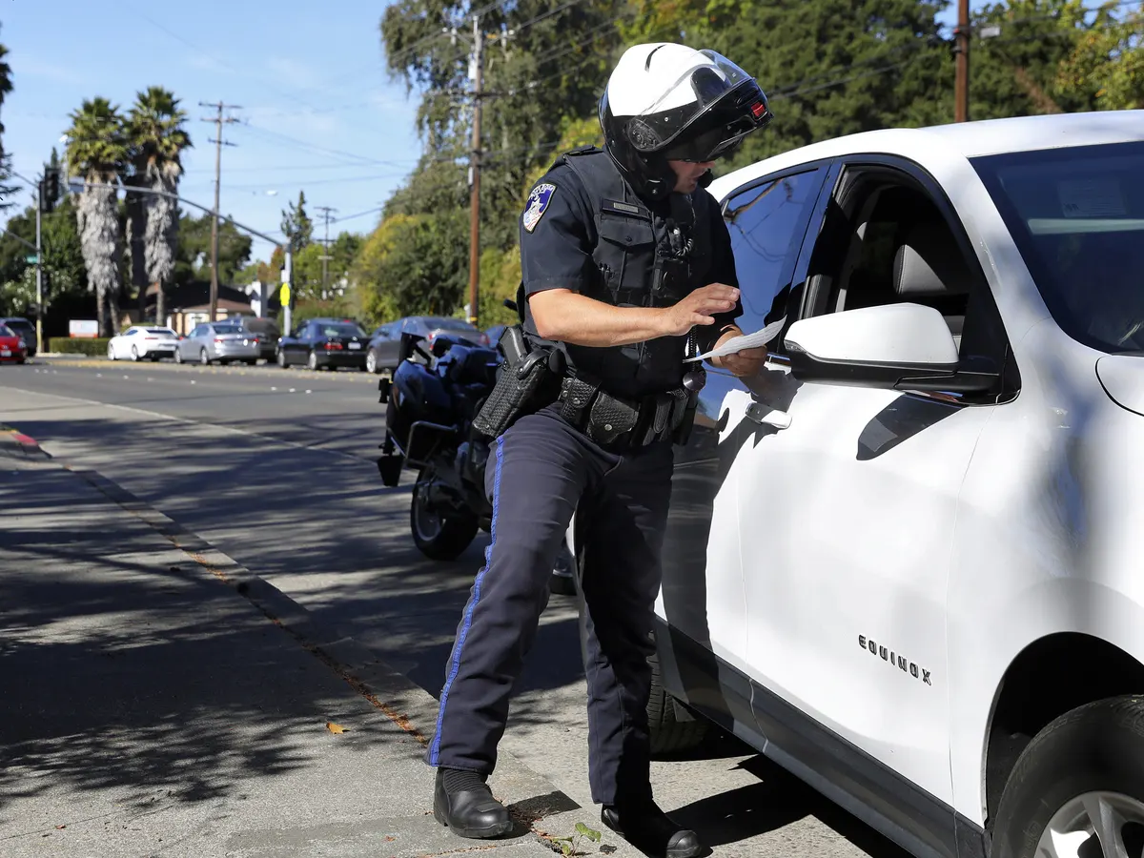
When Can I Be Stopped by the Police?
If they suspect you have committed a crime
If they see you committing a crime
If you are driving

Slide 3
Answering Questions
In most cases you do not need to answer questions directed to you by the police; however, it is a good idea to be polite.
If you have been involved in a car accident and the police question you, you must answer their questions.
If you’ve been detained by the police, it is a good idea to wait for a lawyer before you answer any questions.
Anything you say to the police could be used as evidence in court.

Slide 4
Offering Your ID
If stopped by the police, they may ask for your name and address, as well as identification. Under most circumstances you are not required to offer this information.
If you are stopped while driving, you are required to provide this information.

Slide 5
Stopped While Driving
Police may stop a driver for a number of reasons:
They believe you have been drinking alcohol or consuming drugs
To see if a vehicle is mechanically fit
To check to see if the driver has a valid license
To check your vehicle registration
They believe you have committed an offense

Slide 6
Searching Your Vehicle
If you have been stopped by the police, they DO NOT have the authority to search your vehicle.
They can look through windows to inspect the inside of your vehicle
They may search your vehicle if they have reason to believe there is illegal alcohol, drugs, firearms, etc.
Only if they believe these items will be destroyed before they can get a search warrant

Slide 7
DUI
If the police suspect you have been drinking or are under the influence of drugs, they can make you do a roadside test or physical sobriety test.
You do not have the right to see a lawyer before a roadside test or screening device is used.
If police have reason to believe that you are impaired, they may have you take a breathalyzer test, usually at a police station. You have right to council prior to breathalyzer test.

Slide 8
Can the Police Search Me?
In most cases, the police can only search you if you have been placed under arrest or have consented to the search, but there are some exceptions:
Police find you in a place where they are searching for drugs
Police find you in a vehicle where people are transporting or drinking alcohol illegally
Police believe you have an illegal weapon or one that was used in a crime

Slide 9
Your Task
Understanding your rights shows that there is a balance between the rights of the police and the rights of citizens. It also reveals how the principle of “innocent until proven guilty” is written into our legal code.
Do you believe we have struck the right balance between the rights of the police and the rights of individuals, or do you think that one side has too much power? Explain.

