Slide 1
The Klondike Gold Rush

Slide 2
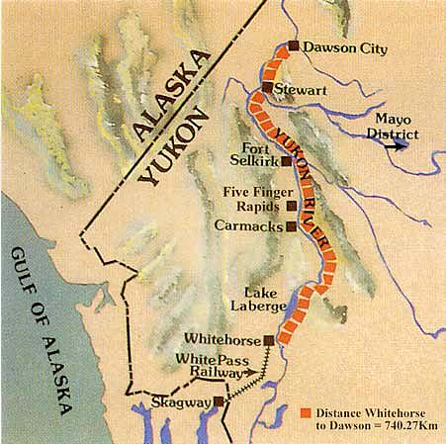
Gold!!
Gold was discovered in the Yukon territory in August of 1896.
The men returned to Seattle and news spread.
The city of Dawson City was founded and grew to nearly 30,000 people.

Slide 3
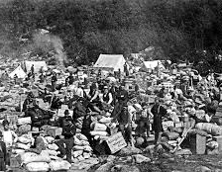
Stampeders
The men (stampeders) were required to bring 1 ton of supplies through the pass so that they could survive the winter.
By the time all of their supplies were at their camp, the men would have had to have trekked some 4,000 km.
Chilkoot Pass

Slide 5
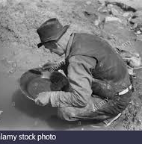
Striking it Rich!
Nearly $30 million (figure adjusted) in gold was discovered during the gold rush. Divided equally amongst all that participated, the amount falls short of the time, money, and effort that they were forced to put in.

Slide 6
NWMP
Created in 1873 after the Cypress Hills Massacre of Assiniboine people by American whiskey traders, the NWMP symbolized a real difference in the experience of the West between America and Canada.
In the American gateway, Skagway, Alaska, there was violence and gangsterism. In Dawson City, on the Canadian side, there were no guns.
Still gambling and prostitution, but the law was established.
Stores were even closed on Sundays

Slide 7
Sam Steele

Slide 8
Positive or Negative
Was the Klondike Gold Rush a positive or negative event for Canada and its people?
Pros | Cons
The economy was poor and this created a lot of wealth and spending. Creation of Yukon Territory Creation of many memorable poems, songs, etc. Established a romantic impression of Canada’s north | Many indigenous tribes were forced off their land. Many prospectors laboured for years to find nothing. Many prospectors died in their attempt at striking it rich

Slide 9
Cremation of Sam McGee
What is the message/theme Robert Service is trying to share with you? Be able to support your theme with evidence from the poem.

