Slide 1
The Killing Fields
Cambodia and the Khmer Rouge

Slide 3
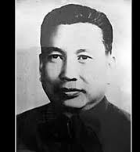
Pol Pot and the Khmer Rouge
In 1975, after a long civil war, Pol Pot and the communist Khmer Rouge defeated right-wing nationalists and took control of the Cambodia.
Pol Pot wanted to reshape the country into a communist-style, agricultural utopia.
He isolated the country
Resettled thousands of city-dwellers in rural farming communes
Outlawed private ownership of land

Slide 4
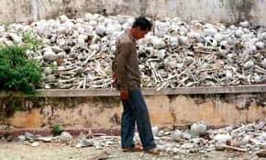
Genocide
Workers on farm communes suffered from overwork and lack of food.
Intellectuals were rounded up and executed.

Slide 5
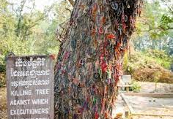
Killing Fields

Slide 6
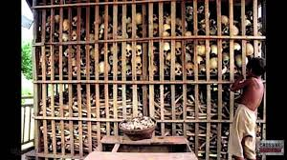

Slide 7
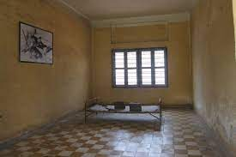
S-21

