Slide 1
Intro to Criminal Law

Slide 2
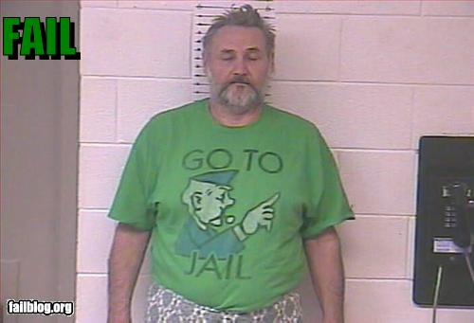

Slide 3
Crime
Crime – an action or the omission of an action that is against the law
4 Conditions necessary to have a crime:
Action is considered wrong by society
Causes harm to society
Must be serious in nature and degree
Punishment must suit the crime

Slide 4
Criminal vs. Civil
Criminal Law | Civil Law
- Between gov’t and an individual | - Between 2 or more people
- Punishment is jail, fine, or community service | - Punishment is $ for pain and suffering, or to pay restitution
- gov’t must prove they are guilty beyond a reasonable doubt | - Judges decide what most likely happened and award $ accordingly

Slide 5
Criminal Act
2 important elements in Criminal Act:
Actus Reus – the wrongful act, which must be proved beyond a reasonable doubt
Mens Rea – criminal intent, “a guilty mind”

