Slide 1
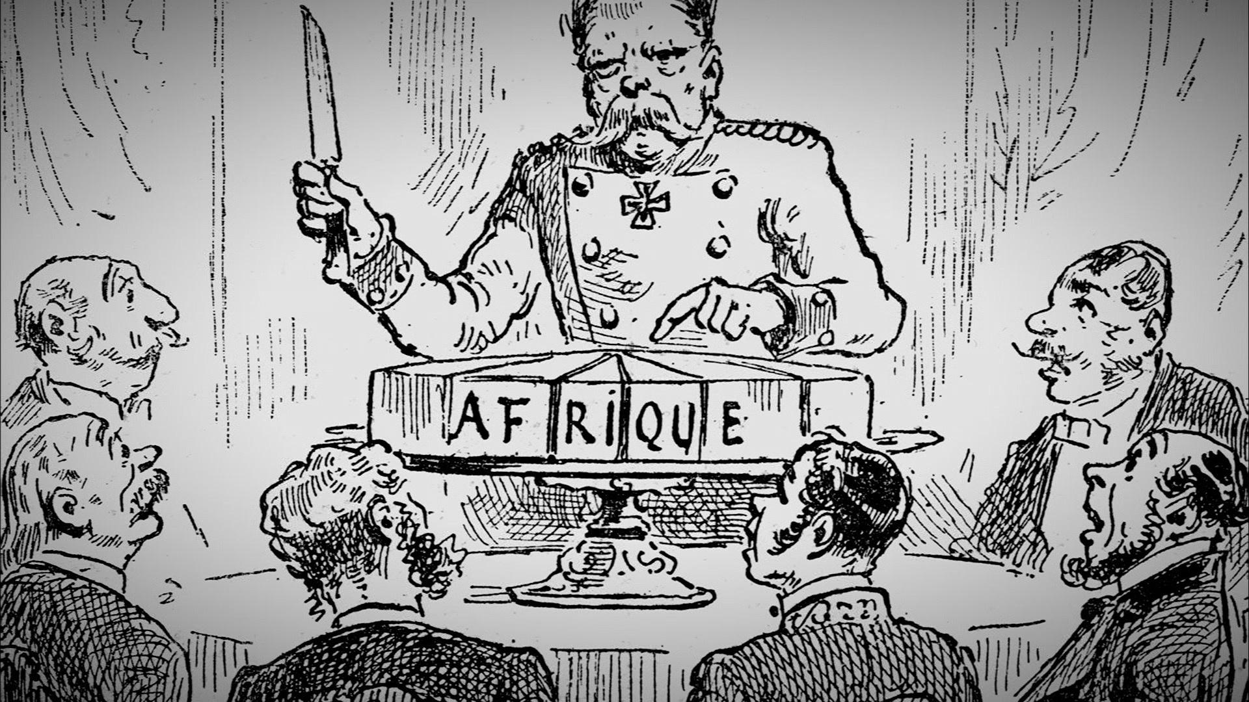
Imperialism and the Scramble for Africa

Slide 2
Berlin Conference
European nations were sending explorers to Africa to stake out large land claims to secure resources.
One of the most infamous is King Leopold II of Belgium who secured areas in the middle of Africa.
He is responsible for the deaths of millions in this region.
The conference, lead by Germany, formalized rules and created a map to recognize territorial claims.
At no point were the perspectives of the African people considered.

Slide 3
Scramble…
The rush for territory lead to the creation of colonies:
Colonialism – when a country takes control of other territories outside of its borders by turning that region into a colony.
Nationalism – the belief that ethnic groups should be free to rule themselves. Patriotism to one’s ethnic group or nation.
Militarism – society should model the army. Emphasis on building the strength of a nation

Slide 4
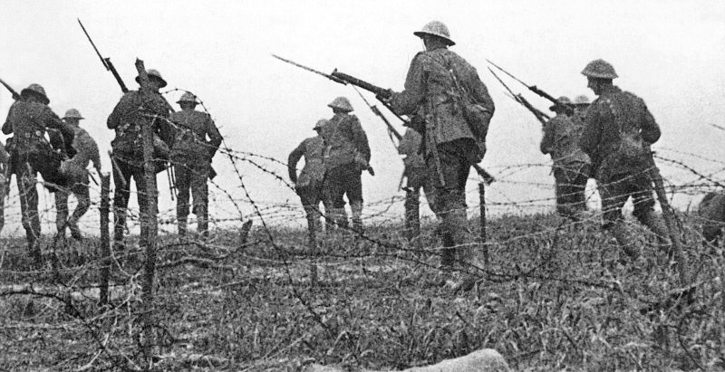
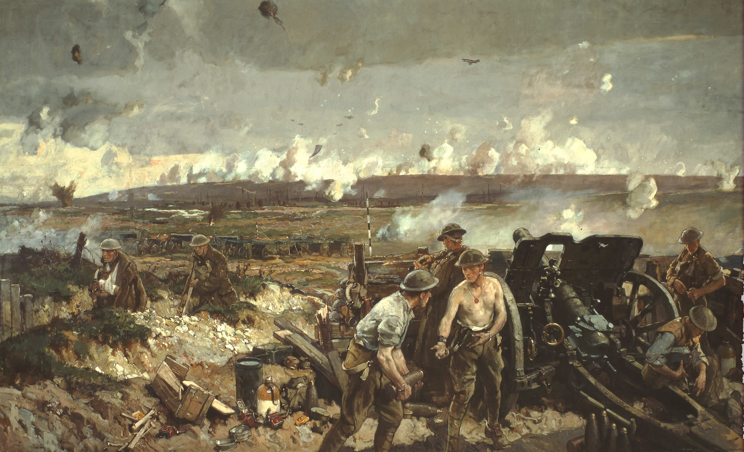
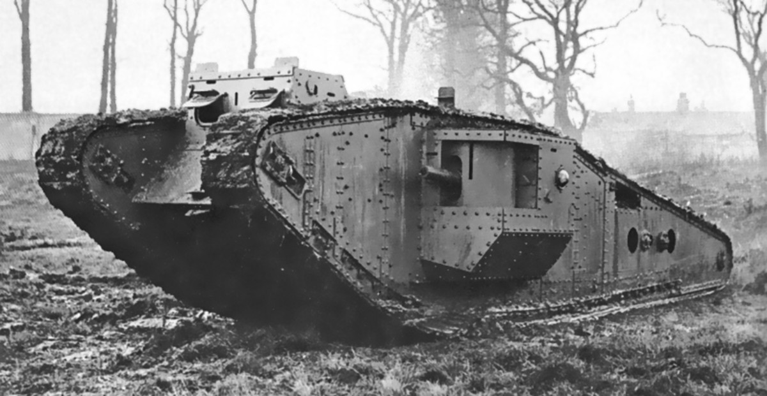
Aftermath

Slide 5
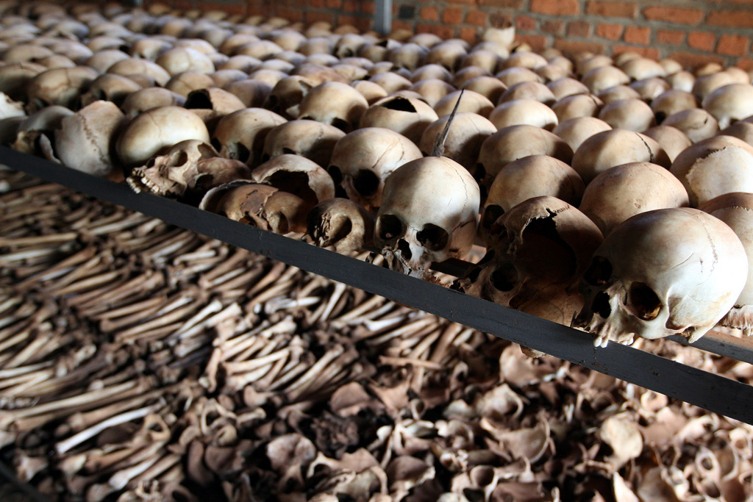
Aftermath

Slide 6
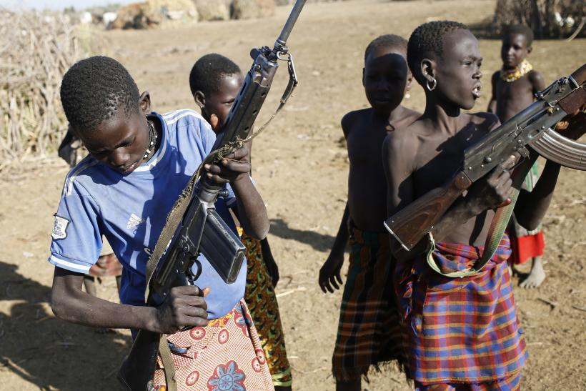
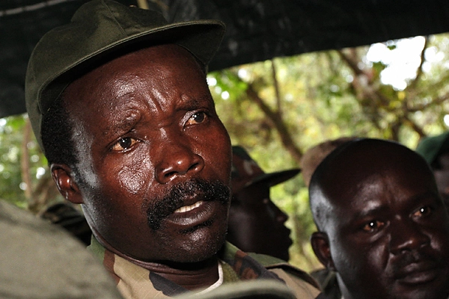
Aftermath

Slide 7
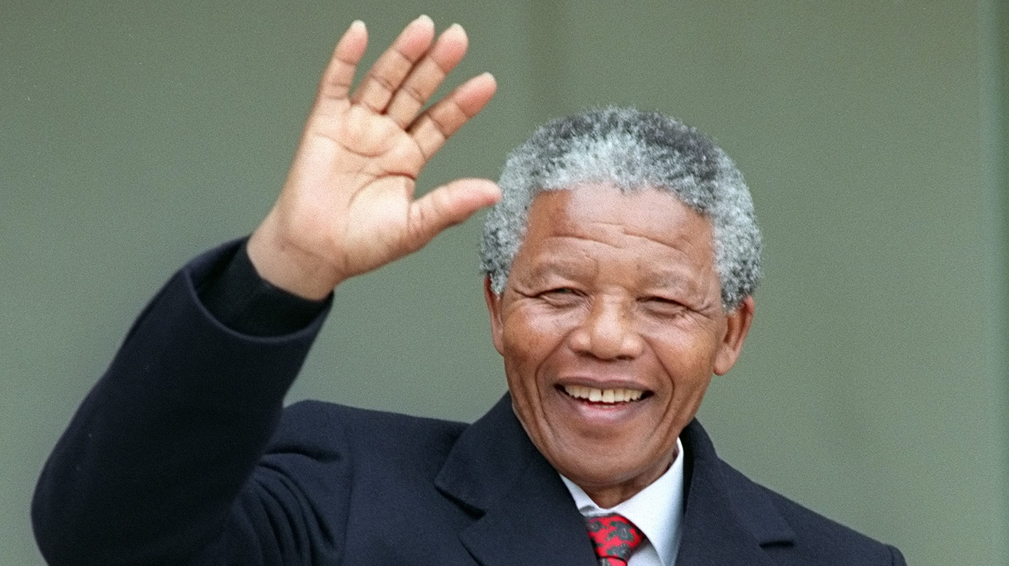
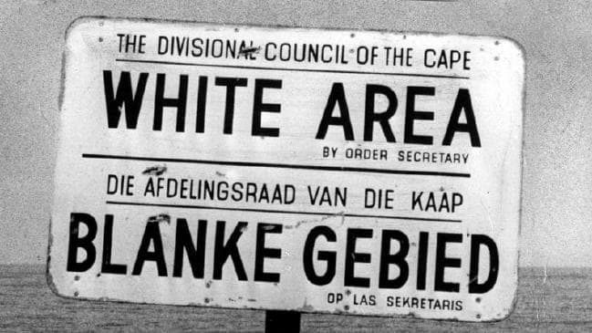
Aftermath

