Slide 1
How Are We Saved?

Slide 2
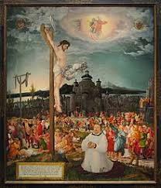
The Medium of Salvation
How is salvation obtained or transmitted?

Slide 3
Ordinance/Sacrament
Sacrament – a rite, or ceremony, through which God’s grace is conveyed.
Ordinance – a practice ordained by Jesus

Slide 4
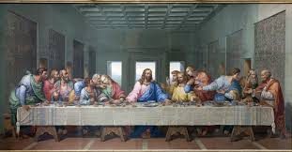
Physical
Some regard the transmission of salvation as a physical process.
This view is held by those that believe that salvation or grace is obtained by means of a physical object.
Ex. Lord’s supper

Slide 5
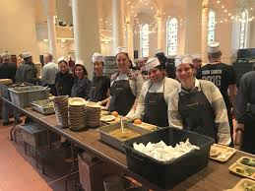
Moral Action
This position argues that salvation is not something possessed by an individual or organization (the Church), but rather is something we can create.
By doing good according to the Gospel, we earn salvation.

Slide 6
Salvation by Faith
Salvation is something granted to us by faith.
Ephesians 2:8-9

