Slide 1
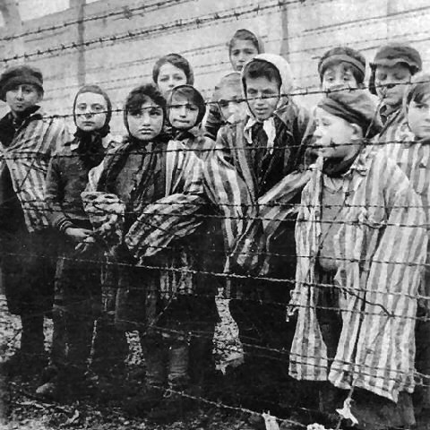
The Holocaust
History 20

Slide 2
What is the Holocaust?
Not one event, cause or person
Rather, a collection of
Fascism
Irresponsible civic leadership
Economic depression
Basically, the systematic persecution and dedicated attempt to exterminate the Jews in Europe

Slide 3
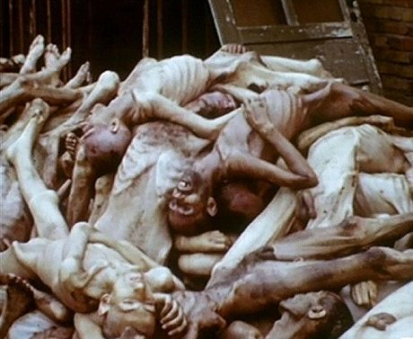
What is the Holocaust?
Ultimately, Hitler is responsible for the death of over 6 million Jewish people

Slide 4
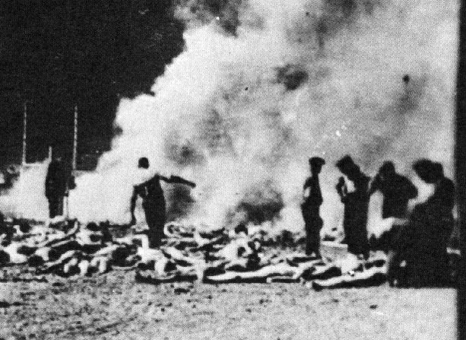
They were shot, starved, gassed and burned…

Slide 5
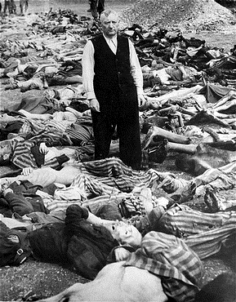
Defining the Holocaust
HOLOCAUST (Heb., sho'ah) which originally meant a sacrifice totally burned by fire
CHANGES TO…
the annihilation of the Jews and other groups of people of Europe under the Nazi regime during World War II

Slide 6
Cold Hard Facts
Casualties of the Holocaust:
63% of Jewish population in Europe killed
91% of Jewish population in Poland killed
Auschwitz-Birkenau was liberated by Soviet troops on Jan. 27, 1945. The Soviets found 836, 255 women’s dresses, 348, 000 men’s suits, 38, 000 pairs of men’s shoes and 14, 000 pounds of human hair. But only 7, 650 live prisoners
Auschwitz had the capacity to kill 20,000 prisoners /day

Slide 7
Anti-Semitic Propaganda

Slide 8
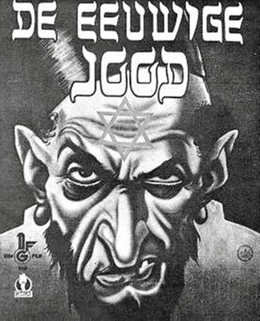
Legacy of Anti-Semitism
Europe had a history of Anti-Semitism, Hitler just added ‘fuel to the fire’
He blamed the Jews for everything (scapegoats), “foreign invaders”, “money hoarders”

Slide 9
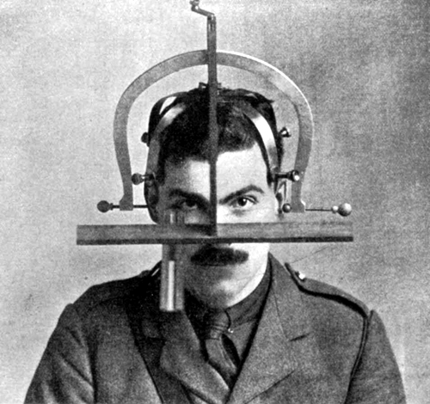
Aryan Ideology
Belief in a “superior Aryan German race”
An extension of Social Darwinism
Even backed up by science— “genetically inferior”

Slide 10
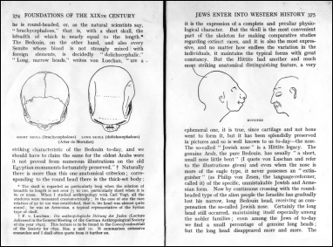
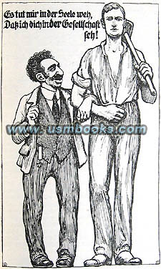

Slide 11
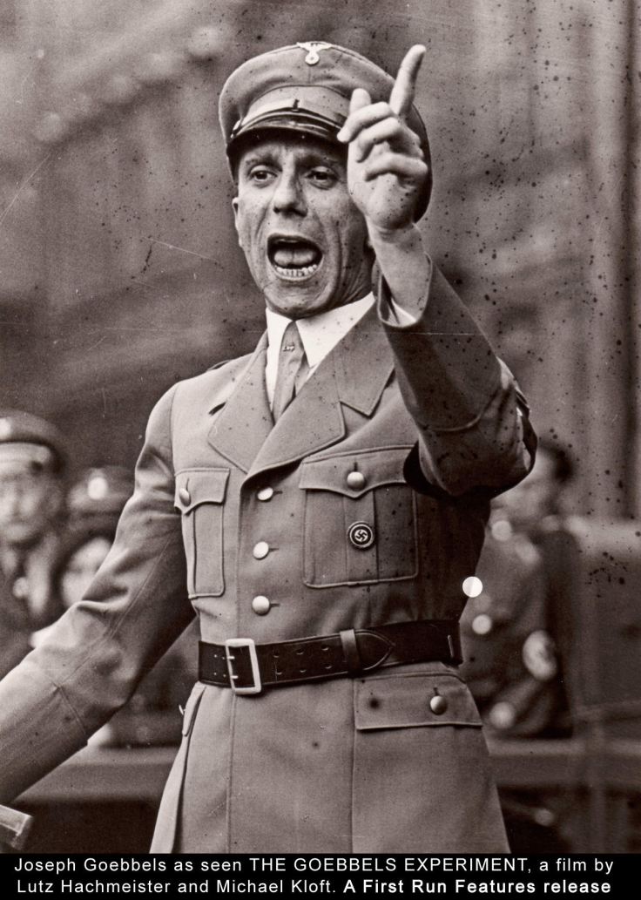
Propaganda
Hitler was able to flood people with enough propaganda and “science” that by the late 1930’s that people were willing to actively attack the Jews, while the rest of the people were willing to let it happen

Slide 12
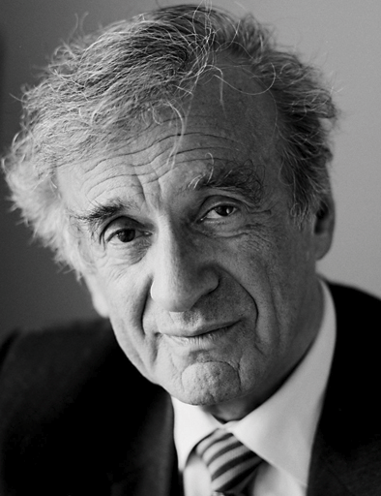
Elie Wiesel
“To remain silent and indifferent is the greatest sin of all.” - Wiesel

Slide 13
