Slide 1
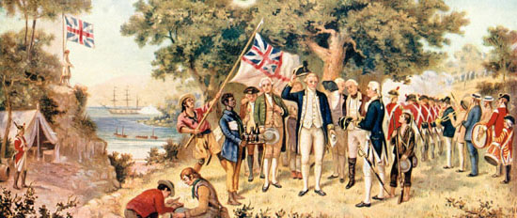
Contact

Slide 2
Terms
Contact – meeting of European (Old World) and American (New World) cultures
Indigenous – original peoples of Canada
First Nation – indigenous peoples of the Canadian shield and plains regions
Metis – ancestors with both First Nations and European relatives
Inuit – indigenous peoples of Canada’s northern regions

Slide 3
Pre-Contact

Slide 4
Pre-Contact
Canadian Indigenous peoples had a long and rich history prior to contact.
Tribes were diverse depending on the region of Canada they inhabited.
Eastern Canada – hunters and farmers
Plains – Nomadic hunters
West Coast – fishing
North – Fishing and trapping

Slide 7
Religious Practices
Spiritual beliefs varied widely amongst indigenous populations. However, there are commonalities among Indigenous spiritual traditions:
presence of creation stories
the role of tricksters (coyote, raven, etc.)
ceremonies

Slide 8
Creation
Creation stories describe the origins of the cosmos.
Among these tales is what scholars often refer to as the “Earth Diver myth.” This is a story where a Great Spirit or cultural hero dives, or orders animals to dive, into the primeval water to bring back mud, out of which the Earth is fashioned.
In some versions of the story, Earth is formed on the back of a turtle; Turtle Island is a popular name used by certain Indigenous peoples for the land of North America.

Slide 10
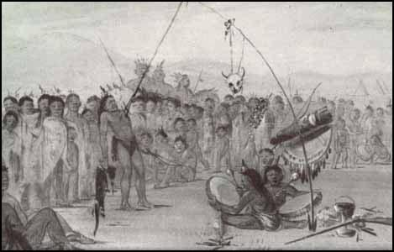
Plains Indigenous Ceremonies
Sun Dance
Conducted when bands met in the summer due to a request of the tribes or because of a vision.
Participants would dance around a sacred pole and pierce themselves as a flesh offering and to show their endurance.
Sun Dance was banned with the Indian Act of 1895. This was rescinded in 1951.

Slide 11
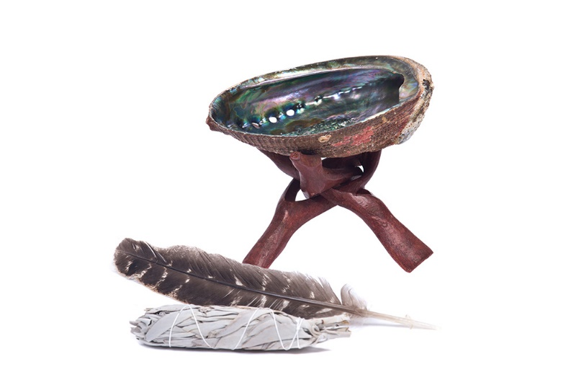
Smudging
Used for medicinal purposes and spiritual ceremonies, often as an act of prayer.
Usually sweetgrass or tobacco is used.

Slide 12
Pre-Contact
Population ~90 million (population of Europe 1300 A.D. ~75 million)
No written language
Dominated by small tribes
Dramatic shifts in climate forced change
Evidence of corn fields as far north as carrot river
Horses, camels

Slide 14
Crow Creek bone bed
Around 1300 A.D. cooler weather forced the migration of many
Malnutrition and disease
Evidence of TB
South Dakota evidence of a tribe killing and mutilating over 500 people and then building new settlement on top of the old.

Slide 15
Contact
Norsemen are likely the first Europeans to set foot in Canada.
Leif Ericsson landed a series of expeditions around 1000 A.D.
Why didn’t these Norse communities survive?
L’Anse aux Meadows https://www.youtube.com/watch?v=FX2KTkgo2Lk

Slide 17
Exploration
John Cabot in 1497 is the first known voyage to mainland North America.
Discovered cod
Beginning in 1534, Jacques Cartier explored the Sr. Lawrence river system including Stadacona (Quebec) and Hochelaga (Montrael).

Slide 18
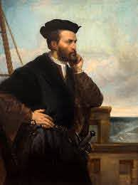

Slide 19
Northwest Passage
Quest to find a route to Asia through the northern part of Canada.
Martin Frobisher, William Baffin, and Henry Hudson searched for the Northwest Passage.
Claimed the Hudson’s Bay region for England.

Slide 21
Cultural Relativism
Ethnocentrism - the attitude that one's own group, ethnicity, or nationality is superior to others
Cultural relativism - Cultural Relativism is the claim that ethical practices differ among cultures, and what is considered right in one culture may be considered wrong in another. The implication of cultural relativism is that no one society is superior to another, they are merely different.

Slide 22
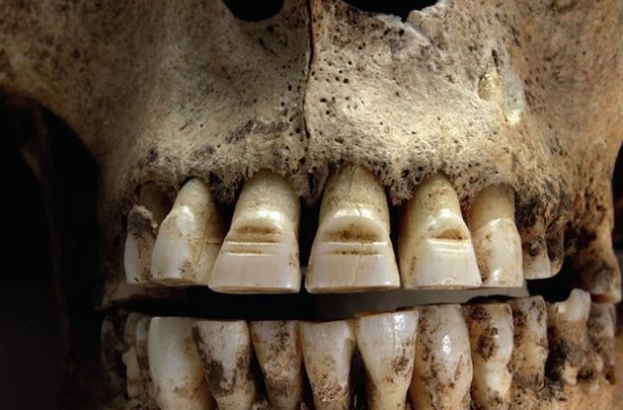
Viking Customs and Rituals
Blot Sacrifice
Human Sacrifice
Berserkers
Tooth Modification
The Blood Eagle
https://listverse.com/2018/08/06/10-interesting-viking-rituals/

