Slide 1
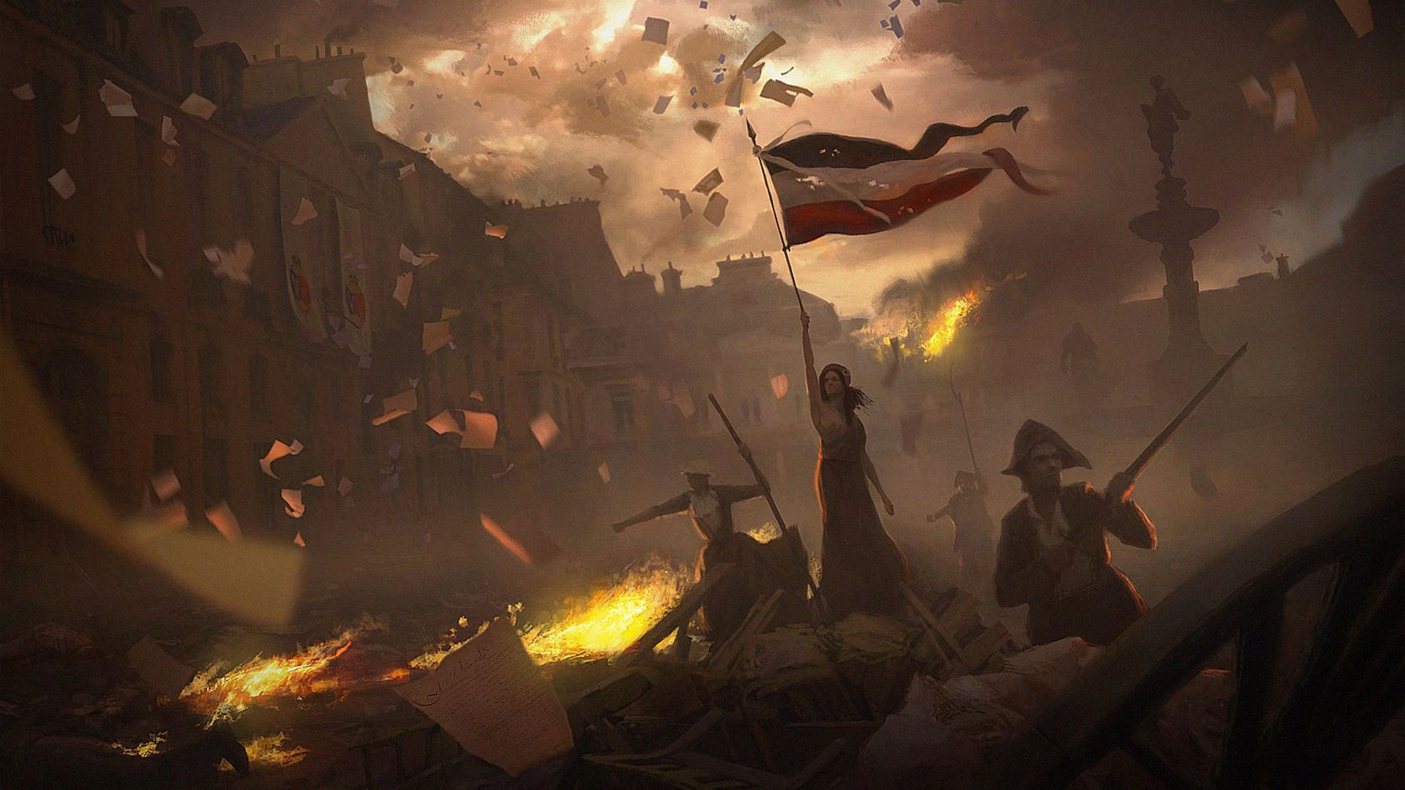
French Revolution
1789-1799

Slide 2
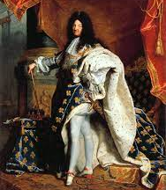
The Sun King
King Louis XIV ruled France for 54 years.
He reorganized the army and consolidated absolute power.
Louis also built to the palace at Versailles. It took 27 years to build and was placed on a 20,000 acre property.

Slide 7
Causes
France’s costly involvement in the American Revolution, and extravagant spending by King Louis XVI had left the country on the brink of bankruptcy.
20 years of poor harvests and drought drove up the price of bread.
The people of France had to pay very heavy taxes.

Slide 8
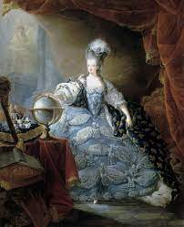

Slide 9
Estates-General
To fix France’s financial troubles, Louis XVI, proposed raising new taxes.
He decided to call the Estates-General to seek a mandate for these taxes.
The Estates-General was an assembly representing France’s clergy, nobility, and the middle-class. It hadn’t been called since 1614.
Each group was to bring a list of grievances.

Slide 10
Rise of the Third Estate
The non-aristocratic members of the Third Estate now represented 98 percent of the population.
Each of the 3 estates had one vote, so the clergy and the nobles could outvote the 3rd estate.
The 3rd estate called for equal representation.
The first 2 estates rejected this idea.

Slide 12
The Tennis Court Oath
By the time the Estates-General met at Versailles, the debate over the voting process had erupted.
With talks stalled, the 3rd Estate met alone at a Tennis Court and adopted the title of National Assembly and vowed to create a new constitution.
King Louis XVI was forced to accept the National Assembly’s demands.

Slide 14
The Storming of the Bastille
The people of Paris grew fearful of the political uncertainty.
Rioters stormed the Bastille, a fortress prison, to secure weapons.
The National Assembly had the ability to denounce the violence but chose to support it.
Many see this as the start of the French Revolution.

Slide 15
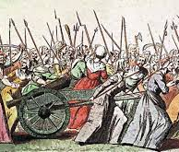
The Fish Women
The women of Paris who worked at the docks, stormed Versailles to king the queen.
The king and queen were saved but were forced to move to Paris.

Slide 17
Declaration of the Rights of Man and of the Citizen
The National Assembly adopted the Declaration of the Rights of Man and of the Citizen, a statement of democratic principles grounded in the ideas of the Enlightenment.
It was based on the principles of:
Equal opportunity
Equal representation
Freedom of speech

Slide 19
New Constitution
It took the National Assembly months to create a new constitution.
The new constitution was quite moderate, which didn’t sit well with radicals like Maximilien Robespierre and Georges Danton who wanted to remove the King.

Slide 20
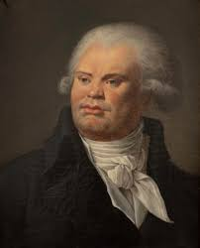

Slide 21
Revolution Turns Radical
In 1792, the Legislative Assembly (new name for National Assembly) declared war on Austria and Prussia which wanted to bring back the monarchy.
The radical Jacobins stormed the royal residence and arrested the king.

Slide 22
Part 2

Slide 23
Radicals
Following a wave of violence, the Legislative Assembly was replaced by the National Convention, which was led by the Jacobins.
The Convention declared an end to the monarchy and the beginning of the French Republic.

Slide 24
Death of the King
King Louis was put on trial for treason.
He was found guilty and sent to the guillotine.
Marie Antoinette followed him to the guillotine 9 months later.

Slide 26
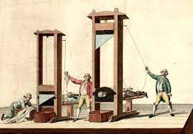

Slide 27
Committee of Public Safety
The Committee of Public Safety was selected from amongst the Convention.
It was given near dictatorial power.
Most believed the Committee was an unfortunate, but necessary, temporary reaction to foreign and civil unrest.

Slide 28
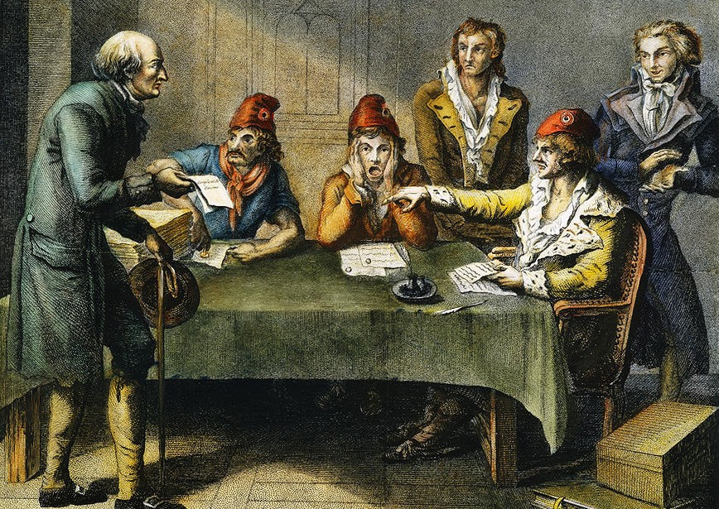

Slide 29
Jacobins
The Jacobins led a complete restructuring of French society including the establishment of a new calendar and the removal of the church.

Slide 31
The Reign of Terror
The Reign of Terror was a 10 month period in which suspected enemies of the revolution were guillotined by the thousands.
Many killings were made under the orders of Robespierre and the Committee of Public Safety.

Slide 32
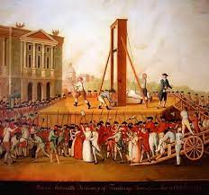

Slide 33
The Reign of Terror
One of the most repressive laws passed by the Committee was that anyone who, “by their conduct, relations, words, or writing show themselves to be supporters of tyranny and federal enemies of freedom” were suspected of treason.

Slide 34
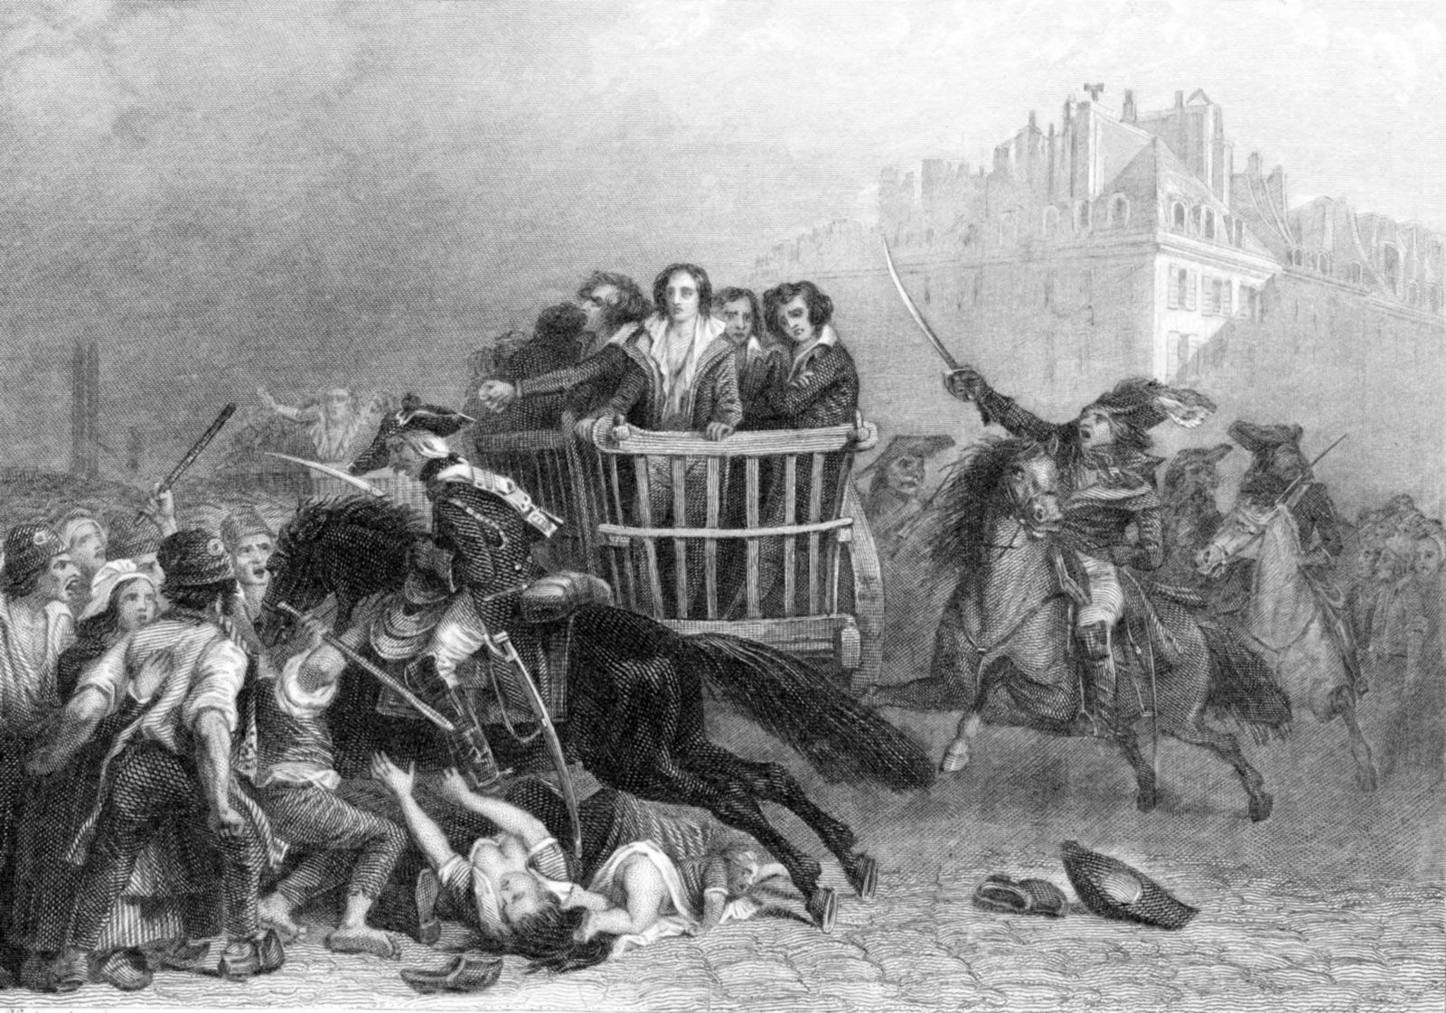

Slide 35
Age of Reason
Robespierre argued that “any institution which does not suppose the people good and the magistrate corruptible, is evil.”
This led to all suspected priests subject to the death penalty. Churches were closed and private worship was banned.

Slide 36
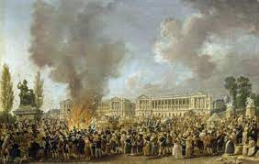

Slide 37
Nearing the End
A climax was reached with the celebration of the goddess of Reason and the creation of the Cult of the Supreme Being which became the official religion of the Revolution.
Robespierre, as the leader of this religion, began to lose his credibility.

Slide 38
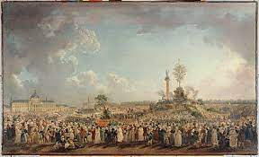

Slide 39
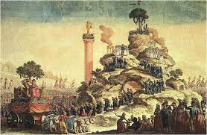

Slide 40
Fall of Robespierre
People began to see that Robespierre was going to far.
It all fell apart when Robespierre brought a list of names to the Convention of people he believed should be executed; however, he refused to announce the names.
Before the names could be read, the Convention arrested Robespierre and he was sent to the guillotine.

Slide 41
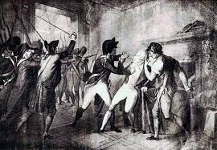

Slide 42
The Directory
With the fall of Robespierre, the National Convention approved a new constitution.
Executive power would lie in the hands of a five-member Directory appointed by parliament.
Both Royalists and Jacobins protested the changes but they were quickly put down by the army, led by a successful general named Napoleon Bonaparte.

