Slide 1
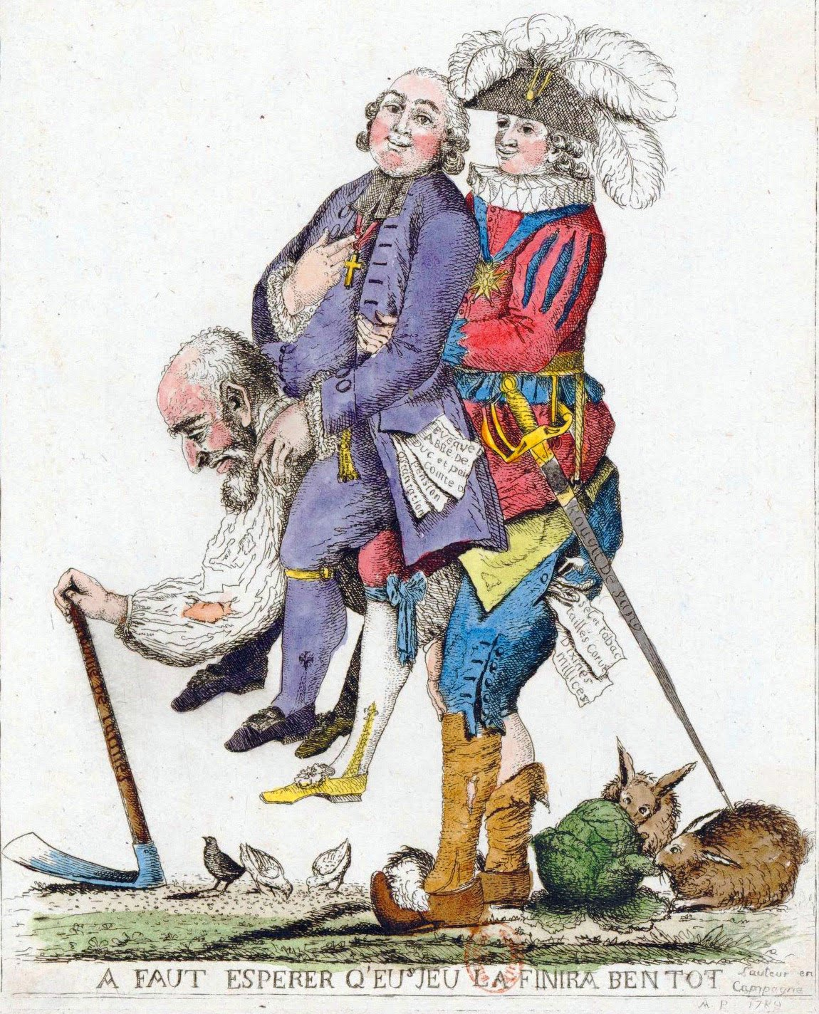
Published in French newspaper in the 1780s.

