Slide 1
The Fall of Communism

Slide 2
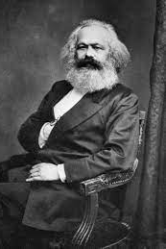
Communism
By the 1970s, one-third of the world’s population was living under some form of communism; however, by the end of the 1980s almost all of these major communist governments had crumbled.

Slide 4
The Berlin Wall
Constructed in 1961, the communist government of the German Democratic Government (East Germany), argued the wall would keep so-called Western “fascists” from entering East Germany, but it primarily served to stop mass defections from East to West Berlin.
The wall became a symbol of communist oppression.
The Berlin Wall fell in 1989, when the head of East Germany announced that citizens could cross the border whenever they pleased. This led thousands to swarm the wall and it was destroyed brick by brick.

Slide 9
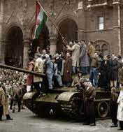
Cracks Forming
In 1953, workers in East Berlin staged a strike over conditions in the country that soon spread.
The dissent was quickly pushed down by the Soviet military.
Unrest spread throughout Eastern Europe, most notably in Poland and Hungary.
Soviet forces invaded Hungary in 1956 to crush what would be called the Hungarian Revolution.

Slide 10
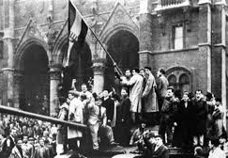

Slide 11
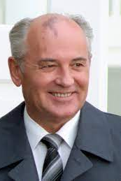
Gorbachev
Mikhail Gorbachev was young and reform-minded. He recognized there were economic problems and a discontentment with communism.
He wanted to introduce a policy of economic restructuring called perestroika. He also wanted to be more open with the West, this policy was called glasnost.

Slide 13
Falling Like Dominoes
When Russians realized that Gorbachev wouldn’t crack down on their new freedom of expression, their complaints went far beyond mere discontentment with the regime and communism.
Gorbachev’s policies made him very popular both in Russia and abroad.
When Eastern Europe realized the Russians wouldn’t step in, they began to topple their communist governments.

Slide 15
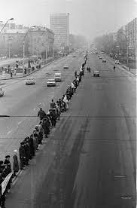
What About Ukraine?
With the Soviet Union crumbling, Ukrainians took to the streets to demand independence.
A referendum in 1991 found that 90% of Ukrainians wanted independence from Russia.
On Dec. 2, 1991 Poland and Canada were the first countries to recognize Ukraine’s independence.

Slide 16
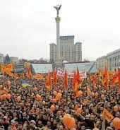
Orange Revolution
The election of 2004 saw two major presidential candidates: Victor Yanukovych (pro-Russia) and Viktor Yushchenko (pro-EU).
Yanukovych won by a narrow majority but people took to the streets in protes arguing that there was electoral interference.
Supreme Court ruled the election void.
In a new election Yushchenko won continuing Ukraine’s move toward the West.

Slide 17
The End
East and West Germany were reunited in 1990.
The Soviet Union disintegrated in 1991.
Although communism has nearly died out, there are still five countries that remain communist: China, Cuba, Laos, North Korea, and Vietnam.

Slide 19
Communism Today
Should we fear communism today? What about socialism?

