Slide 1
Entrepreneurship Basics
Unit 1

Slide 2
Intro to Entrepreneurship Video
https://www.youtube.com/watch?v=Y8z3OM8iwSU

Slide 3
What is An Entrepreneur?
Someone who exercises initiative by organizing a venture to take benefit of an opportunity and, as the decision maker, decides what, how, and how much of a good or service will be produced.
An entrepreneur supplies risk capital as a risk taker, and monitors and controls the business activities. The entrepreneur is usually a sole proprietor, a partner, or the one who owns the majority of shares in an incorporated venture.
They come in all ages, backgrounds, and create all different types of businesses.
What is An Entrepreneurship?
Entrepreneurship focuses on recognizing a business opportunity, starting a business based on the recognized opportunity, and operating and maintaining that business.

Slide 4
Why Do People Become entrepreneurs?
There are many reasons why someone starts their own business:
Leave their daily job.
Pursue a dream.
Thought of a great idea.
What to run their own business with their own hours
Other reasons?

Slide 5
Think about it…
List 3 reasons why you think someone would want to start their own business.
Name 3 local businesses and think of the purpose why the business was created.

Slide 6
Pros and Cons of Entrepreneurship
Advantages
disadvantages
Your own boss
Right to choose a business that interests you
You can be creative
You can make large sums of money
Risky
Uncertain outcomes
Work long hours
Make all decisions by yourself

Slide 7
Types of Entrepreneur businesses
Manufacturing- produces the products they sell.
Wholesaling- sell products to other businesses rather than the final consumer
Retailing- sell products directly to the people
Service- sell services rather than products
Green- focus on being organic or “green”.
Social- find innovative solutions to society's most press social problems.

Slide 8
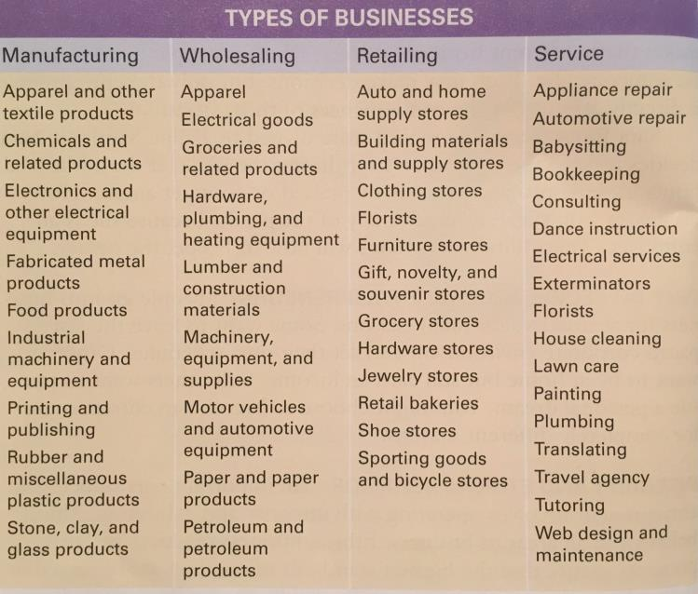

Slide 9
Think about it…
What type of business would you like to start up?

Slide 10
Entrepreneurs who changed America
Steve Jobs- Invented Apple
Bill Gates- He created Microsoft who created the internet
Henry Ford- created Ford Company
Mark Zuckenberg – invented facebook and boosted social media.
Name 2 more…

Slide 11
Characteristics of successful entrepreneurs
Independent
Self-confident
Determination and perseverance
Goal-oriented
Creative
Strong work ethic
Master networkers
Up to date with technology
What characteristics do you have to make you a great entrepreneur?

Slide 12
Integrity and Ethical Behavior
This is extremely important when running a business.
Ethical Behavior is acting in ways consistent with what society and individuals typically think are good values. Ethical behavior tends to be good for business and involves demonstrating respect for key moral principles that include honesty, fairness, equality, dignity, diversity and individual rights.
Integrity is the quality of being honest and having strong moral principles; moral uprightness. Operate with integrity entrepreneurs behave consistently in actions, values, methods, measures, principles, expectations, and outcomes.

Slide 13
Characteristics of good team members
Entrepreneurs realize there are other stake holders to make their business successful. Such as investors, partners, employees, suppliers, customers, etc. Good team members display the following characteristics:
Commitment
Competency
Communication
Cooperation
Creativity

Slide 14
Employees VS. Entrepreneurs
Employee
Entrepreneur
Hired to work for someone else.
They assume the risk. They are directly affected by the business.

Slide 15
Random Facts
Small businesses usually fail and owners lose their investments
There are over 9 million business owned by women
Almost half of all new businesses do not succeed.
A thriving community can help the success of your business.
All it takes is one good idea.
Many entrepreneurs start out with small business that grow into large corporations.

Slide 16
Finish
Finish your notes and answering rest of the questions.
This is due by the end of class.

Slide 17
Project
You will be researching a business or entrepreneur of your choice.
The project with details is on Google Classroom
Read your directions to complete your project.

Slide 18
Work Cited
Entrepreneurship Ideas In Action- Cynthia L. Greene
http://www.forbes.com/sites/kenkrogue/2013/07/03/what-is-an-entrepreneur/#2947f84f5586
https://www.entrepreneur.com/slideshow/271993
http://www.businessdictionary.com/definition/ethical-behavior.html
https://www.entrepreneur.com/article/200730
https://www.nbea.org/newsite/curriculum/standards/entrepreneurship.html
http://www.businessdictionary.com/definition/entrepreneur.html
https://www.entrepreneur.com/article/200730

