Slide 1
Enthusiasm for War
Canada

Slide 2
Request for Men
When Britain declared war on Germany, Canada was automatically also at war with Germany.
Britain requested 25, 000 men
Prime Minister Borden passed the War Measures Act, giving the government the authority to do whatever it thought necessary for the “security, defense, peace, order and welfare of Canada.”

Slide 3
War Measures Act
The War Measures Act was an incredibly powerful piece of legislation. In 1988 this Act was repealed and replaced by the Emergencies Act. Which act do you believe is better?
War Measures Act | Emergencies Act
Gave the government broad powers to maintain “security, defense, peace, order and welfare of Canada during war, invasion or insurrection.” | The Emergencies Act authorizes “the taking of special temporary measures to ensure safety and security during national emergencies and to amend other Acts in consequence thereof.”

Slide 4
Motivation to Fight
Germany’s brutal invasion of Belgium shocked many Canadians.
School texts and poems depicted war as a romantic adventure.
Some saw war as a temporary escape from the monotony of work.

Slide 7
Recruitment
Potential soldiers needed to be at least 5’3”, and between 18 and 45 years old.
Most visible minorities were rejected. First Nations peoples were embraced for their skills as scouts and snipers, but most black and Asian Canadians were rejected.

Slide 8
Francis Pegahmagabow https://www.youtube.com/watch?v=kYzDBeG3By0

Slide 9
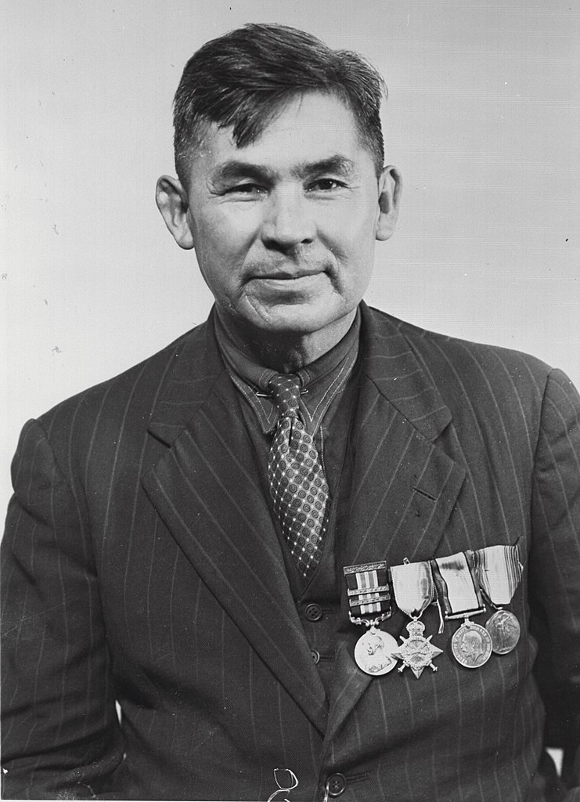
Is there ever justifiable reason to discriminate against certain groups of the Canadian population when is comes to military service?
Here are a few debates that have been prominent in the past:
Women serving on the front lines
Women serving on submarines
At war with Germany and German-Canadians want to join the Canadian Army.

