Slide 1
Dialectical/ Argumentative Thesis Statements

Slide 2
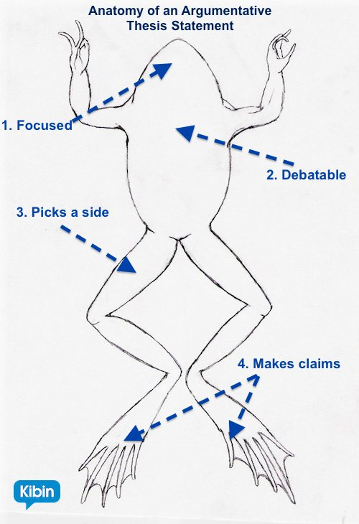

Slide 3
Creating Your Dialectical Essay Thesis Statement
Your thesis statement needs to be focused, it should pick a side, and should let the reader know what they will find in your essay.

Slide 4
Examples
“The long history of abuse at Canada’s Residential Schools reveals a deep failure by the Canadian government, and while many argue that compensation can no longer be awarded due to the passage of time, I believe that compensation is the best path forward in beginning to heal these deep wounds.”
“The relationship between the French minority and English majority in Canada is long and marked by conflict, and while recent events continue to remind us of this age old conflict, it is my belief that the relationship between these two communities is stronger now than it has been in decades.”

Slide 5
Chicago Style
http://www.citationmachine.net/chicago
Your essay must include a bibliography. This should be a list of sources on the last page of your essay. For the purpose of this essay, you do not need footnotes or endnotes.
Everyone must include the movie as one of their sources:
John A: Birth of a Nation. Directed by Jerry Ciccoritti. Performed by Shawn Doyle and Peter Outerbridge. Canada: CBC, 2011.

