Slide 1
Dialectical/ Argumentative Thesis Statements

Slide 3
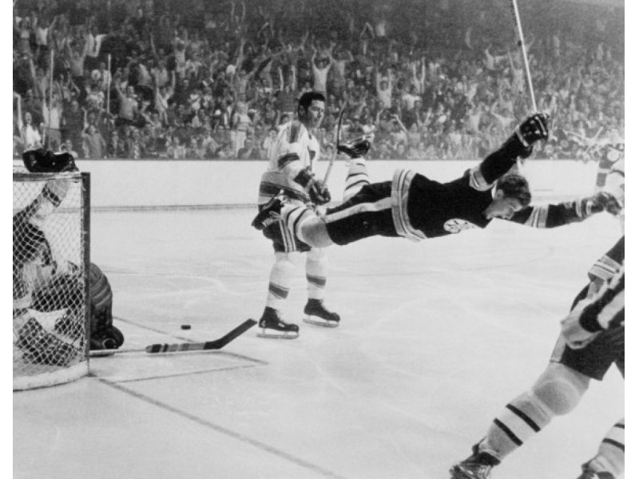
1. Focused
A good thesis statement is focused and not too broad.
DON’T WRITE, “The Boston Bruins are a skilled and formidable hockey team.”
DO WRITE, “The Boston Bruins are a formidable hockey team because of their superior talent, will to win, and championship legacy.”

Slide 4
2. Debatable
A good argumentative thesis is centred on a debatable topic.
DON’T WRITE, “There are high numbers of homeless people living in Vancouver, British Columbia.”
DO WRITE, “Homeless people in Vancouver should be given access to services, such as public restrooms and camping facilities, because it would improve life for all inhabitants in the city.”

Slide 5
3. Picks a side
A good thesis picks a side.
DON’T WRITE, “Chevy trucks have been one of the most reliable vehicles on the market for years; therefore it should be one of your first choices when purchasing a truck, but there are also many other good options out there as well.”
DO WRITE, “Chevy trucks have been one of the most reliable vehicles on the market for years; therefore, because of their long-standing reputation and pursuit of excellence, it should be your first choice in choosing a new truck.

Slide 6
4. Makes a claim
A good thesis statement makes a claim that will be supported later in the paper.
DON’T WRITE, “Some people like horses, others prefer quads.”
DO WRITE, “Horses are a dated technology that should be replaced by quads which allow farmers greater flexibility in their day to day work.”

Slide 7
Writing a Killer Thesis Statement!
Answer the question
Refine your answer
Focus with examples
Go deeper
https://www.youtube.com/watch?v=9R0ivCaLtnY

Slide 8
Practice
Answer the question:
Anne Nelson is the most admirable historical figure in the Confederation of Canada.
Refine:
In the Confederation of Canada, Anne Nelson may not be one of the most prominent figures, but she changes the history of the country through the influence she has on George Brown.
Focus:
In the Confederation of Canada, Anne Nelson may not be one of the most prominent figures, but she changes the history of Canada though the influence she has on George Brown: by challenging his beliefs, providing him with a listening ear, and encouraging him to do the right thing for the country above all else.

Slide 9
Bibliography

Slide 10
Chicago Style
http://www.citationmachine.net/chicago
Your essay must include a bibliography. This should be a list of sources on the last page of your essay. For the purpose of this essay, you do not need footnotes or endnotes.
Everyone must include the movie as one of their sources:
John A: Birth of a Nation. Directed by Jerry Ciccoritti. Performed by Shawn Doyle and Peter Outerbridge. Canada: CBC, 2011.

