Slide 1
The Cold War
An Introduction

Slide 2
The Cold War
The open yet restricted rivalry that developed after WW2 between the United States and the Soviet Union, or between capitalism and communism.

Slide 3
Germany Divided
After WW2 Germany was occupied and then divided between the Allies. The American, British, and French zones made up the western two-thirds, while the Soviet zone comprised the eastern third.
Berlin, which was surrounded by the Soviet zone, was also split into 4 zones of occupation.

Slide 5
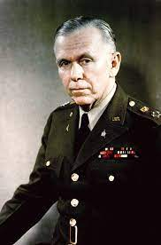
Marshall Plan
US program to provide aid to the nations destroyed by WW2.
Named after US secretary of state George Marshall.
By 1952, those nations that received assistance through the Marshall Plan had surpassed pre-WW2 economic levels.

Slide 6
Ethical Dimension
Should Canada be providing financial aid to developing nations? What level of assistance should be provided?

Slide 8
Berlin Airlift
The U.S., Britain, and France unified their occupation zones. The Soviets did not want unification. They wanted to continue to occupy Germany to prevent further aggression.
The Soviet Union feared the power and influence of a unified capitalist Germany.
The Soviets put up a blockade of West Berlin to starve the West into submission.
The Allies decided to resupply West Berlin from the air.
The Allies delivered about 8,000 tons of supplies/day.
An Allied plane took off or landed in West Berlin every 30 seconds. The planes made nearly 300,000 flights in all.

Slide 9
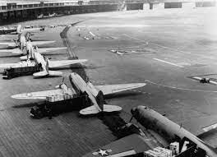
Berlin Airlift

Slide 10
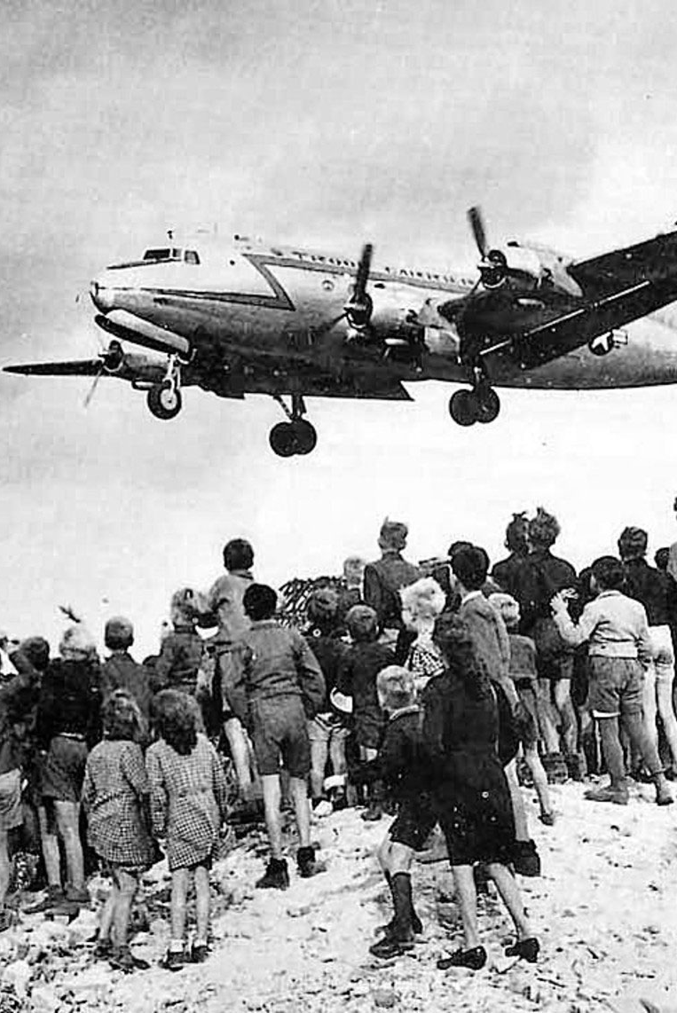
Berlin Airlift
The Soviet blockade was a failure and ended soon after it started.
The Marshall Plan and the Berlin Airlift are often seen as the beginning of the Cold War.

Slide 11
The Arms Race

Slide 12
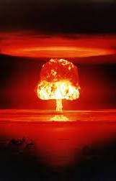
Nuclear Arms Race
When the United States dropped the atomic bombs on Japan in 1945, they didn’t tell the Soviets about their plans.
To help discourage Soviet communist expansion, the US built more atomic weaponry.
In 1949, the Soviets successfully tested their own atomic bomb.
In 1952, the US tested the first hydrogen bomb. The Soviets followed in 1953.

Slide 13
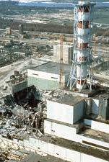
Effects of Nuclear Blast
The blast: 40-50% of total energy
Thermal radiation: 30-50% of total energy
Ionizing radiation: 5% of total energy
Residual radiation: 5-10% of total energy

Slide 15
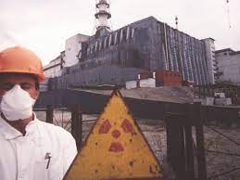

Slide 17
Small Modular Reactors

Slide 18
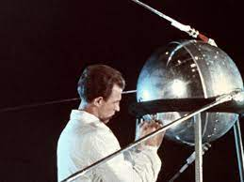
Arms Race Heads to Space
Soviet’s launched the first Sputnik satellite is 1957.
The US poured funds into their own space program and launched its first satellite into space in 1958.
Race began to get to the moon.
US successfully landed a man on the moon in 1969.

Slide 22
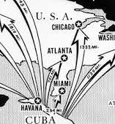
Cuban Missile Crisis
The Cold War arms race came to a tipping point in 1962 after John F. Kennedy’s administration failed to remove Fidel Castro’s communist government in Cuba (Bay of Pigs).
Soviet premier Nikita Khrushchev implemented a secret agreement to place Soviet warheads in Cuba to deter future occupation.
US intelligence intercepted the Soviet attempt to bring nuclear weapons into Cuba and enforced a blockade of Cuba.
Both sides began to question the need for weapons that guaranteed “mutually assured destruction.”

Slide 23
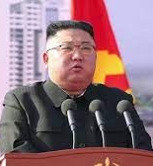
Arms Races Continue
In 1968, the UN created the Nuclear Non-Proliferation Treaty (NPT) which seeks to discourage the trading of nuclear arms and the disarmament of nuclear nations.
North Korea, India, Israel, Pakistan, and South Sudan have not signed.

Slide 24
Ethical Dimension
Is it ethical to implement nuclear deterrence as a self-defense strategy? Should Canada be pursuing its own nuclear program?

