Slide 1
Changes to Warfare
WW1

Slide 2
Total War
Coined in the 1930s by Germany’s Paul von Ludendorff
Total war – when all segments of society are mobilized for the war effort. “The entire nation is called into service, not just the military.”

Slide 3
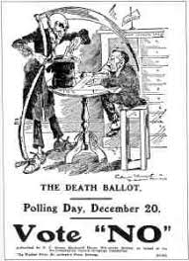
Conscription

Slide 4
Conscription

Slide 5
Total War
Economy transformed
Governments enacted law granting them powers that would have never been enacted during times of peace.
From curriculum: “The war demonstrated that the government could successfully manage large sectors of the economy.”

Slide 7
Women in WW1
Large numbers of women were recruited into jobs vacated by men as the war began.
Munitions factories were the single largest employer of women in 1918.
Women were paid a lower wage than the men who had previously held the same position.

Slide 8
Women in WW1

Slide 10
Women in WW1
At the end of the war and afterward, women began petitioning and striking for voting rights and ‘equal pay for equal work’.
Canada implemented its first minimum wage policy in 1918. It was only for women and children.
Women won the right to vote in Manitoba in 1916.
Federally, women won the vote in 1919.
Men had been given the vote free of land/financial requirements in 1898.
Many minority groups still did not have the vote.

Slide 11
Women in WW1

Slide 12
Suffragette – a women seeking the right to vote through protest

Slide 13
Technology
the most extensively used, most devastating, and by far the most important was artillery.
More artillery was used in WW1 than in WW2, the Korean War, and the Vietnam War combined.
One of the largest artillery barrages was in 1917 prior to the Battle of Passchendaele. The British launched over 4.5 million shells in less than 2 weeks.

Slide 14
Big Bertha 420 mm howitzer
At the time of its construction, it was the largest mobile artillery piece in the world.

Slide 15
Paris Gun
238 mm
Had a range of over 120 kms

Slide 16
Paris Gun

Slide 17
Paris Gun

Slide 18
Trench Warfare
“Stand-to” at Dawn
Each dawn, soldiers woke to “stand-to,” guarding the front line trenches.
This was when most attacks would occur.

Slide 19
Trench Warfare
Dangerous Nighttime Activity
In the night soldiers would go into No Man’s Land and repair barbed, dig new trenches or raid enemy trenches.

Slide 20
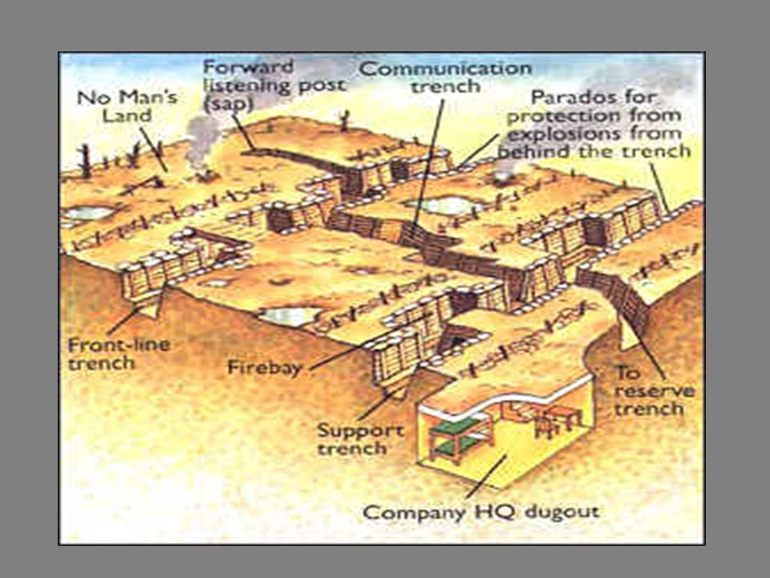

Slide 21
Trench Warfare
“Wastage”
“Wastage” refers to the steady trickle of death between raids usually by shelling or snipers.
“Wastage” rates were arount 10% of all causualties.

Slide 22
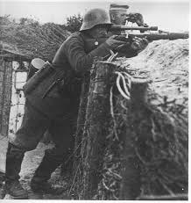

Slide 23
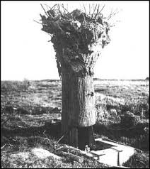

Slide 24
Trench Warfare
https://www.youtube.com/watch?v=P92guhd7d-8

Slide 25
Trench Warfare
Psychological Affect of War
Shell Shock - a term coined in WW1 used to describe soldiers who broke down under the strain of war

Slide 26
PTSD
Shell Shock is a term we don’t use anymore,. Today we refer to the psychological effects of war as PTSD.
A lot of progress has been made in the treatment of PTSD.

Slide 27
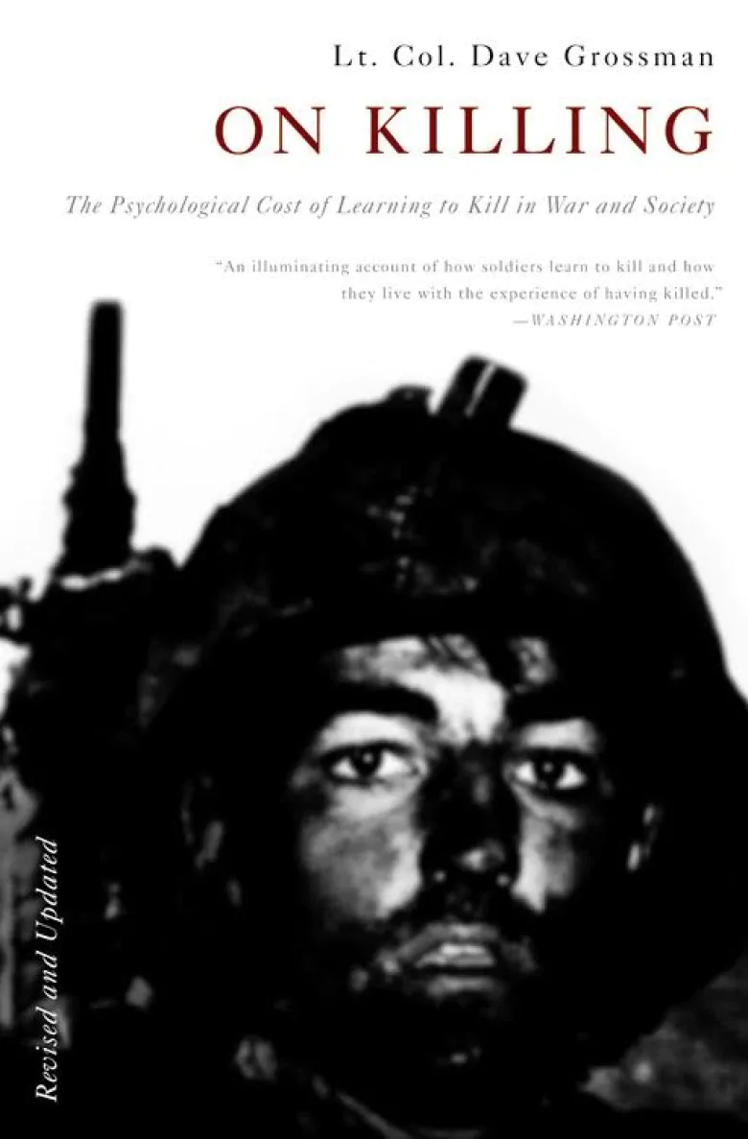
Psychologist and U.S. Army Ranger Dave Grossman writes that the vast majority of soldiers are reluctant to pull the trigger in battle. Unfortunately, modern armies, using Pavlovian and operant conditioning, have developed sophisticated ways of overcoming this instinctive aversion. The mental cost for members of the military, as witnessed by the increase in post-traumatic stress, is devastating. The sociological cost for the rest of us is even worse. Contemporary civilian society, particularly the media, replicates the army's conditioning techniques and Grossman argues this type of society is responsible for the rising rate of murder and violence, especially among the young.

Slide 28
Response
Question #1 – Are there segments of our society that are currently marginalized? Explain.
Question #2 – Should an individual’s freedom of speech be curtailed in times of crisis to maintain order and unity?
Question #3 – What affect does our current media have on creating a society where random acts of violence are commonplace?
Question #4 – Is the fact that our brains can change in such a short period of time something that we should fear? Can you predict what kinds of changes may be coming?

