Slide 1
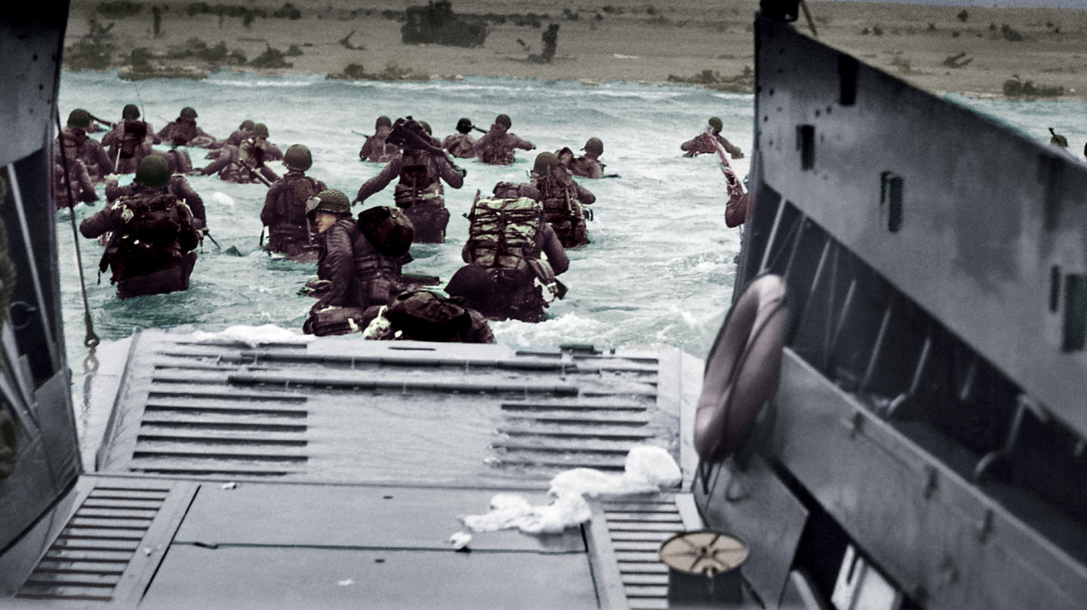
Canada and the Second World War

Slide 2
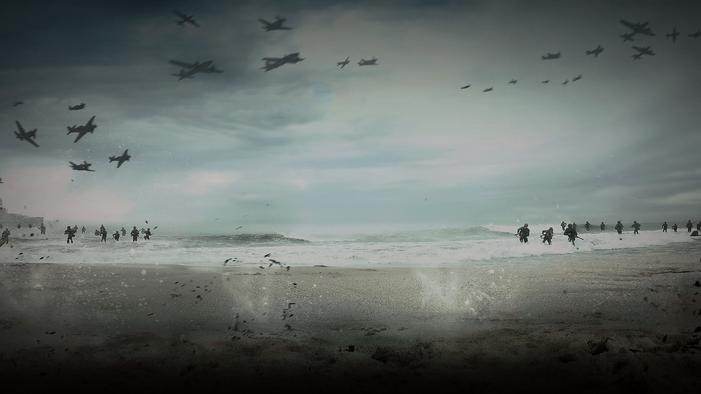
Path to War
Appeasement – policy of making political or military concessions to an aggressive power
Initially PM King supported Britain’s stance of appeasement under British PM Neville Chamberlain.
When Germany invaded Poland in 1939, both Canada and Britain abandoned appeasement and declared war.

Slide 3
Neville Chamberlain at the Munich Agreement. “Peace in our time.”

Slide 4
The Battle of the Atlantic
The battle was fought from 1939-1945, and was the longest continuous battle of the Second World War.
Germans sought to cut off England from supplies to starve it into submission.
Canada’s primary role was in escorting ships across the Atlantic.
U-boats fought in ‘wolfpacks’
Black Pit – refers to a stretch of ocean beyond range of the Allied aircraft.
*play scene from Greyhound

Slide 5
Project Habbakuk

Slide 6
Battle of Hong Kong
Hong Kong was the first land battle that Canadians took part in.
Troops from Winnipeg and Quebec City fought bravely in defense of the city against an overwhelming Japanese force.
*play video of Victoria Cross winner

Slide 7
Dieppe Raid
In 1942, the Canadians launched a major raid on the French coastal port of Dieppe.
Codenamed Operation Jubilee.
It was designed to test the German sea wall defenses.
The raid was a disaster.

Slide 8
Dieppe Raid
https://www.youtube.com/watch?v=sbSn0wccJAo
What was the purpose of the raid?
a. To provoke a major air battle so the RAF could knock out the Luftwaffe.
b. An attempt to show Stalin that opening up a front in France was not possible.
c. To collect intelligence and collect prisoners.
d. To test out German defenses in preparation for D-day.

Slide 9
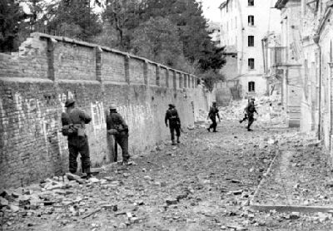
Invasion of Italy and Battle of Ortona
In 1943, the Canadians took part in the invasion of Germany's ally, Italy.
The battle was one of the most
vicious of the war.
Characterized by heavy street fighting.
Canadians would eventually clear a
path into Rome, but were halted
outside of the city.

Slide 11
D-Day and the Battle of Normandy
On June 6, 1944, Allied forces began their invasion of France in an effort to create a beachhead against Hitler’s Atlantic Wall.
Codenamed Operation Overlord.
Canadians responsible for taking Juno Beach.
Juno was the most heavily defended beach apart from Omaha Beach and the Canadians were able to push further inland than any other Allied force.
Largest amphibious invasion in history.

Slide 15
Why D-Day?
Military operations often didn’t have a specific date attached to them, this was the case for the invasion of Normandy.
The operation date was known as D-day.
Play Bloody Normandy

Slide 16
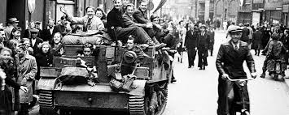
Liberation of the Netherlands
While the Americans swept through France on their way to Berlin, it fell to the Canadians to liberate the lowlands of the Netherlands.
Cost the lives of over 10,000 Canadian soldiers.

Slide 17
Industrial Contribution
During the First World War, Canada’s industrial contribution was restricted to the manufacture of munitions.
During the Second World War, Canada manufactured aircraft (Hurricane), frigates, corvettes, and destroyers, as well as technical military equipment.

Slide 18
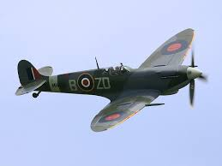

Slide 19
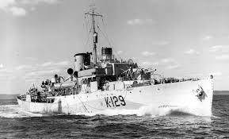

Slide 21
Glide Bomb

Slide 22
Atomic War
Canada had a limited role in the development of the atomic bomb and the Manhattan Project.
Canada was one of the few nations that had knowledge of the project and provided materials.
There was tension between Britain and the US, but at the Quebec Conference, Canada was given some control over the decision making process as a kind of mediator.

Slide 24
Trinity Test *play trinity test video

Slide 25
Conscription
After the D-day landing, many in English Canada clamoured for conscription.
King and Liberals knew this would not be popular in Quebec, so they offered a plebiscite on releasing the government from its pledge of resisting conscription.
At the end of 1944, conscripts were finally sent overseas but were used in a limited role.

Slide 26
Cost
The financial cost of the war was astronomical. Expenditure for 1939-40 was $118,000,000, and in 1943-44 it was $4,500,000,000.
The significance of the Second World War in Canadian history is great, but probably not as significant as the Great War (WW1).
National unity was damaged due to the conscription debate, but not to the extent seen in WW1.
Why do you think this is the case?
Our status as an independent country was established after WW1. Following WW2, Canada was without question an important ‘middle power’ in the world.

Slide 27
