Slide 1
Canada-U.S. Relations
History 30

Slide 2
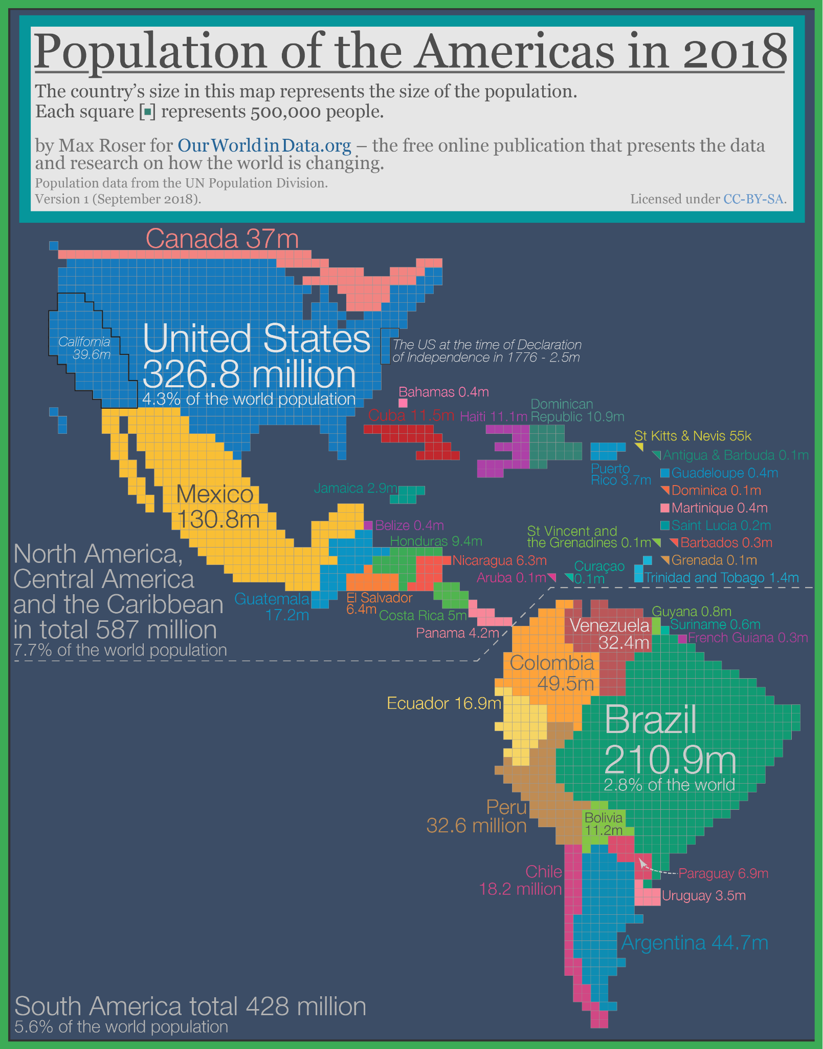
Canadian author, Robertson Davies, once wrote that Canada was the “attic” of the North American continent: upstairs was the unimportant little nation of Canada and downstairs was the giant American superpower.

Slide 3
Canada After the War
In the late 1940s and 50s Canadians were proud of their wartime achievements and looking forward to taking their place in the world:
Canada had made a sizable contribution to the Allied victory in WW2
Canada was at the forefront of science and technology (ex. Invention of insulin and radiation therapy for cancer, invention of the Avrow Arrow)
Canada was finding great success in the Olympics (especially the Winter Games)
Canadian entertainers found great success within Canada and were greatly admired (ex. Creation of the CBC)

Slide 4
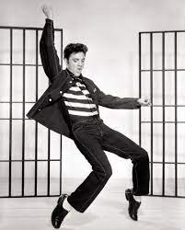
Americanization
During the late 1950s there was a rising tide of American culture that flooded Canada through radio, television, books, and magazines.
A debate began within Canada concerning our identity and independence in the North American continent.

Slide 5
Defense
As the Cold War progressed, Canada lacked the funds to provide the United States with the protection it felt it required from the north.
In 1966 NORAD (North American Aerospace Defense Command) was established as a joint effort between Canada and the United States to provide an early warning system for North America.
Increasingly Canada began to rely on the United States for defense.

Slide 6
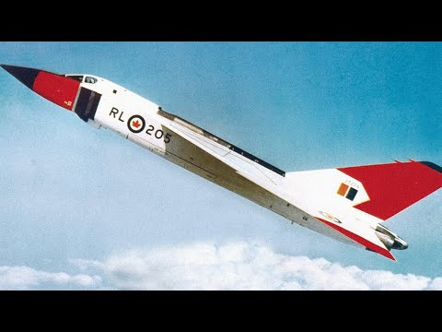
Avrow Arrow
Canada developed one of the most advanced fighter jets in the world, but it was scrapped because the government believed it was too expensive and it would be better to simply rely more on American military strength to protect Canada.
https://www.youtube.com/watch?v=pBAF0Sl2Hq4

Slide 7
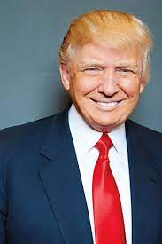
Defense
In 1949, NATO (North Atlantic Treaty Organization) was signed by 30 countries including Canada and the United States.
Member states agree to mutually defend one another as a deterrence to future conflict.
Under the NATO agreement, member states are expected to spend at least 2% of their GDP (Gross Domestic Product) on their military. Under PM Trudeau, Canada spends less than 1.5%.
In 2019, President Trump called out Trudeau for failing to meet this target and called him”two-faced”.

Slide 8
Defense
Should Canada increase its military spending?
Should we continue to rely on the United States for much of our defense?

Slide 9
Culture
There has always been a great fear in Canada that the American media will swallow up our Canadian identity and we will lose what makes us different.
One answer to this is the CBC, which is a publicly funded (taxpayer funded) media network which produces original Canadian programming.
Is there a unique Canadian identity? How would you describe it?

Slide 10
Culture
Should we fear media influences from the United States?
Do we need the CBC?
Read CBC articles.

