Slide 1
Battle of 1812
Primary Sources

Slide 2
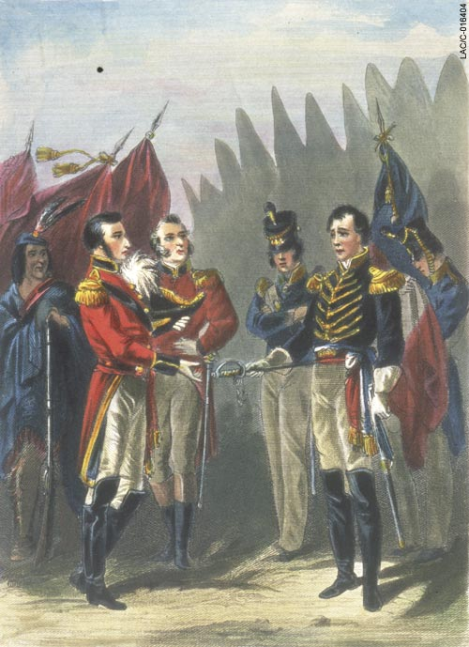
Who are the two people in the picture?
Describe their reaction to what is happening.
What do you think is happening in the picture?

