Slide 1
Baptism
An Anabaptist Perpective

Slide 2
Is baptism necessary for salvation?
Sanctification is a process
Justification through faith
Romans 3:28, 5:1, 4:5
John 3:16
Acts 13:38

Slide 3
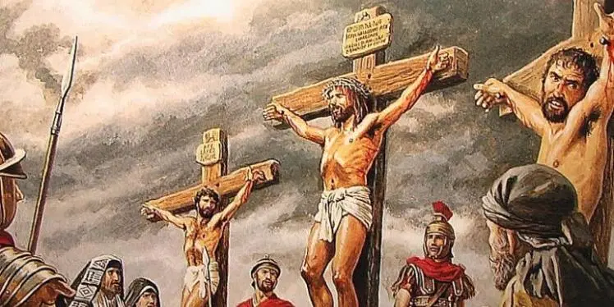
Thief on the cross
Promised that he would be in
heaven.
Wasn’t baptized.
Special case…

Slide 4
Colossians 2:11-12
^{11 ”}In him you were also circumcised with a circumcision not performed by human hands. Your whole self ruled by the flesh^{[a]} was put off when you were circumcised by^{[b]} Christ, ¹² having been buried with him in baptism, in which you were also raised with him through your faith in the working of God, who raised him from the dead.”
Baptism is a symbol.

Slide 5
Re-baptize?
^{Ephesians 4:5-6}
^{“5} One Lord, one faith, one baptism,
⁶ One God and Father of all, who is above all, and through all, and in you all.”

Slide 6
Menno Simons on Baptism
“Again, Paul calls baptism "the washing of regeneration." O Lord, how lamentably thy Holy Word is abused. Is it not greatly to be lamented, that men are attempting, notwithstanding these plain passages, to maintain their idolatrous invention of infant baptism, and set forth that infants are regenerated thereby, as if regeneration was simply a pressing into the water? O no, regeneration is not such a work of hypocrisy, but is an inward change, which converts a man by the power of God, through faith, from evil to good, from carnality to spirituality, from unrighteousness to righteousness, out of Adam into Christ, which can in no wise take place with infants. The regenerated live by the power of the new life; they crucify the flesh with its evil lusts; they put off the old Adam with his deeds; they avoid every appearance of evil; they are taught, governed and influenced by the Holy Ghost.” Rom. 1:17.

Slide 7
Persecution
Anabaptism was made a capital crime. Prices were set on the heads of Anabaptists. To give them food and shelter was a made a crime. The duke of Bavaria, in 1527, gave orders that the imprisoned Anabaptists should be burned at the stake — unless they recanted, in which case they should be beheaded. In Catholic countries the Anabaptists, as a rule, were executed by burning at the stake; in Lutheran and Zwinglian states, Anabaptists were generally executed by beheading or drowning.

Slide 8
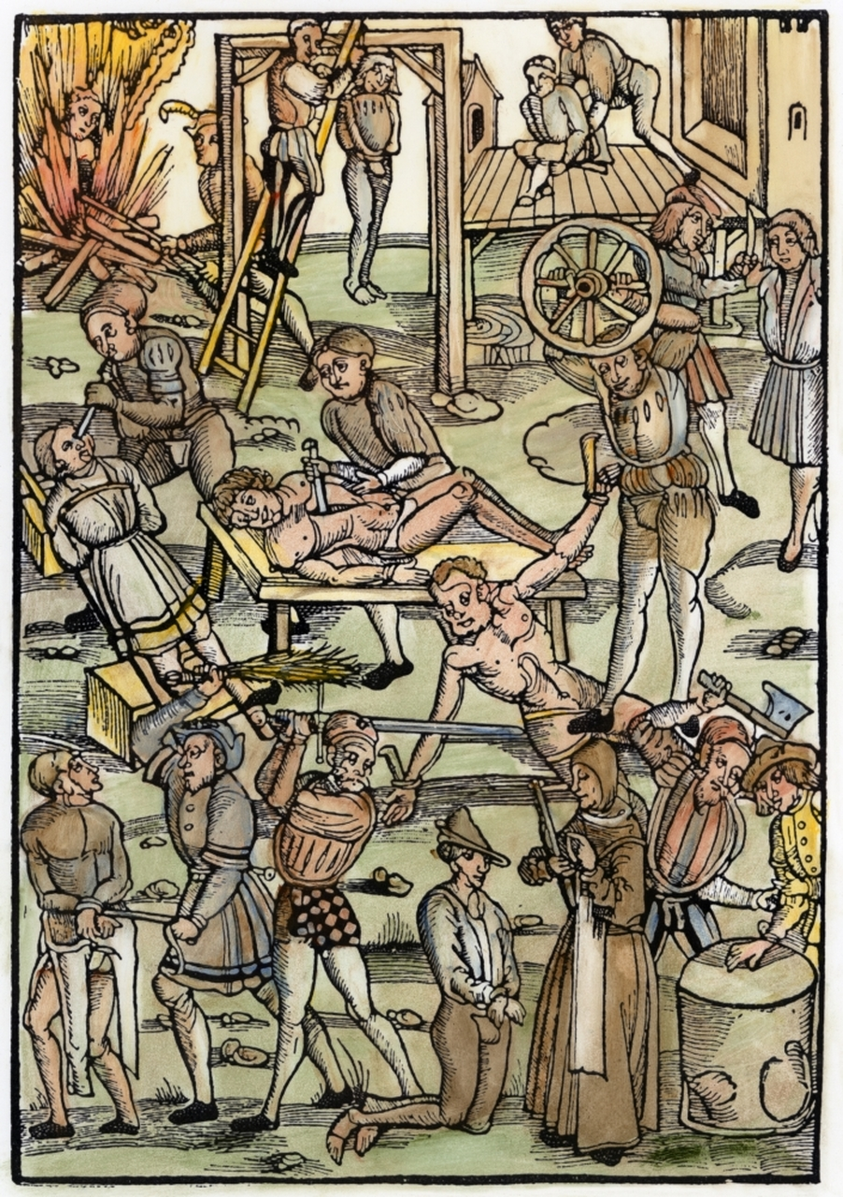
Medieval Persecution

Slide 9
Persecution
Dirk Willems of Holland was re-baptized when he became a believer, thus rejecting the infant baptism practiced at that time. This action, plus his continued devotion to his new faith and the re-baptism of several other believers in his home — led to his subsequent arrest and martyrdom.
An officer came to arrest him at the village of Asperen. Running for his life, Dirk came to a frozen pond. After making his way across in great peril, he realized that his pursuer had fallen through the ice, and into the freezing water.
Turning back to save the drowning officer, Dirk dragged him safely to shore. The man wanted to release Dirk, but a burgomaster, having appeared on the scene — reminded him that he was under oath to deliver criminals to justice. Dirk was bound off to prison, interrogated, and tortured in an unsuccessful effort to make him renounce his faith. He was tried and found guilty of having been re-baptized, of holding secret meetings in his home, and of allowing baptism there — all of which he freely confessed. "Persisting obstinately in his opinion", Dirk was burned at the stake near his hometown on 16 May 1569, by these blood-thirsty, ravening wolves — enduring it with great steadfastness.

