Slide 1
World War 1
History 20

Slide 2
The Outbreak
War began on June 28th, 1914
Austria-Hungary declaring war on Serbia

Slide 3
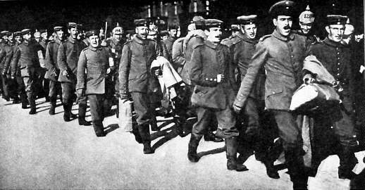
The Road to War
In 1914, Europe was primed for war.
It was not only the politicians who were anticipating war – frequent war scares had caused European society to become increasingly militaristic and nationalistic.
Many people not only expected war, but welcomed it.
Each side had long prepared for war. They had written plans, books and policies on what to do. These plans also played a part in the outbreak of large-scale war in 1914.

Slide 4
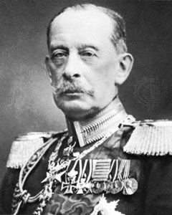
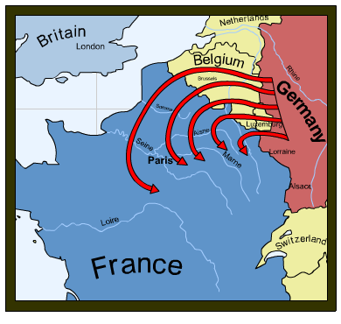
The Schlieffen Plan
The most influential plan was that of Germany – the Schlieffen Plan – drawn up in 1905 by General Alfred von Schlieffen.
It was an ambitious plan designed to avoid Germany having to fight a two-front war against France and Russia.
The plan was to invade France and capture Paris before the Russians could mobilize.
It relied on three things:
German speed
slow Russian mobilization (6 weeks?)
Britain staying out of the war.

Slide 5
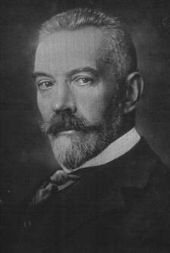
Britain’s Position
Britain’s position in 1914 was complicated.
Despite having alliances with France and Russia, Britain had made no firm promises to help them in war.
However, Britain had promised in 1834 to protect the neutrality of Belgium if she was ever attacked.
The Schlieffen Plan required the German army to attack France through Belgium. The German generals gambled that Britain would not keep her promise to defend Belgium.

Slide 6
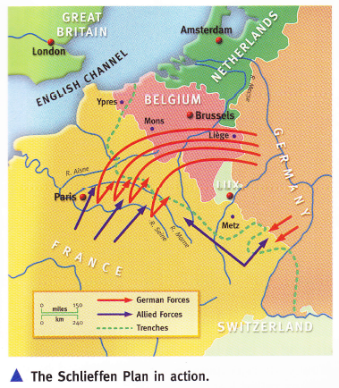

Slide 7
Stalemate on the Western Front

Slide 8
“The boys will be home by Christmas”
Europeans on both sides declared confidently in August 1914
Think:
Take a moment to think what would lead these countries to expect to be done by Christmas?
Discuss it with the person beside you

Slide 9
What caused the Schlieffen Plan to fail?
Use your phones to look up:
Why did the Schlieffen Plan fail?
Find a minimum of 4 reasons and clearly explain why they lead to German failure
What was the Battle of the Marne
Who fought
What happened?
What did this mean for the German army?

Slide 10
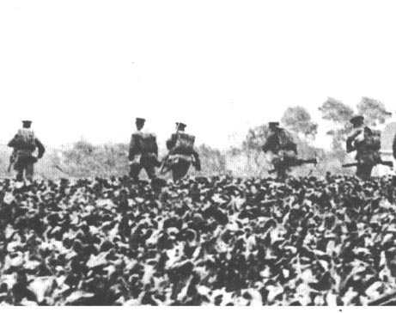
Why did it fail? Reason 1
Whilst the plan looked good on paper, it underestimated the distances the German Army had to cover in the strict timetable.
The German troops on the extreme right were exhausted after several weeks of marching and fighting and were unable to keep up the pace. This meant Paris was not surrounded.

Slide 11
Why did it fail? Reason 2
Second, even before 1914, the plan was changed. Von Moltke, the new Chief of Staff, withdrew forces from the right wing of the German army to strengthen the left.
He also sent some battalions to the Eastern Front with Russia. This slowed down the advance and left the German right wing unable to push forward and surround Paris from the West.
Year | Right flank in Belgium | Left flank in Alsace-Lorraine
1905 | 54 | 8
1912 | 75 | 11
1914 | 54 | 17
> Numbers of German infantry divisions in the Schlieffen Plan

Slide 12
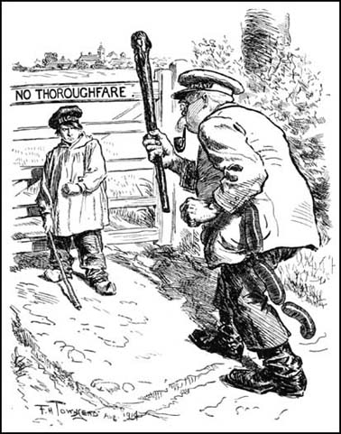
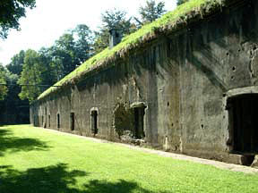
Why did it fail? Reason 3
Thirdly, Belgian resistance was stronger than expected. The Belgian forts at Liége held out for 12 days and Brussels was not occupied until 20th August.

Slide 13
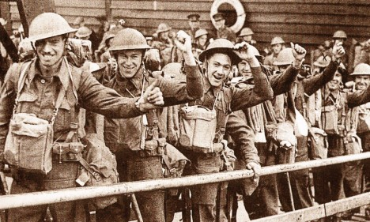
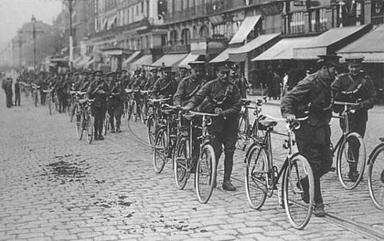
Why did it fail? Reason 4
Fourthly, the British sent an Expeditionary Force (BEF) of 80,000 men to Belgium. They met the Germans at Mons on 23rd August and again at Le Cateu on 26th August.
Although the British were forced to retreat at Mons, they managed to inflict heavy casualties on the Germans before issuing a tactical retreat to Paris which took 2 weeks.

Slide 14
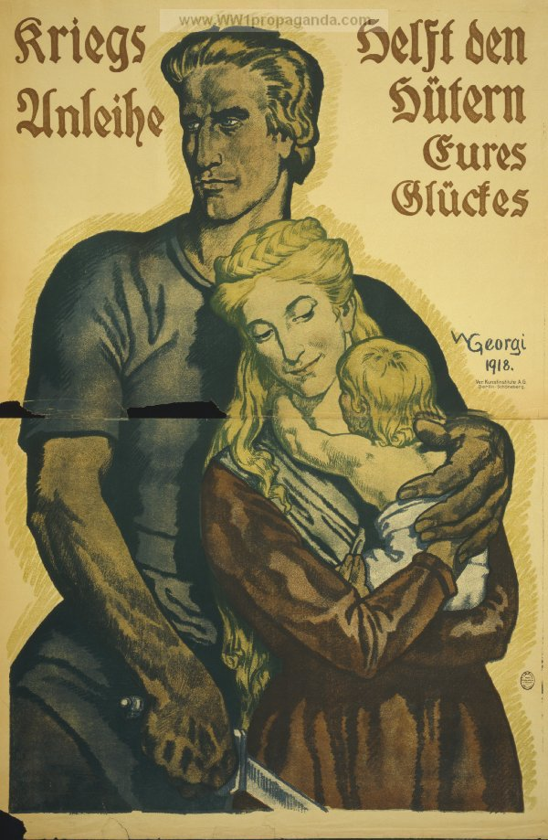
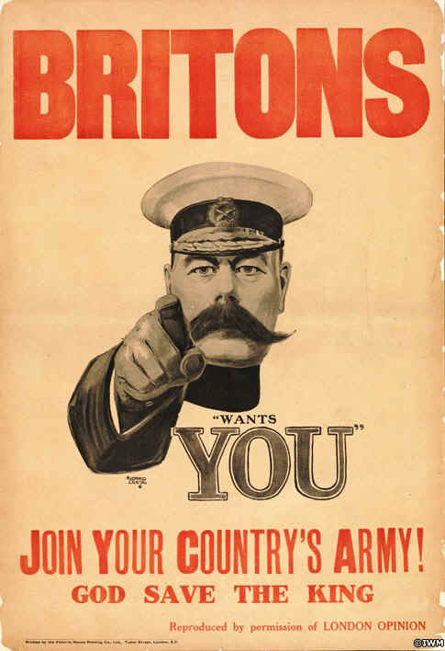
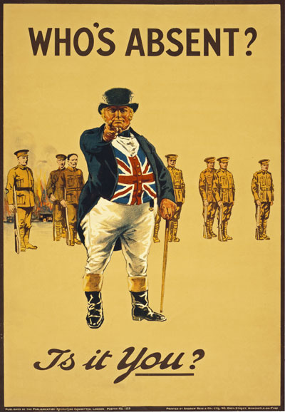
Propaganda
War loans help the guardians of your happiness.

Slide 15
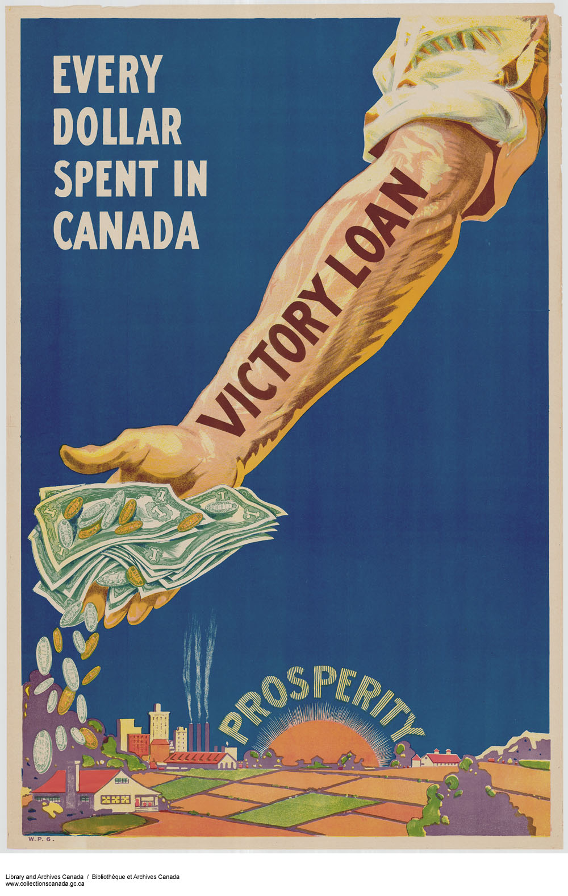
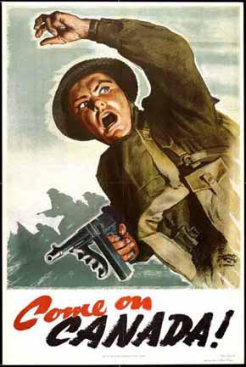
Propaganda

Slide 16
Propaganda
“Buy 5 1/2% bonds – War Bonds for Victory”
Russian poster promoting woman participation

Slide 18
Propaganda
What made these so effective
Name – Calling
The word Hun was a slang word for Germans that means they were barbarian like and evil
Bandwagon
Plain folds
Posters use “plain folk” by referring that everybody (man and woman) could have a part in WW1

Slide 19
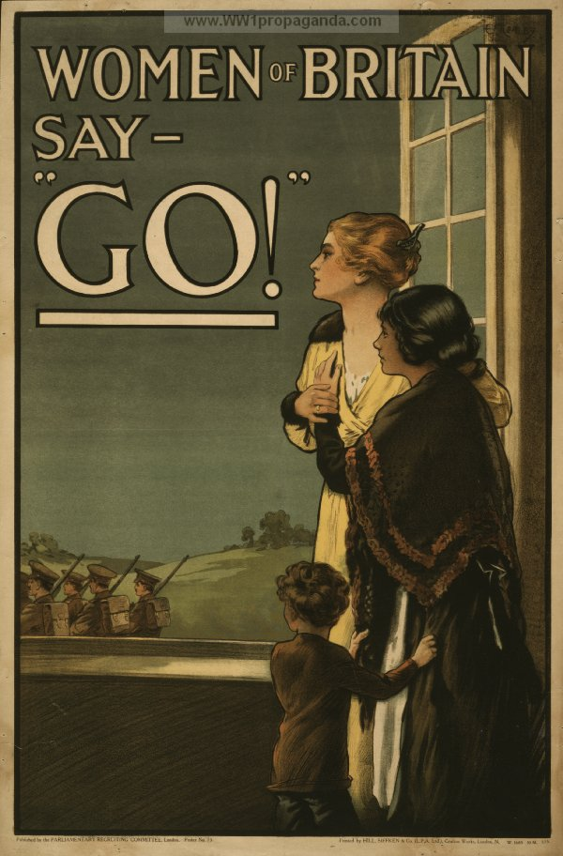
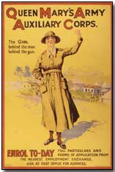
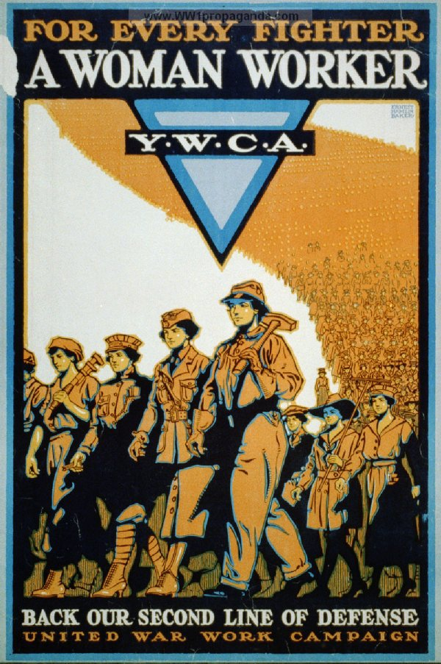
Women Involvement

Slide 20
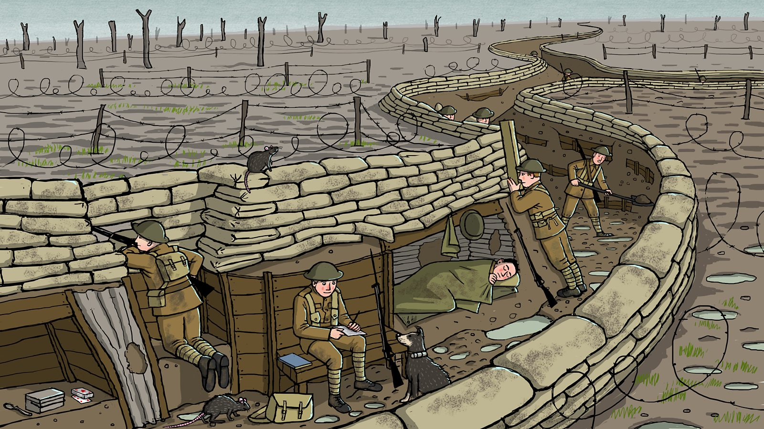
Trench Warfare

Slide 21
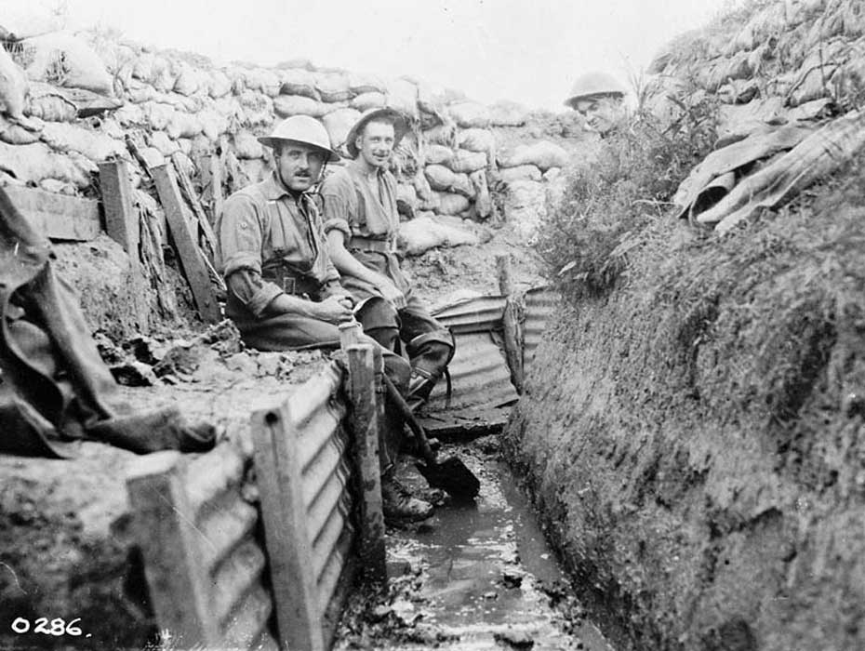

Slide 22
Trench Warfare
The Battle of the Marne was a turning point.
The Schlieffen Plan failed
Germany now caught in a war on two-fronts.
When Germans were unable to break enemy lines, the decided to outflank the enemy.
By the end of 1914, fighting reached a stalemate.
The German army decided to hold ground by digging trenches.

Slide 23
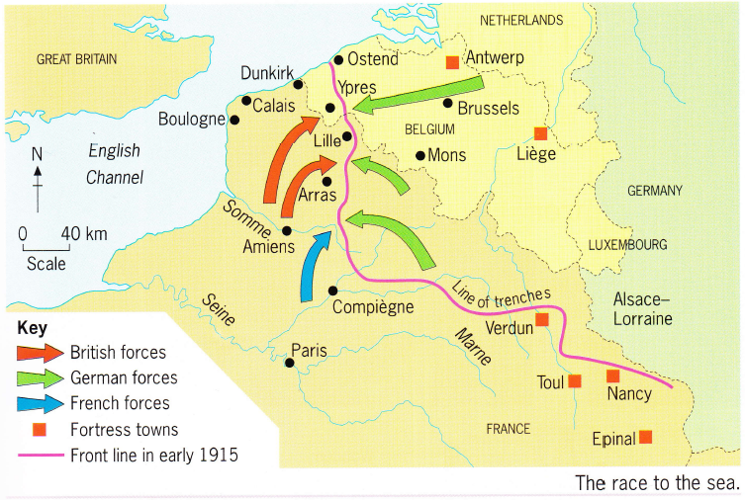

Slide 24
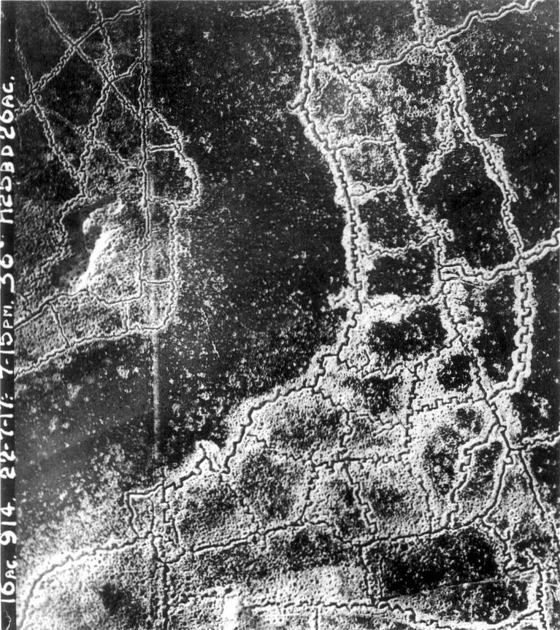
British/French German
Why were trenches dug by the two sides to begin with?
Did trench warfare favour the attacker or defender? Explain.
Why were the British and French trenches not as well built as the German trenches?

Slide 25
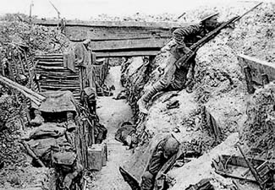
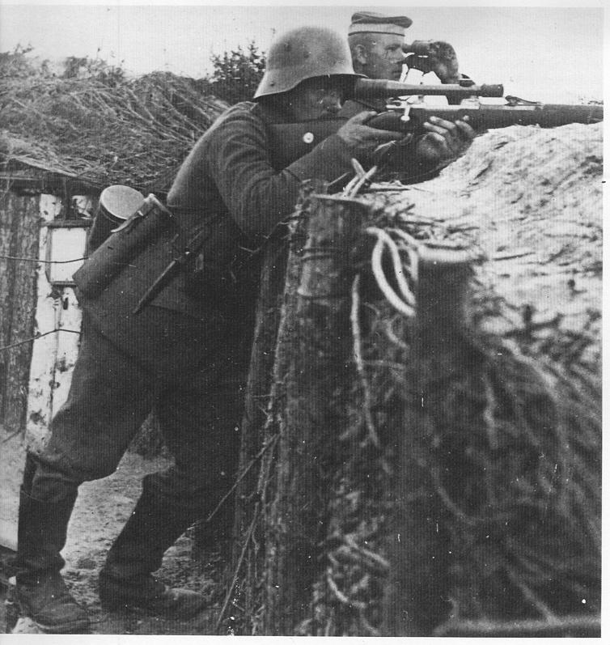
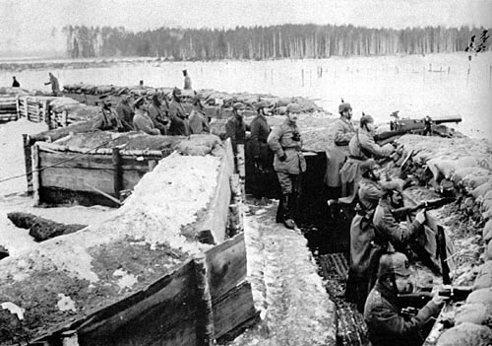
Listen & Follow Along:
Trench warfare consisted of days of shelling the enemy’s defenses. Then front-line troops would be ordered “over the top.” Soldiers would scramble out of their trenches to race across no-man’s land and attack the enemy lines. Most offensives resulted in huge casualties and little gain of territory. During the 11-month battle of Verdun in 1916, the Germans lost 330,000 men trying to overrun the French lines. “They shall not pass,” was the rallying cry of the French defenders. The French lost at least as many soldiers as the Germans. In 1916 alone, at least 2 million soldiers were killed in Europe.

Slide 26
“The Trenches” worksheet
Follow the instructions on the handout and complete the questions.

Slide 27
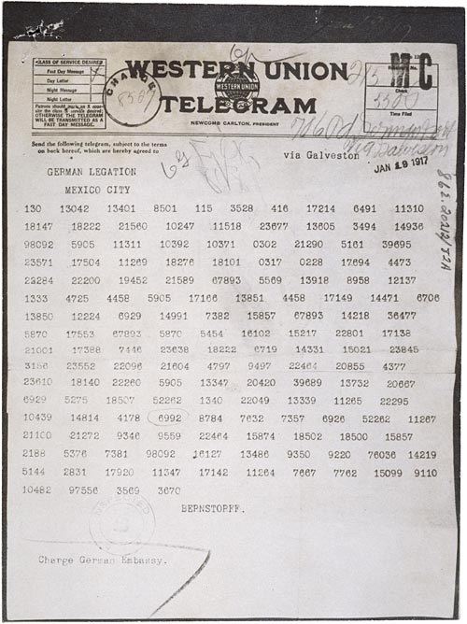
Decoding
Codes and ciphers were used extensively in World War I
Eg. The decoding by British Naval intelligence of the Zimmermann telegram helped bring the United States into the war.
Trench codes were used by field armies of the Americans, British, French, and German
Codes were either simple substitution codes or mathematical encryption for extra security.

Slide 28
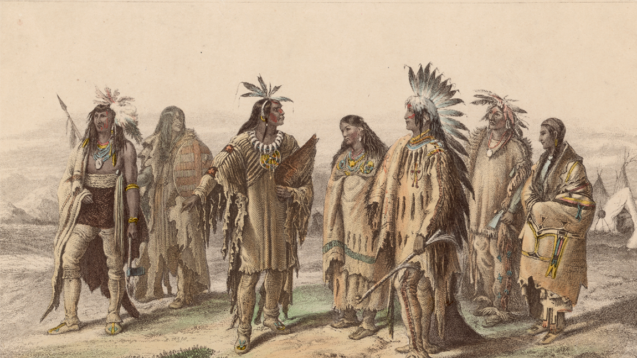
Decoding
Germans often learned of Allied tactical plans by tapping into their telephone lines and breaking their codes.
Frustrated a U.S. commander came up with the idea of using Choctaw Indians to transmit messages in their native language.
This not only helped turn the tide of battle against the befuddled Germans, but it paved the way for the more extensive use of Native American code talkers in the next world war.

Slide 29
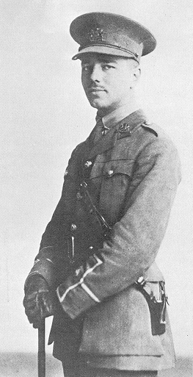
Poetry
Roughly 10 million soldiers lost their lives in World War I, along with seven million civilians.
Poets responded to the brutalities and losses of the war in new ways.
Wilfred Edward Salter Owen was an English poet and soldier, one of the leading poets of the First World War.
He created shocking and realistic war poetry on the horrors of trenches and gas warfare

Slide 30
Poetry
Read through the two poems and answer the questions on the back
Create a poem of your own – following the instructions on your sheet

Slide 31
Germany Continues it’s War of Attrition
Attrition warfare is the sustained process of wearing down an opponent so as to force their physical collapse through continuous losses in personnel, equipment and supplies or to wear them down to such an extent that their will to fight collapses.

Slide 32
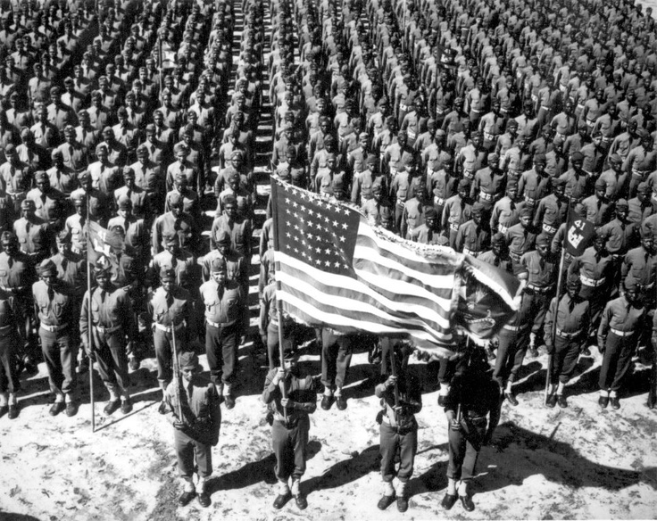
Leading Up to USA Entering the War
The USA swore to remain neutral even though they were one of Britain's top trading partners
In early 1917
Germany begins all-out submarine warfare on every commercial ship headed toward Britain
Germany also offered to help Mexico regain territories lost in the Mexican–American

Slide 33
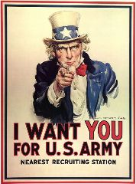
USA Enters the War
United States President Woodrow Wilson asked Congress for "a war to end all wars" that would "make the world safe for democracy“
Congress voted to declare war on Germany on April 6, 1917
On April 6, 1917, the U.S. declared war on the Austro-Hungarian Empire

Slide 34
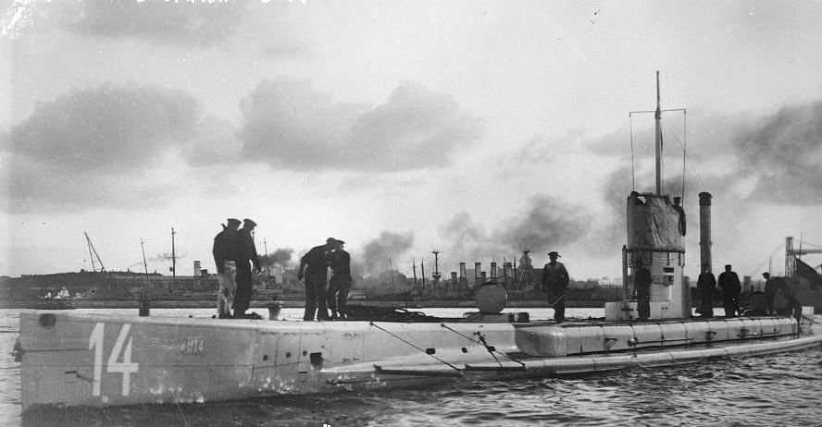
USA’s Effect on the War
The US did not like the fact that Germany was using submarines to sink ships headed for England.
The entry of the US broke the stalemate that had existed for most of the war and led to the Allied victory.
The Allies and Germany had been pretty evenly matched so throwing in a huge new army naturally tipped the balance.
German U-Boat →

Slide 35
Treaty of Brest-Litovsk
Research and complete the questions on the Treaty of Brest-Litovsk

Slide 36
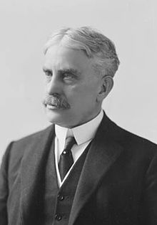
Canada’s Involvement
During the great war, Canada, a dominion of the British Commonwealth, was summoned as an allied force to bear arms
The Canadian Prime Minister, Sir Robert Borden immediately offered assistance

Slide 37
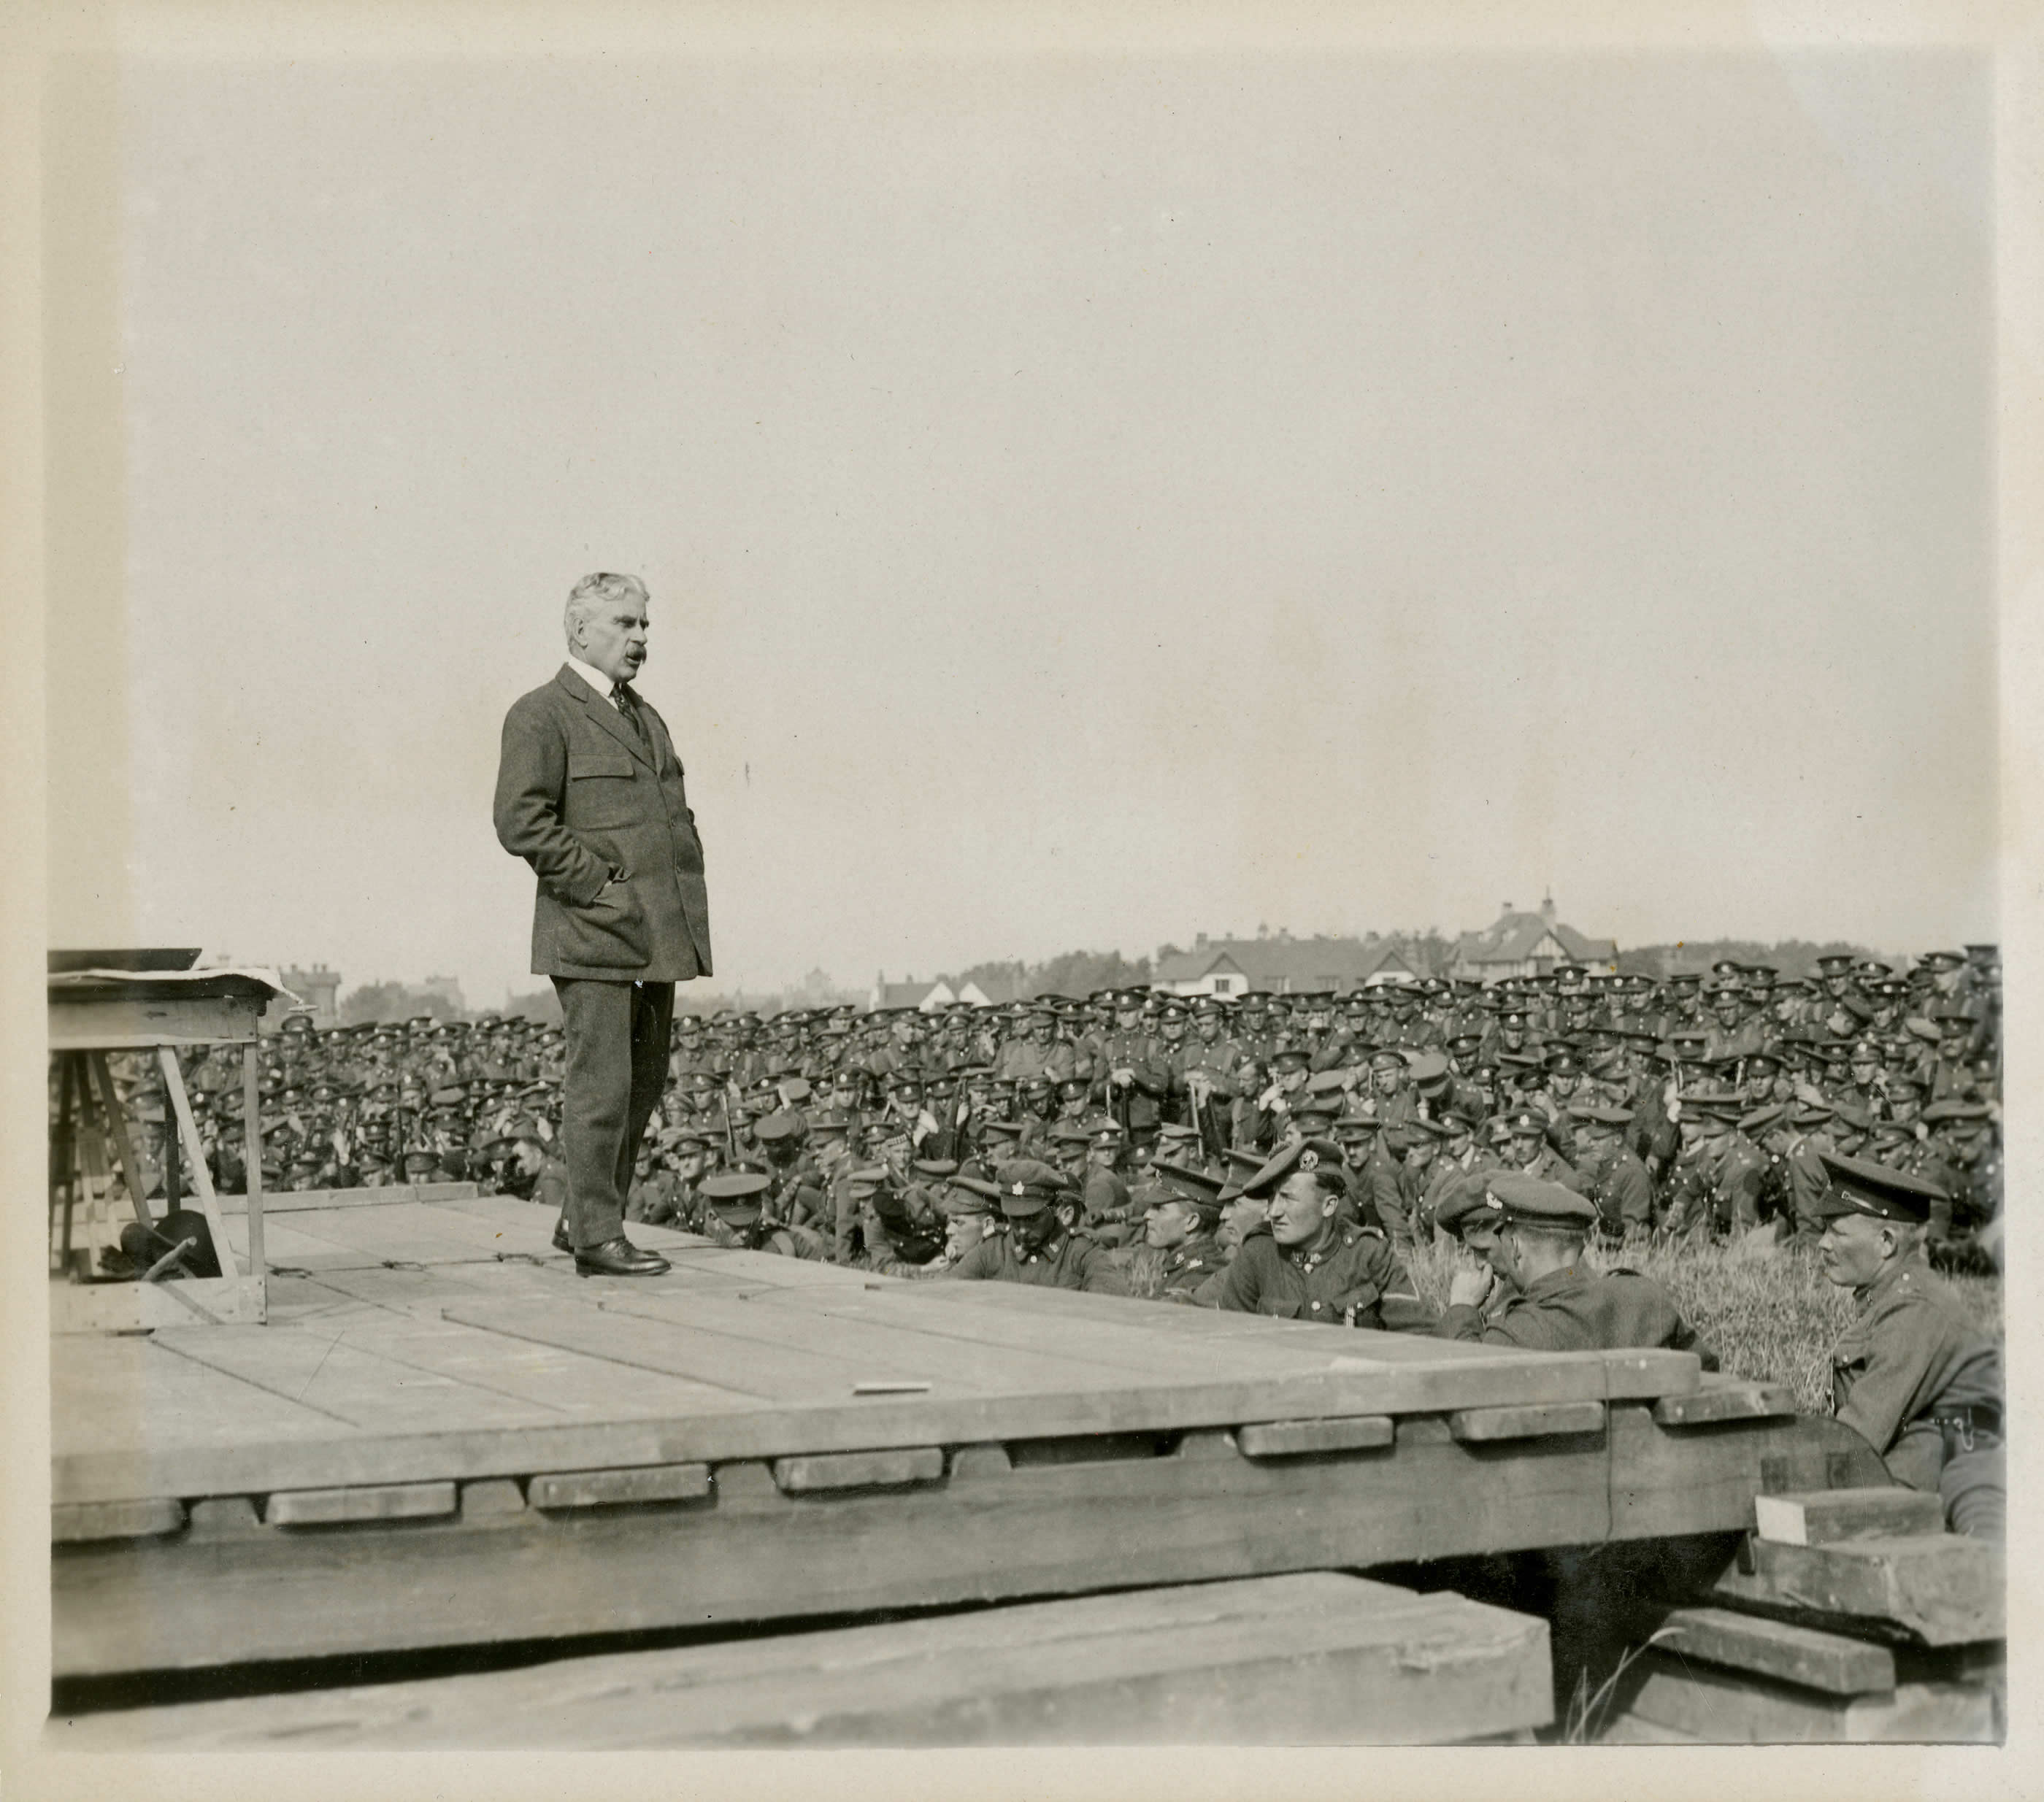
Canada’s Involvement
Borden led Canada through one of the most difficult periods in its history.

Slide 38
Canada’s Involvement
Borden believed Canada should make every effort, including conscription to help the war effort.
Conscription, or drafting, is the compulsory enlistment of people in a national service (i.e. it was now the law to enlist)
Voluntary recruitment was failing to maintain troop numbers
Borden’s decision in early 1917 to invoke conscription in order to maintain Canada’s armies in the field nearly tore the country apart.

Slide 39
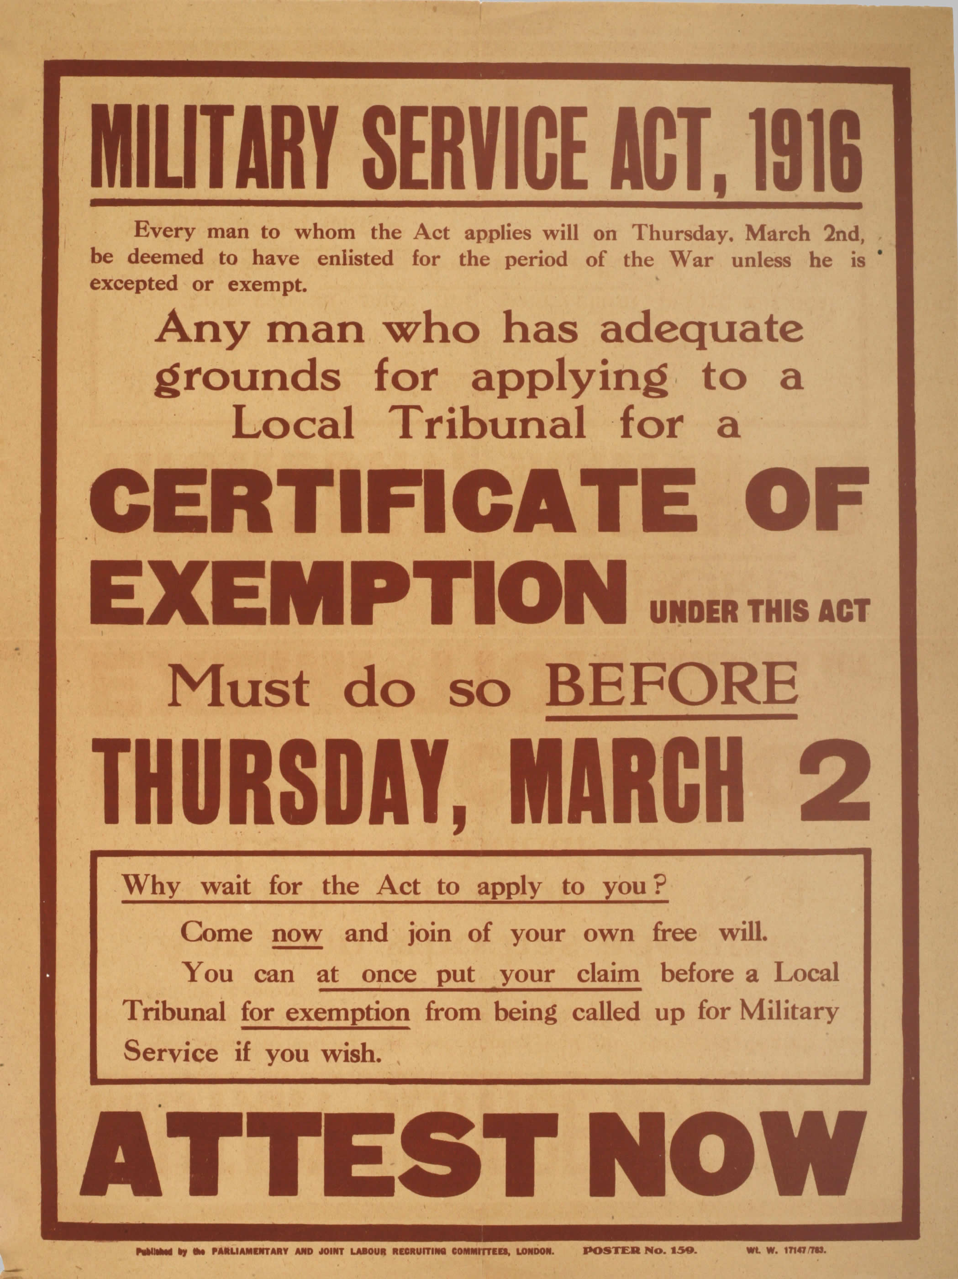

Slide 40
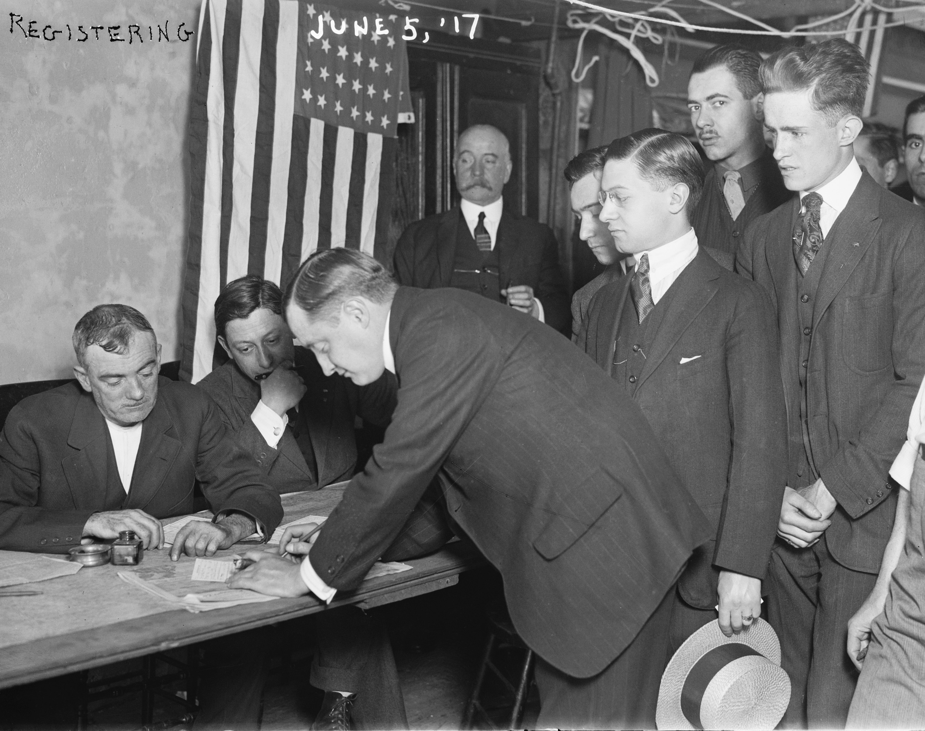
Notice the date

Slide 41
Canada’s Involvement
“The First World War of 1914–1918 was the bloodiest conflict in Canadian history”

Slide 42
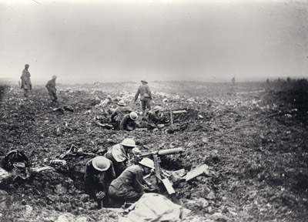
Canada’s Involvement
The two major battles fought by the Canadians were:
The Battle of Vimy Ridge
Canada's most celebrated military victory
It was believed to spark national pride and awareness
Attacked the ridge from April 9 to 12 , 1917 and succeeded in capturing it from the German army

Slide 43
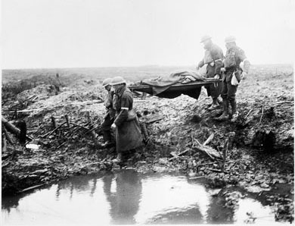
Canada’s Involvement
2. Battle of Passchendaele
July 31, 1917 – November 10, 1917
A vivid symbol of the mud, madness and the senseless slaughter of the First World War

Slide 44
Canada’s Involvement
Videos

